Slide 1
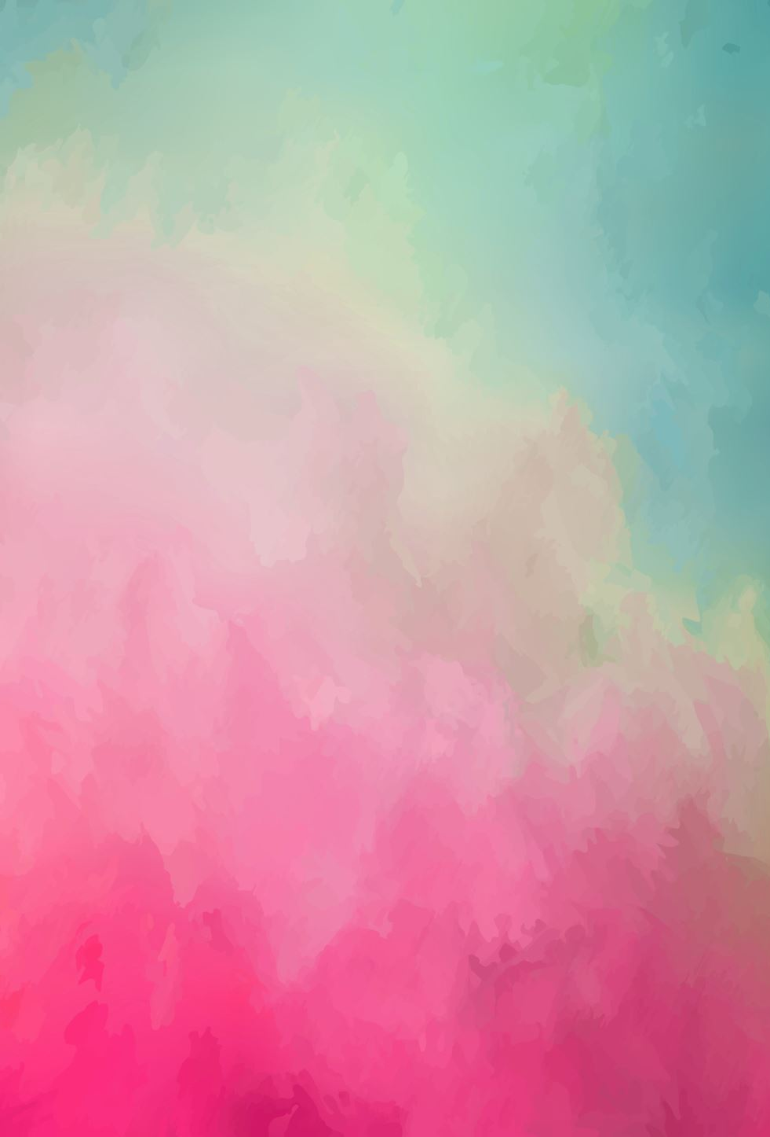
How social Media has ruined relationships
By: Veronica Sierzant

Slide 2
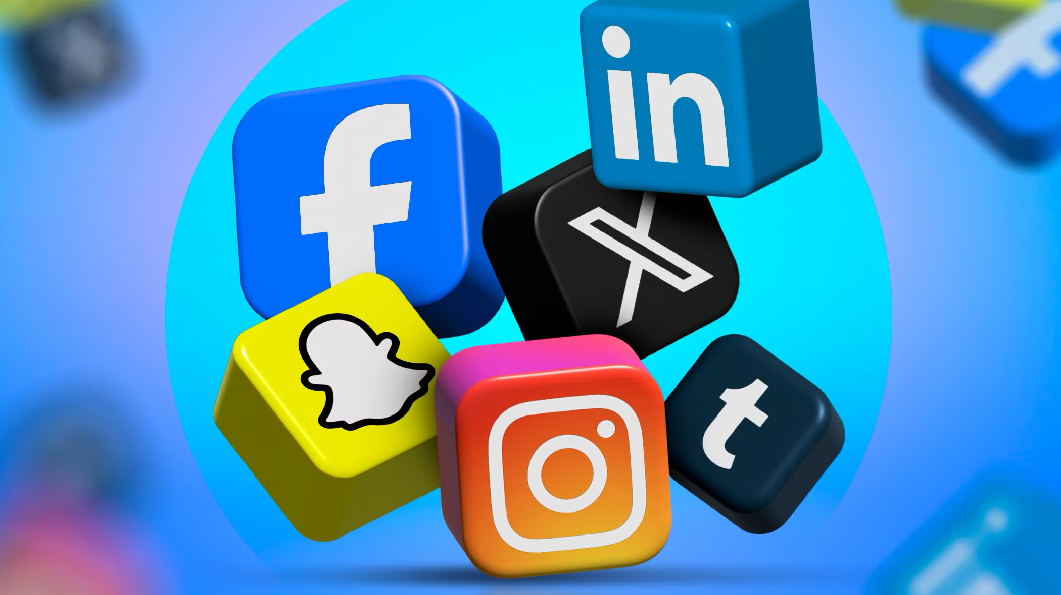
Social Media is apart of our everyday lives.

Slide 3
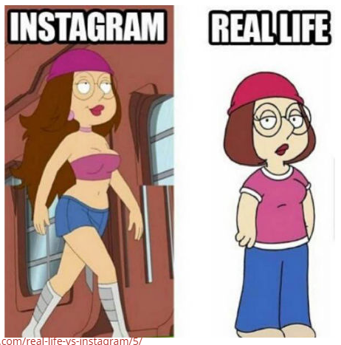
The power of Comparison and insecurity
Constant comparison to others
Jealousy
Low Self-Esteem
Trust Issues

Slide 4
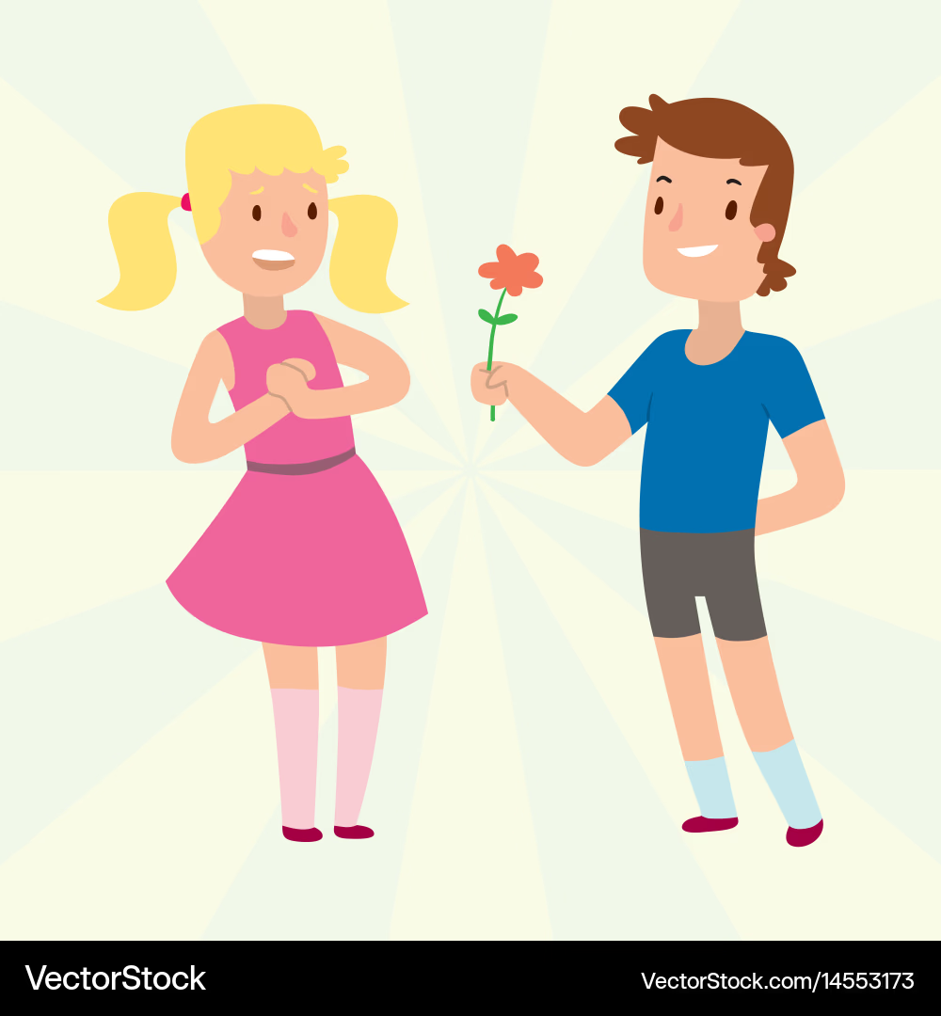
Impacts on different Relationships
Romantic:
Pressure, jealousy, unrealistic standards
Friendships:
FOMO (seeing plans online)
Surface-level interactions
Family:
Less face-to-face time
More distraction
Professional:
Blurred boundaries
Online image affects real opportunities

Slide 5
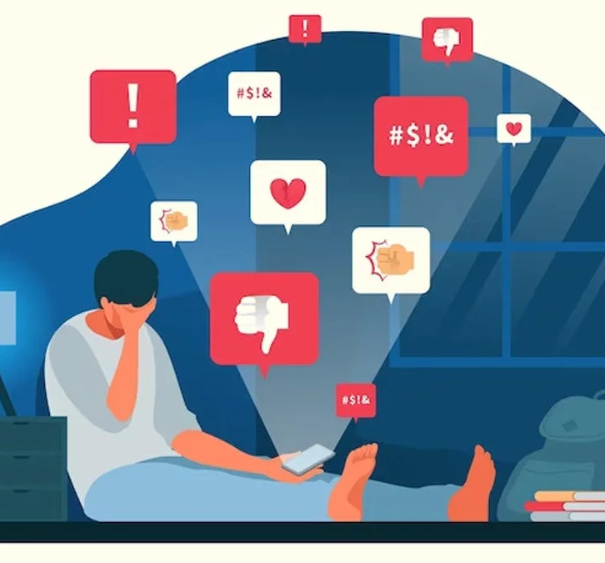
Mental health connection
Increased anxiety and overthinking
Validation through likes, comments, followers, etc.
Emotional dependence on online approval
“When your self-worth comes from a screen, relationships start to suffer.”

Slide 6
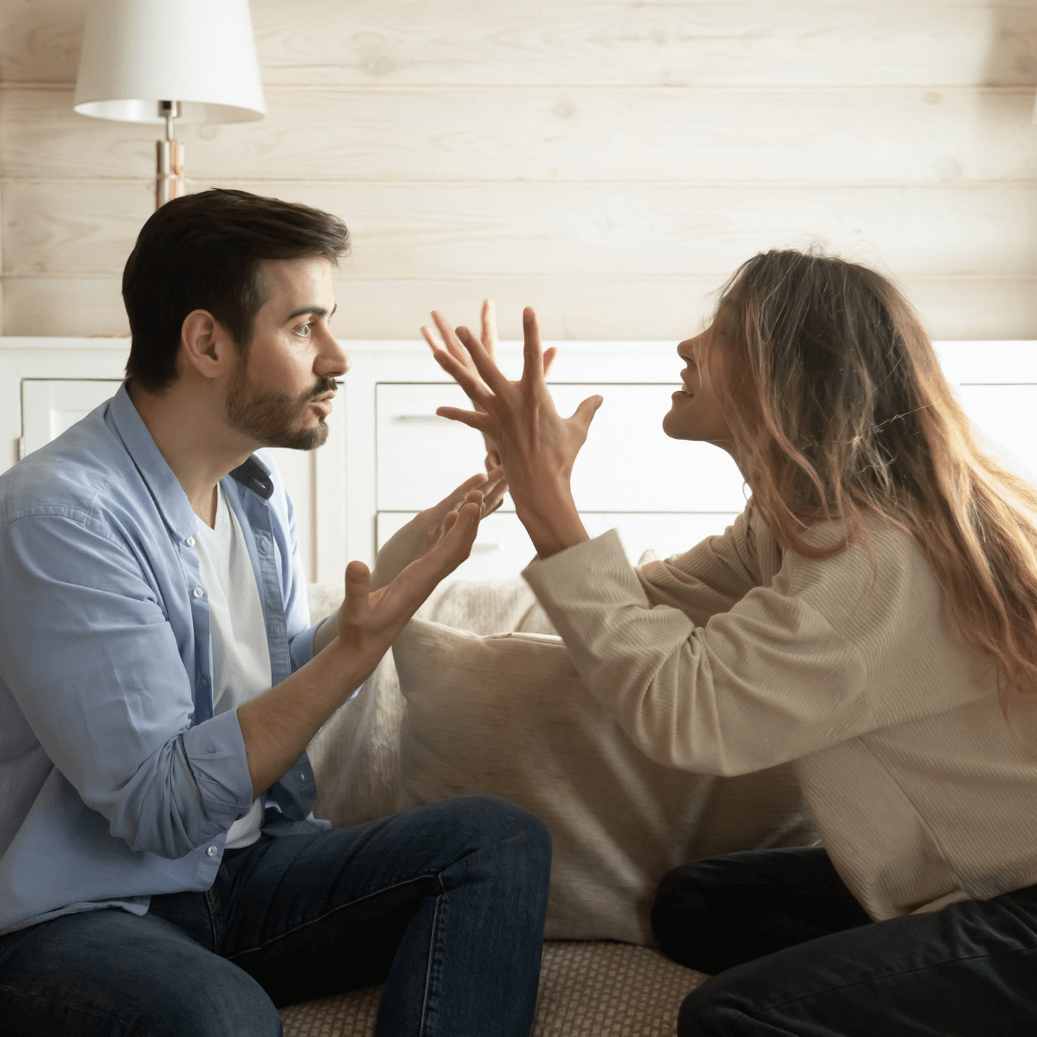
Jealousy & trust issues
Social media creates new problems:
Liking someone’s post
Following exes
Hidden messages / DMs
Leads to:
Arguments
Overthinking
Lack of trust

Slide 7
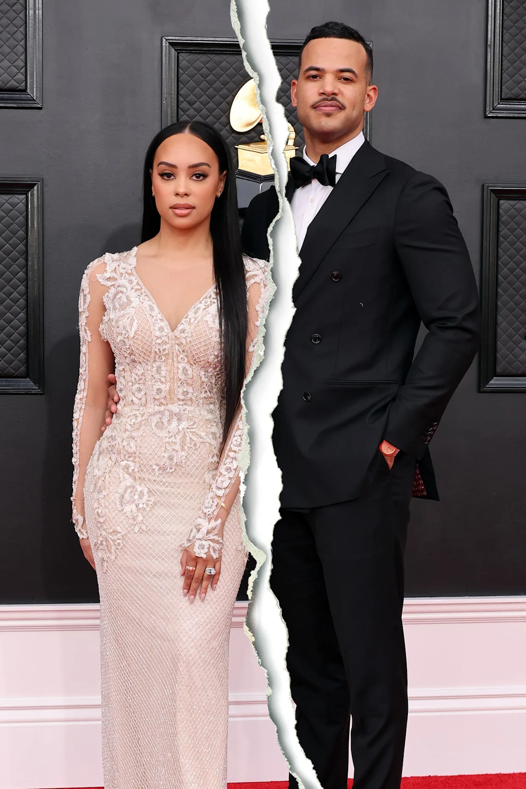
Realistic versus unrealistic
People only post the best parts of their lives
You only see what the person wants you to see
Creates pressure for relationships to look “perfect.”
“Instagram couples”
Ex: Christie & Desmond Scott

Slide 8
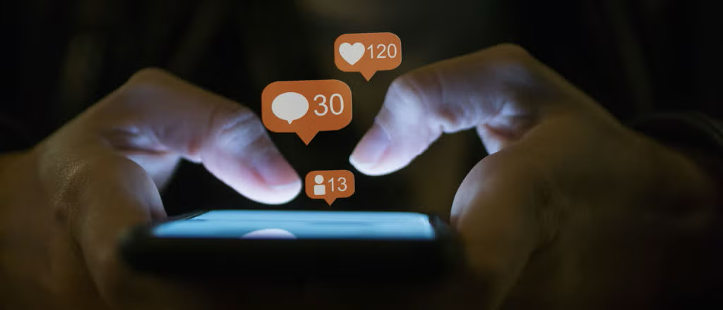
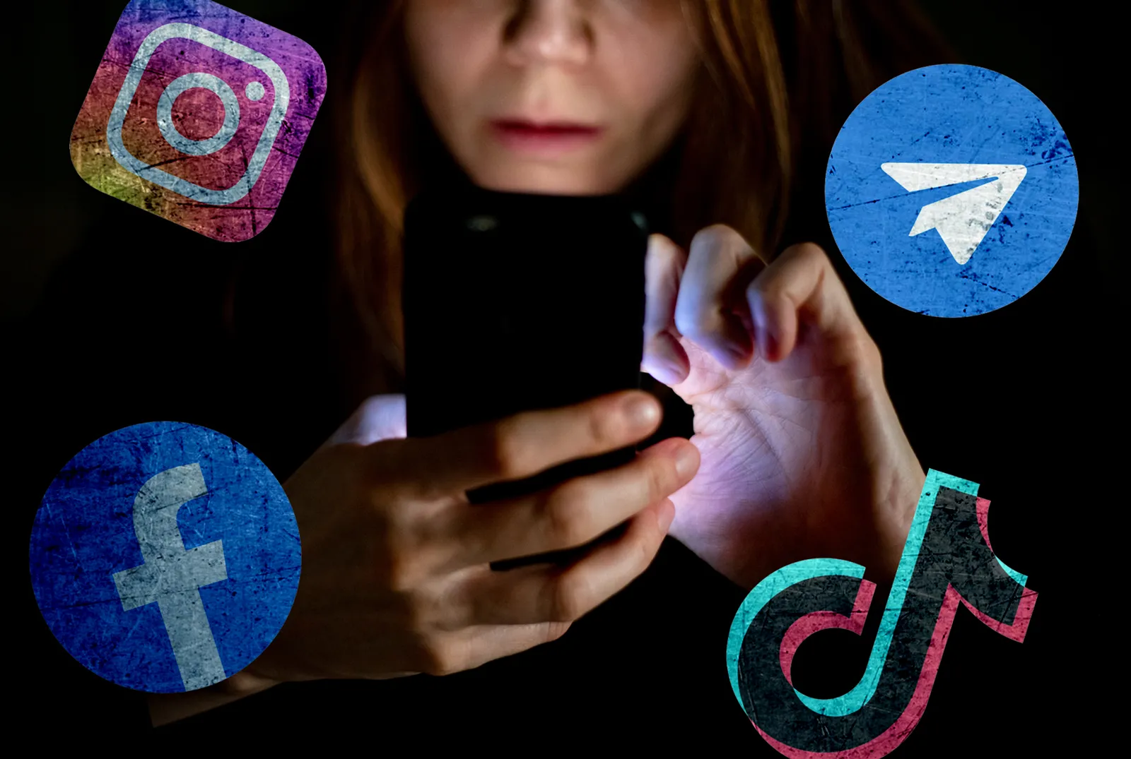
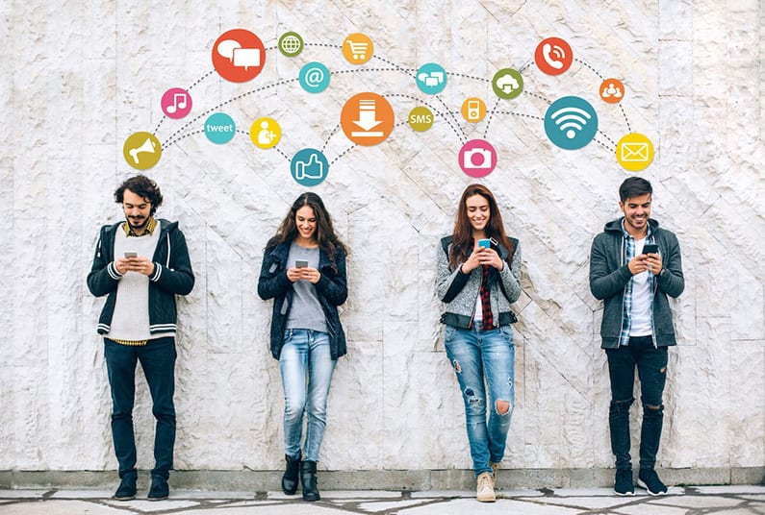
Connections? No. Appearance? Yes!

Slide 9
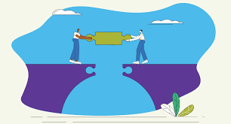
solution – rebuilding relationships
Remember that what is behind the screen isn’t always what's going on
Prioritize real communication
Stop comparing, start connecting
Take breaks/digital detox

Slide 10
Thank you!

