Slide 1
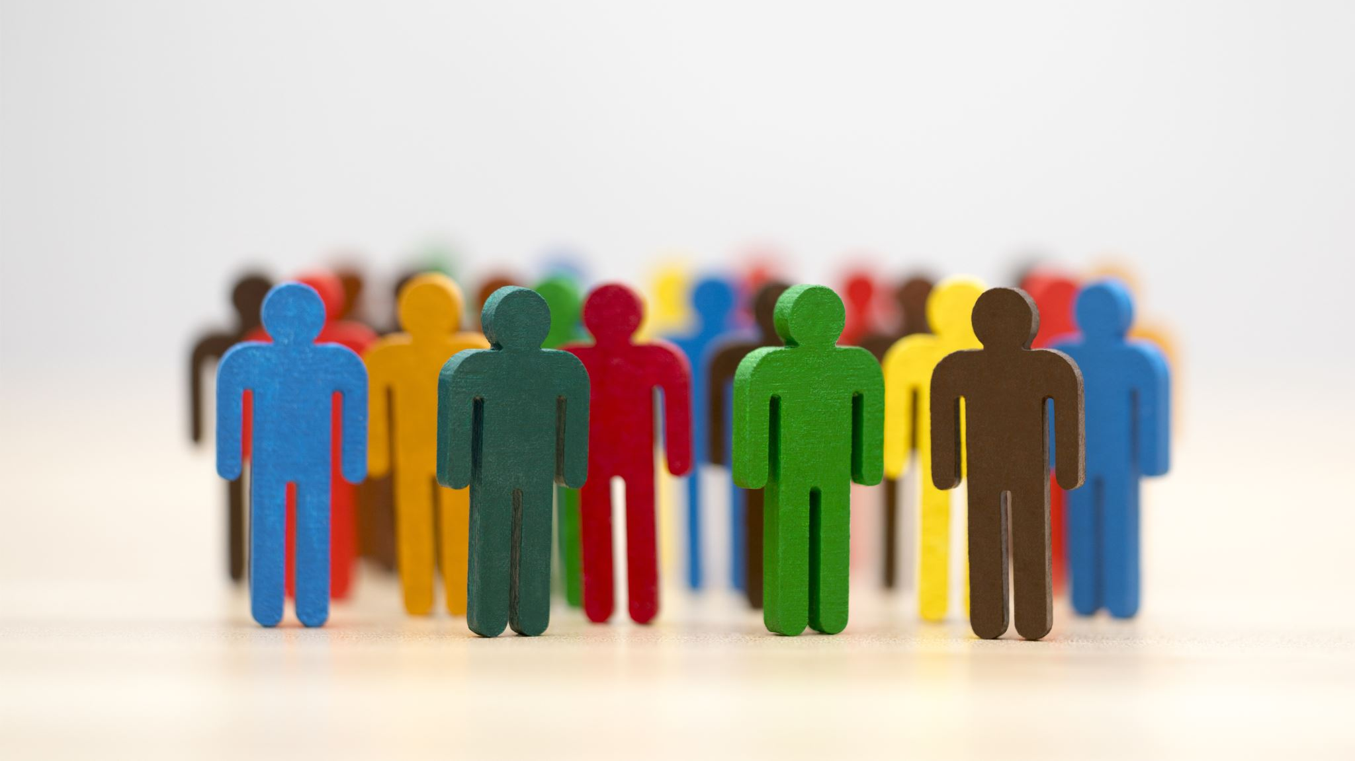
Social Media as a Discourse Community How social media shapes communication, debate, and ethics in modern society
By: Javier Roman Jr

Slide 2
Intro
Social media is a central part of everyday life.
Platforms like Instagram, TikTok, and X influence how we communicate.
This presentation explores how social media acts as a discourse community.

Slide 3
What is a Discourse Community?
A group of people who share ideas, language, and communication styles.
They have common goals and ways of interacting.
Social media users form one of the largest discourse communities today.

Slide 4

Popular platform
Instagram – visual storytelling and branding.
TikTok – short-form, viral content.
X (Twitter) – fast-paced discussion and news.
Each platform shapes communication differently.

Slide 5

How Social Media Shapes Communication
Encourages short, quick responses.
Relies on visuals, trends, and hashtags.
Communication becomes more public and performance-based.

Slide 6
Role of Algorithms
Algorithms decide what content we see.
Content with more engagement is promoted.
This can prioritize emotion over accuracy.

Slide 7

Impact on Young Adults
Young adults grew up with smartphones.
They are more comfortable expressing opinions online.
Communication styles are faster and more reactive

Slide 8
Examples of Social Media Algorithms
Political debates on X.
Viral trends on TikTok.
Influencer culture on Instagram.
Online activism and social movements.

Slide 9
Shift from Discussion to Performance
People often post to gain likes and attention.
Conversations become about visibility.
Authenticity can be lost.

Slide 10
Importance of Ethical Participation
Be respectful in discussions.
Share accurate information.
Think before posting.
Hold others accountable responsibly.

Slide 11
Ethical Concerns
Misinformation spreads quickly.
Cyberbullying and toxic behavior.
Lack of accountability for harmful content.

Slide 12

Main Argument
Social media transforms communication into performance.
It shapes opinions and public discourse.
Users must be mindful of how they participate

Slide 13
Call to action
Be
Be more aware of your online behavior.
Promote
Promote respectful and honest communication.
Use
Use social media responsibly to improve discourse.

