Slide 1
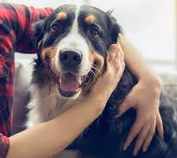

Why Dogs are better than Cats
By Brett Spallina

Slide 2

Reason #1: Dogs Provide an active lifestyle and protection

Slide 3
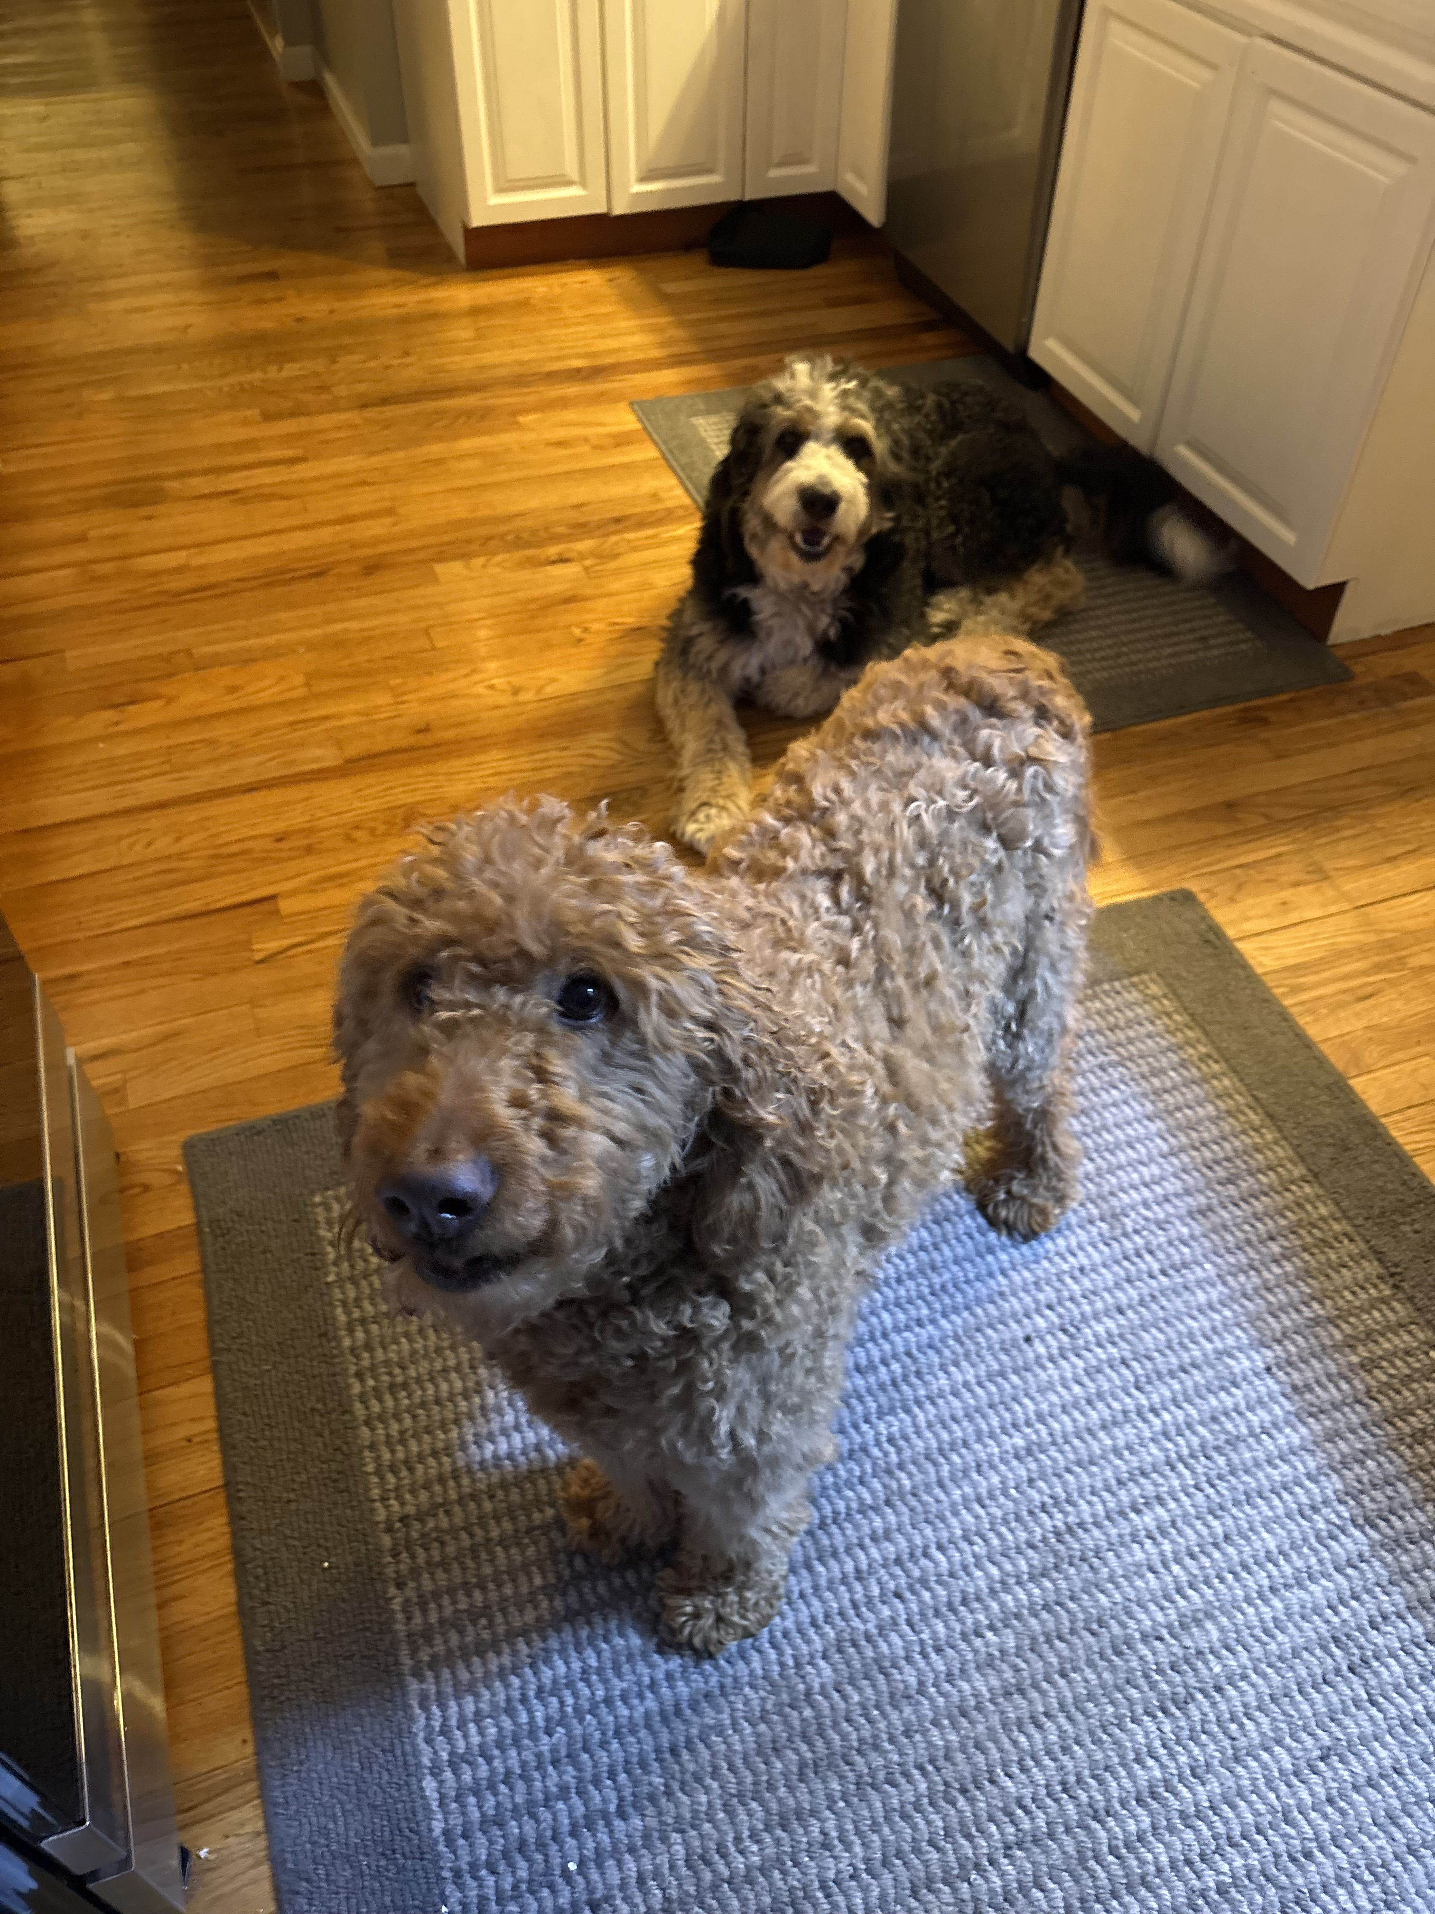

Slide 4
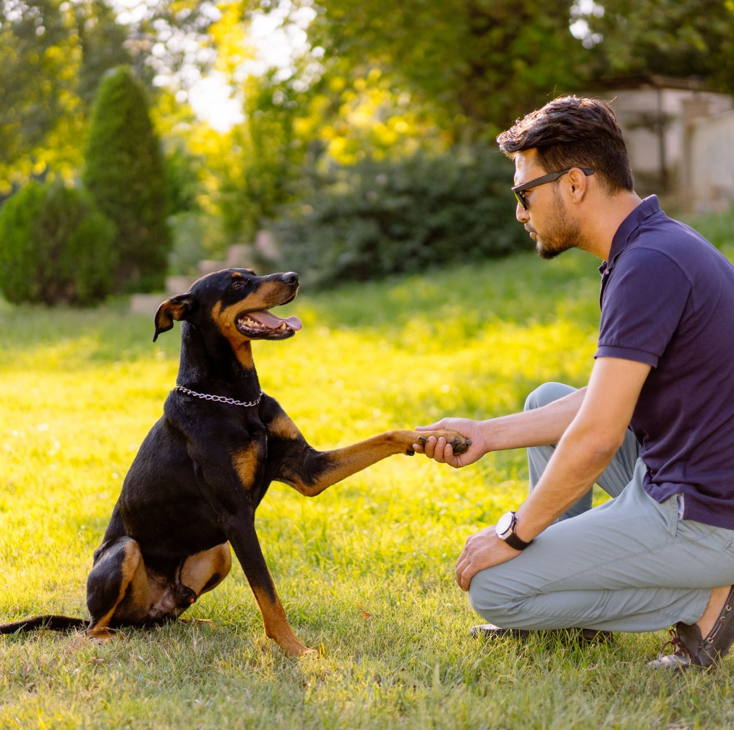
Reason #2: Easy to train

Slide 5

Reason #3: Far more emotional than cats

Slide 6

Reason #4 Dogs are man's best friend

Slide 7

Thank You

