Slide 1


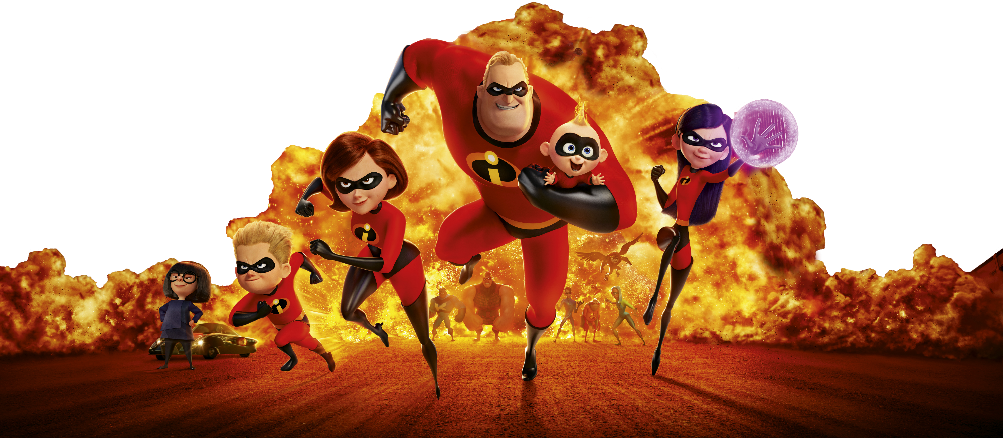
Team 2
Cameron Emmer, Tyler Curotte, Mateo Gonzales, Echo Huang, Weixi Xu

Slide 2

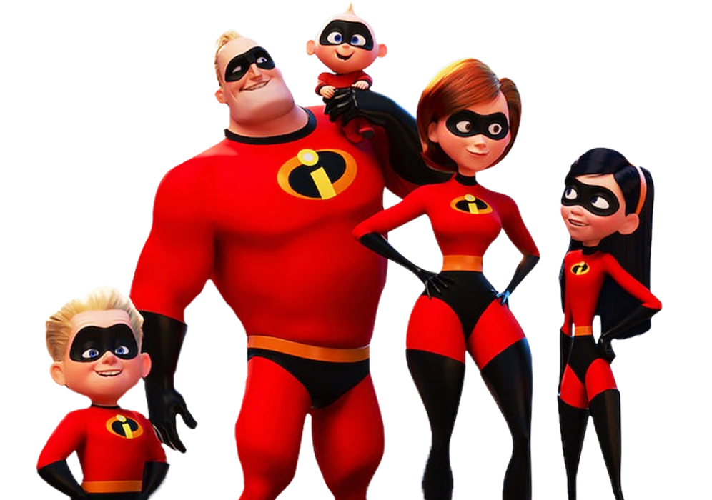
Introduction
The Incredibles is an animated film about the Parr family, secret superheroes forced to live ordinary lives after superheroes are banned. When Mr. Incredible returns to action, he gets caught in a villain's plot, forcing the whole family to use their powers and unite as a team to save the world. The story highlights family, teamwork, and embracing one's true self. In the end, they defeat the villain and regain acceptance as heroes.

Slide 3
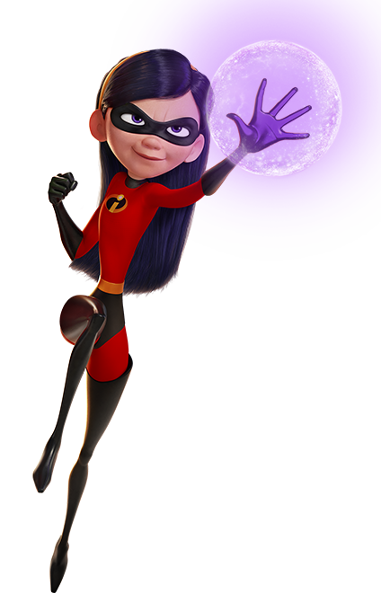
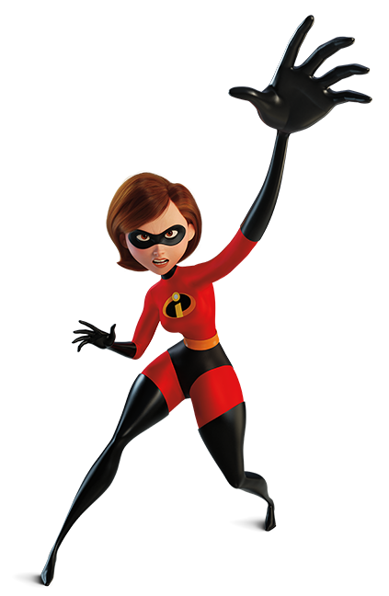
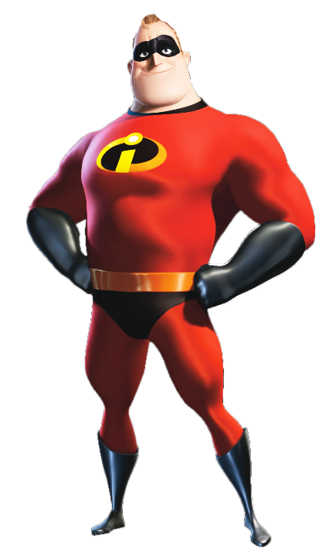
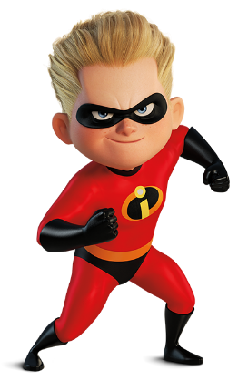
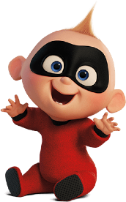
The family
Bob Parr (Mr. Incredible)
Jack-Jack Parr
Violet Parr
Dash Parr
Helen Parr (Elastic girl)

Slide 4
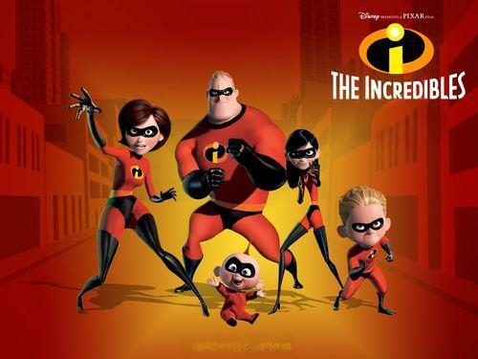
Why The Incredibles & Our Focus
Great example of interpersonal communication
Real family issues: secrets, arguments, not listening
Shows trust, support, clear communication
3 main areas we focus on:
Jet scene: nonverbal communication & attachment
Argument: conflict management
Final battle: family teamwork using Expectancy Violations Theory, Communication Accommodation Theory, Social Exchange Theory

Slide 5
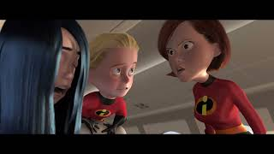
1. The Jet Scene:
https://www.youtube.com/wat ch?v=bg94uui8Ucs

Slide 6
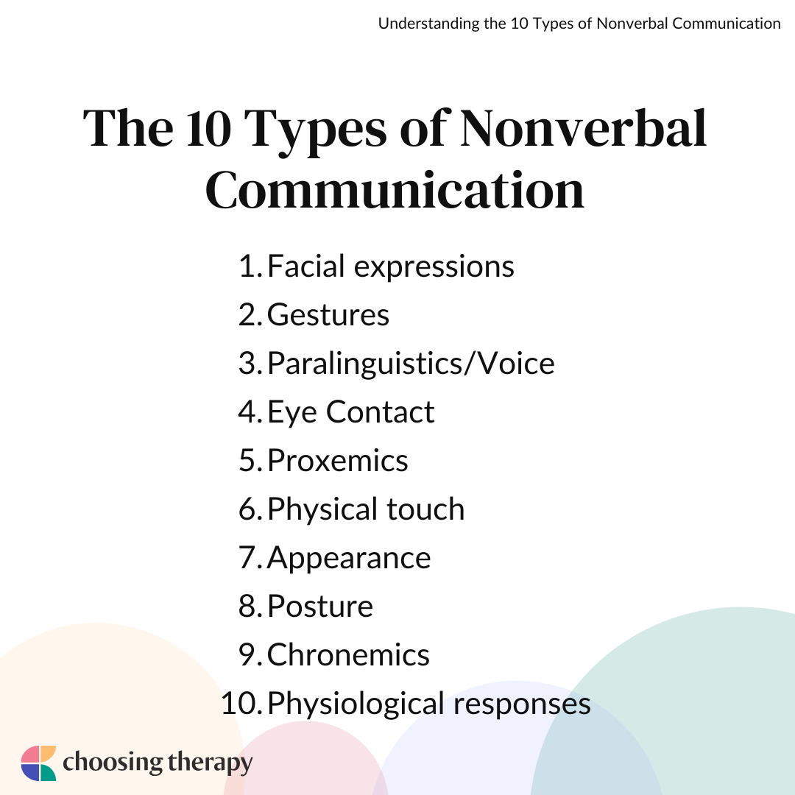
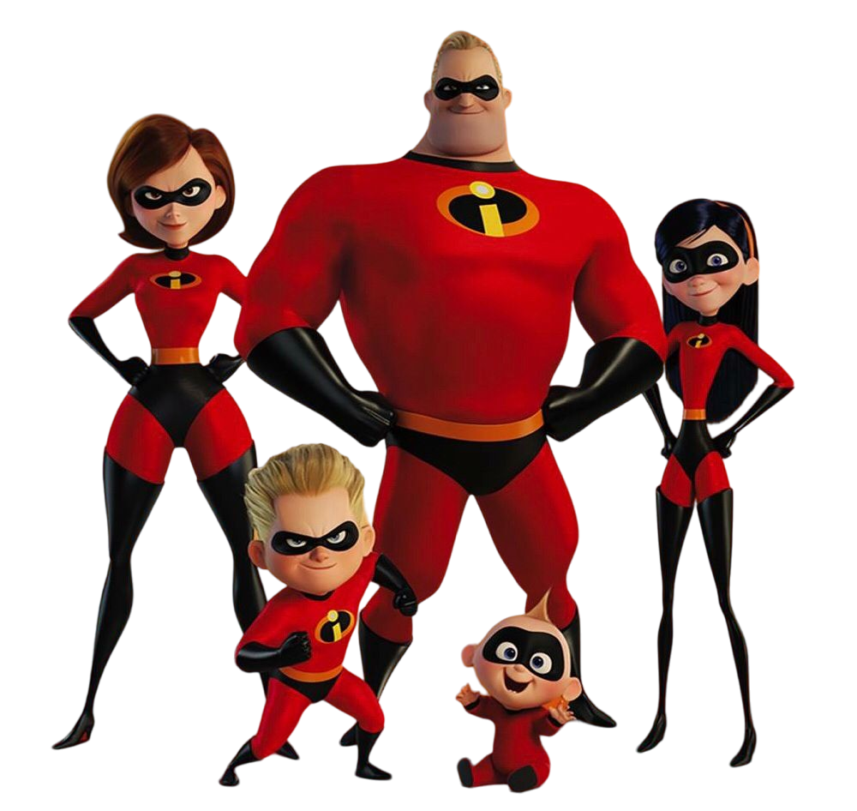
Nonverbal communication
Facial Expressions Show Fear and Urgency Helen’s wide eyes and tense face show panic before she even speaks, helping the audience understand the danger immediately.
Body Language Communicates Protection and Control Helen physically shields her children and grips the controls tightly, showing her instinct to protect without needing words.
Gestures Signal Teamwork and Quick Decision-Making The family uses rapid hand movements and visual cues to coordinate their actions, showing trust and understanding under pressure.

Slide 7

Attachment theory:
Violet shows insecure attachment She panics and struggles to activate her force field because she doubts her own abilities and feels unsafe, revealing low confidence developed from uncertainty about her role in the family.
Helen (Elastigirl) models secure attachment She comforts and guides Violet with calm, supportive instructions, showing the behaviors of a secure caregiver who helps regulate a child’s fear in a crisis.
The family shifts toward secure attachment through trust Violet only succeeds once she feels supported by her mom, showing how secure attachment increases confidence and helps children perform under pressure.

Slide 8
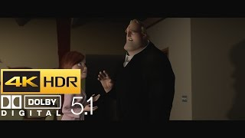
2. Bob and Helen’s Argument: https://youtu.be/lYxx-8wQSO0

Slide 9
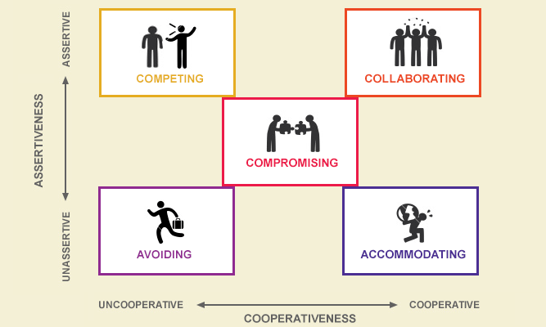
Conflict Management Theory
Definition:
Competing- prioritizing your goals over the other person
Avoiding- withdrawing or not addressing conflict
Accommodating- giving in to maintain harmony/ balance
Compromising- both sides give up something to reach an agreement
Collaborating- both sides work toward a win-win situation

Slide 10
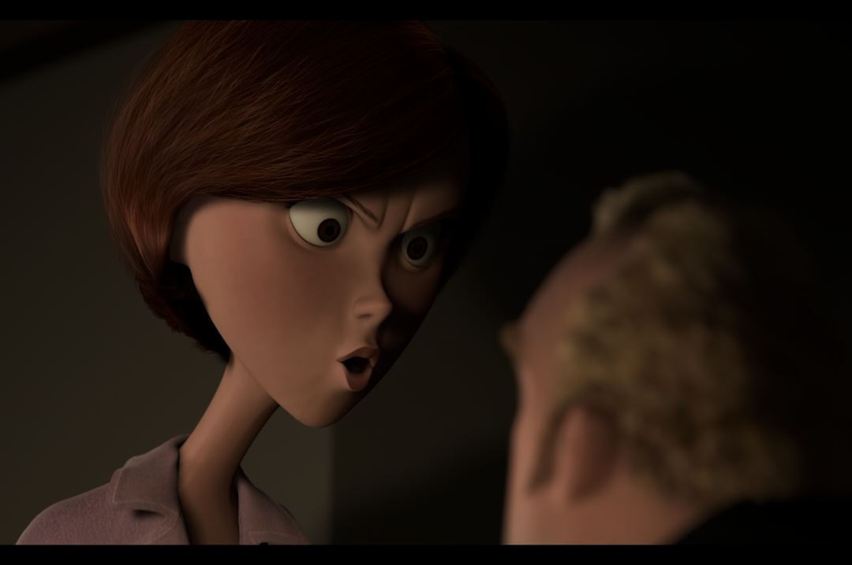
Thick Description
What Happens?
Helen confronts Bob about sneaking off and lying about his job
Bob raises his voice and turns away, using defensive posture
Helen steps toward him, hands on hips, trying to re-engage
Bob shouts: “Because he’d be great!” showing emotional overload
Helen replies: “This is not about you!” signaling frustration and hurt

Slide 11
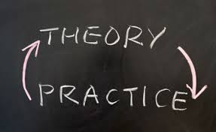
Applying Conflict Management Theory
How Conflict Management Theory Appears Here:
Bob = Competing Style
Raises voice, dominates conversation
Focuses on his independence, not Helen’s feelings
Helen = Collaborating / Concerned Style
Asks questions, tries to re-establish trust
Wants clarity and openness
Why It Fails
Opposite conflict styles → misalignment and escalation
Both feel unheard

Slide 12

Nonverbal Communication in the Argument
The Role of Nonverbal Communication:
Bob:
Hands in fists → anger & frustration
Turns away → avoidance, emotional withdrawal
Leaning forward → dominance
Helen:
Raised eyebrows, widened eyes → disbelief, hurt
Steps closer → wanting connection
Arms crossed at moments → defensiveness
Impact
Their bodies show conflict even more than their words

Slide 13
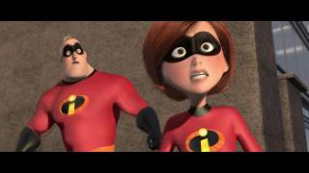
. The Final Battle (Family Fighting Together)
https://youtu.be/pBiF2S6VcYI?si=I_c-JNVPvWX_Kpuu

Slide 14
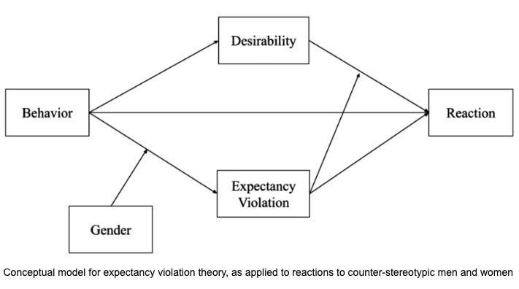
Expectancy Violations Theory in The Incredibles Final Battle
This theory demonstrates how individuals react in different ways when someone behaves outside of their expectations. These violations can be viewed positively or negatively, which impacts how we interpret the interaction.
Violet’s sudden, assertive control of her powers defies her family's view of her as insecure, demonstrating a powerful positive violation.
Dash shatters the assumptions about a child's combat limitations, astonishing both his family and the Omnidroid with his super-speed, illustrating a positive violation.
Bob asks his family for help unexpectedly, changing his usual pattern of acting alone. This expectancy violation is a relational one which demonstrates both personal growth and vulnerability, signaling his shift toward true cooperation. As a result, the family dynamic becomes stronger and more cohesive. This demonstrates a positive expectancy violation.

Slide 15
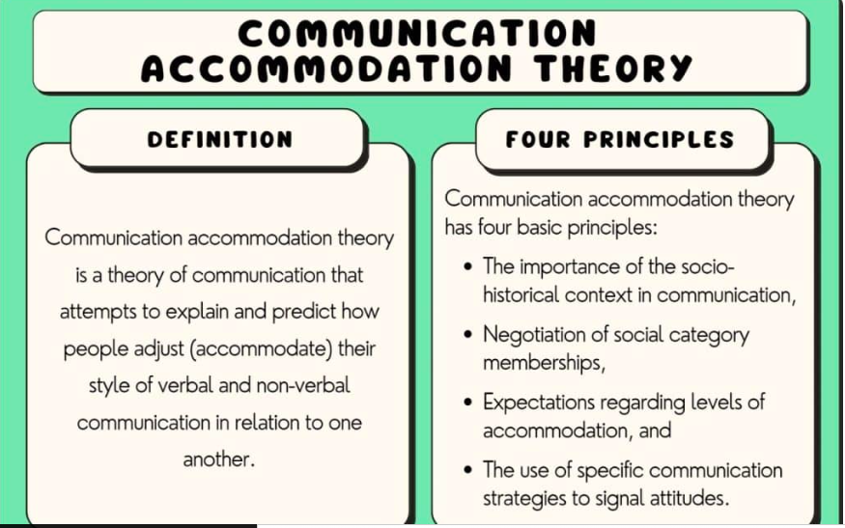
2. Communication Accommodation Theory in the Final Battle
Communication Accommodation Theory demonstrates how people adjust their communication styles to unite or diverge (create distance) from others.
In the final battle, the Parrs family use both strategies for teamwork and strategy.
Convergence of Family
The family aligns communication: short commands, quick turn-taking, shared nonverbal cues.
Their actions synchronize (Violet shields, Dash distracts, Elastigirl coordinates, Bob attacks).
Convergence builds cohesion and increases team effectiveness.
Elastigirl as the Accommodation Leader
Helen adapts her tone and communication to whom she addresses, whether it be her kid or husband.
Uses clear instructions to guide the group.
Models emotional regulation that helps everyone align.

Slide 16
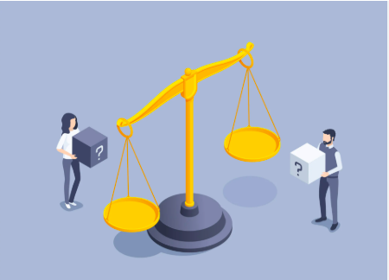
3. Social Exchange Theory In The Final Battle
SET explains decisions based on costs, rewards, risks, and benefits. In the final battle, each character evaluates what they stand to lose vs. what they stand to gain.
Mr. Incredible’s Cost–Benefit Analysis
Weighs personal risk against the reward of saving civilians and protecting his family.
Chooses high-risk actions because the social and moral rewards outweigh the costs.
Family Risk-Sharing
Each family member takes on different dangers (Violet shielding, Dash distracting, Helen rescuing).
Distributing risk maximizes group success and minimizes individual cost.
Frozone’s Prosocial Exchange
He fights alongside family due to loyalty and moral responsibility, expecting no reward from participating.
This illustrates altruistic decision-making.

Slide 17
What We Learned from The Incredibles
Secrets and poor communication almost break the Parr family
Nonverbal cues show fear, love, and protection (jet scene)
Different conflict styles hurt Bob and Helen’s relationship
Final battle: family teamwork turns conflict into connection

Slide 18
Why This Matters in Real Life
Our families also have secrets, stress, and unspoken rules
Hiding feelings does not really protect relationships
Trust, listening, and clear talk make families safer and closer
Notice your own communication and conflict style

Slide 19
References
Nostalgy. (2023, March 6). The Incredibles (2004) – Plane Scene [Video]. YouTube. https://www.youtube.com/watch?v=bg94uui8Ucs
4K HDR Media. (2018, June 17). The Incredibles – Family Argument (HDR – 4K – 5.1) [Video]. YouTube. https://youtu.be/lYxx-8wQSO0
Tail fish. (2018, June 6). The Incredibles Final Fight 1080p Blu-Ray [Video]. YouTube. https://www.youtube.com/watch?v=pBiF2S6VcYI

Slide 20

Thank You
Team 2
Cameron Emmer, Tyler Curotte, Mateo Gonzales, Echo Huang, Weixi Xu

