Slide 1
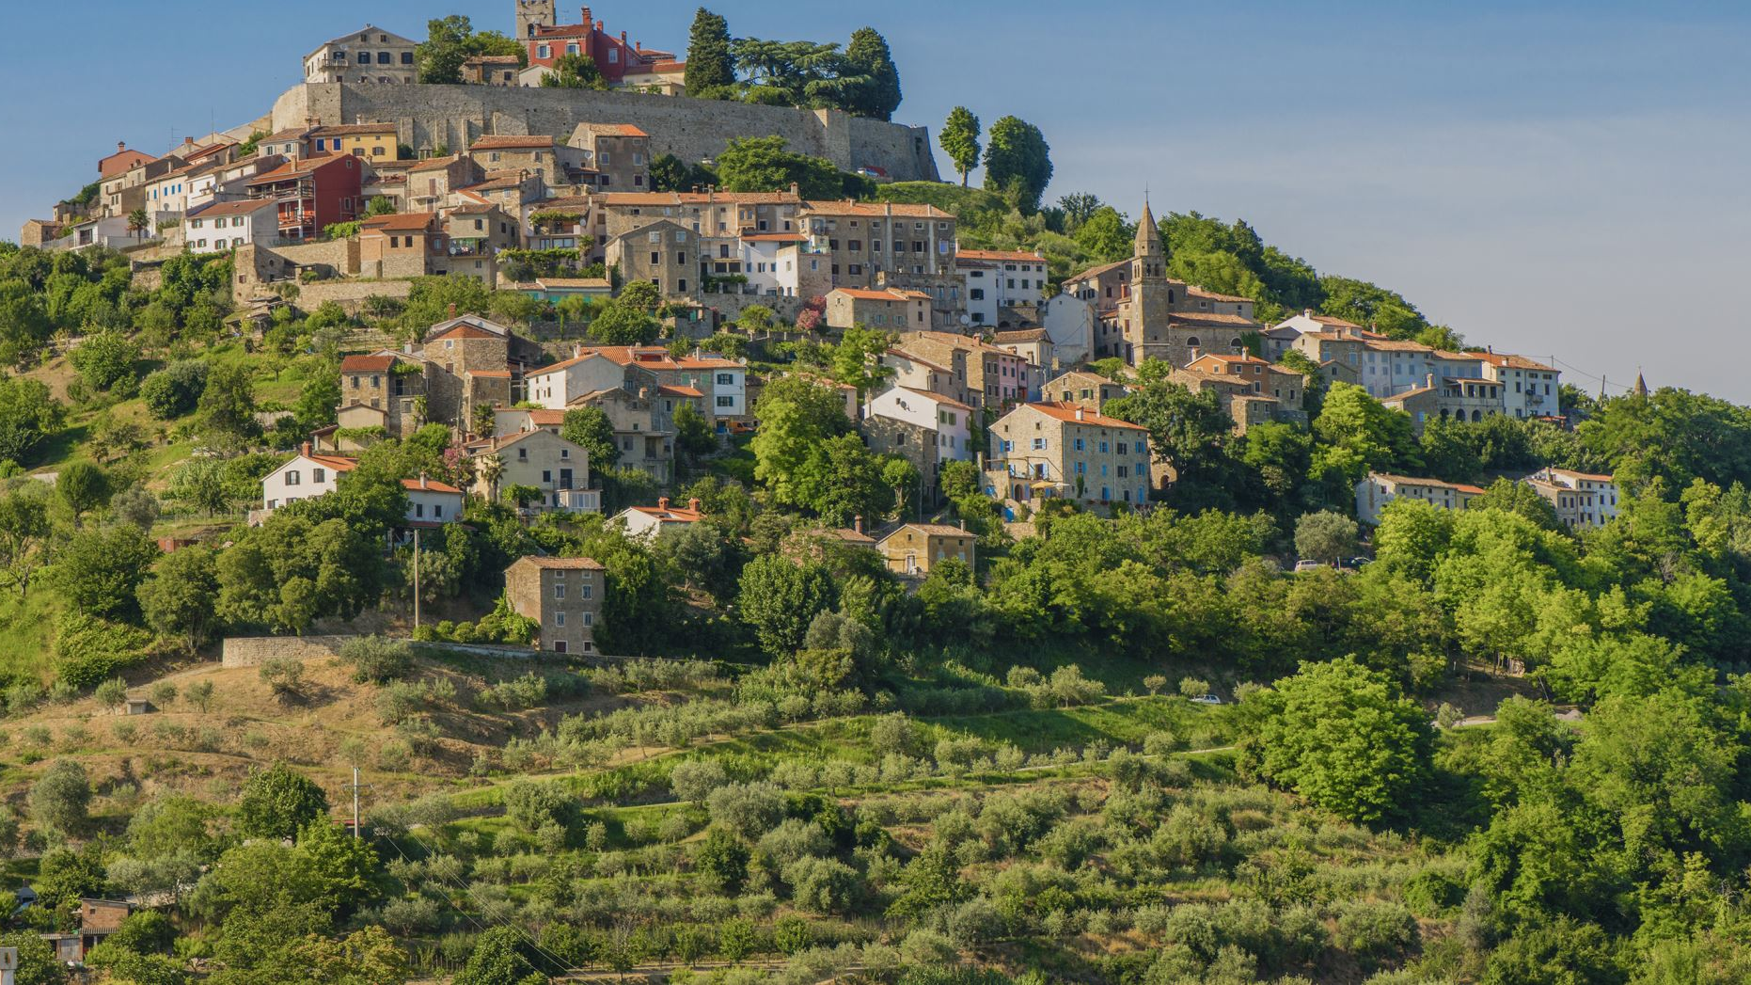
History of Italy
John Ancona

Slide 2
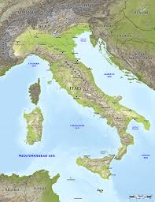
Unique Geography
One of the most unique regions of the world geographically
Mediterranean
Alps
Coastline

Slide 3
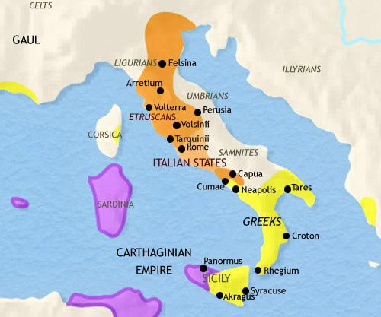
Before Rome Era
Etruscans
Latins
Greeks

Slide 4
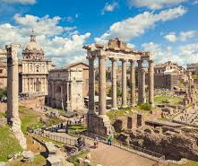
Early Rome Era
Etruscan Rule
Technology
Politics

Slide 5
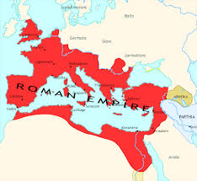
The height of the Roman republic and Empire
Large Territorial Conquests
Large building of infrastructure and cities
Rise of political system and economics
Rise of Christianity

Slide 6
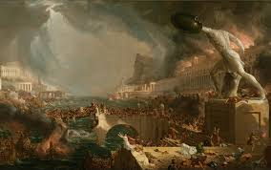
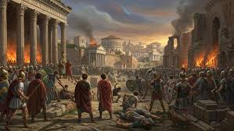
Fall of the Roman Empire
The year of 476
Failing economy and inflation
Invasions from the goths and the vandals
Fragmentation of Italy

Slide 7
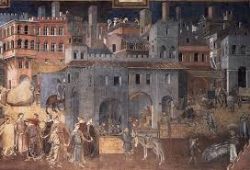
Medieval Ages
Very politically fractured environment following the fall of Rome
Different areas under different control
  Led to some areas becoming very rich while others become increasingly poor

Slide 8
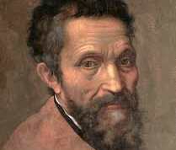
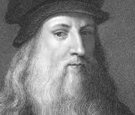
Rise of Culture During the renaissance
Leonardi Da Vinci
Michaelangelo
Cultural capital of the world
Iconic architecture

Slide 9
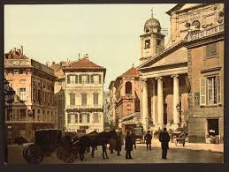
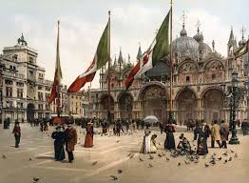
Rise of Italian identity
1800's
Strong sense of Italian nationalism
Napoleonic influence on Italy
  Increased unity between different areas of Italy

Slide 10
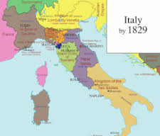
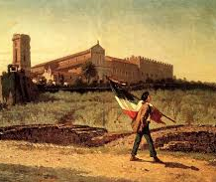
Risorgimento
1861, the Kingdom of Italy was declared
Rome was added in 1870
Cavour used political strategy, Mazzini inspired nationalist movements, and Garibaldi led volunteer armies that united southern Italy
Still large divide and inequity in Italy after unification.

Slide 11
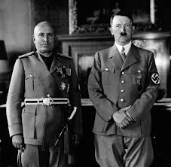

Fascism in Italy
Economic suffering from WW1 caused a major political divide
Rise of Mussolini
Alliance with Hitler

Slide 12
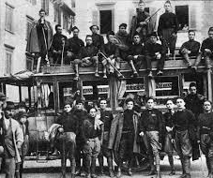
Post-Fascism Italy
In 1946, Italians voted to abolish the monarchy and form a republic
A new democratic constitution was written in 1948
Increased rights and equality throughout Italy

Slide 13
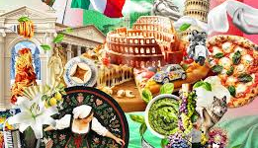
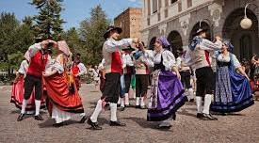
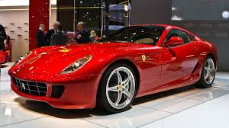
Modern day Italy
Large economic growth since the ending of fascism
Fashion
Art
Entertainment
Cars
Largest vacation destination

Slide 14
Sources
https://bluegreenatlas.com/italy.html
https://timemaps.com/civilizations/etruscans/
https://www.britannica.com/place/ancient-Rome
https://timemaps.com/civilizations/roman-empire/
https://gertitashkomd.com/the-fall-of-the-western-roman-empire-476-ce/
https://aeon.co/essays/how-the-fall-of-the-roman-empire-paved-the-road-to-modernity
https://www.medieval.eu/medieval-day-in-italy/
https://www.understandingitaly.com/risorgimento.html
https://en.wikipedia.org/wiki/Fascism
https://slate.com/news-and-politics/2017/01/how-italian-fascists-succeeded-in-taking-over-italy.html
https://slate.com/news-and-politics/2017/01/how-italian-fascists-succeeded-in-taking-over-italy.html
https://www.goway.com/destinations/europe/italy/culture-and-traditions
https://www.slashgear.com/906769/the-10-most-expensive-italian-sports-cars-ever-made/

