Slide 1
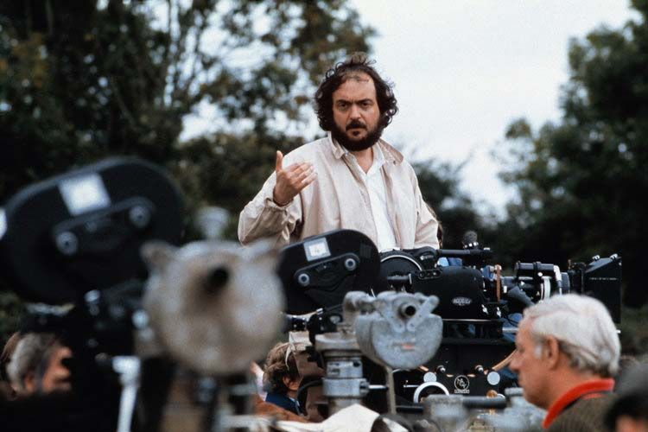
Why Stanley Kubrick is the Greatest Director
By Joel Pelachik

Slide 2
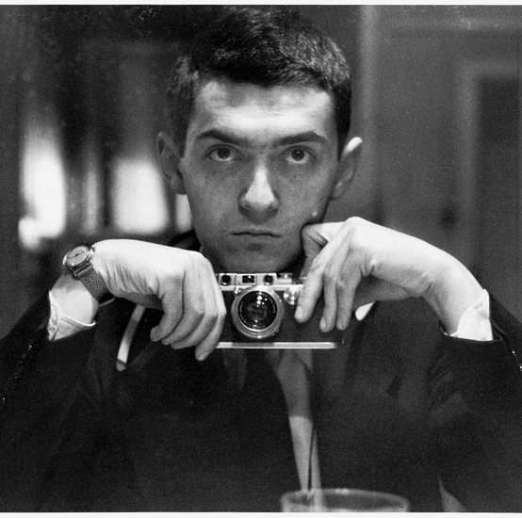
Who was Kubrick?
Born in 1928
Jewish roots
Poor student, yet rumored 200 IQ
Started as a photographer
Directed Day of the Fight (1951)

Slide 3
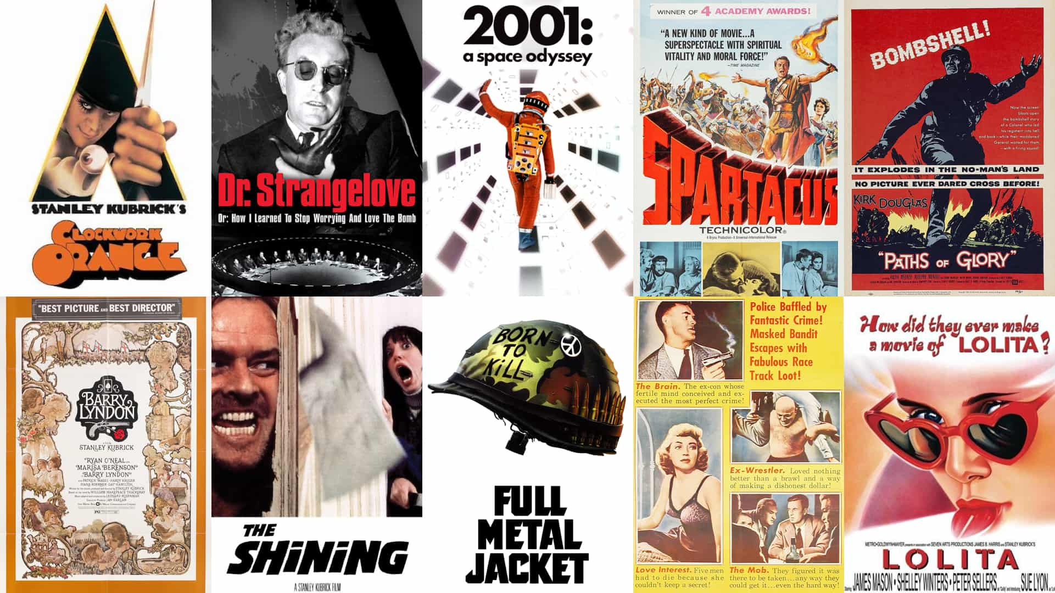
Diverse Genres:
Comedy — Dr. Strangelove (1964)
Sci-fi — 2001: A Space Odyssey (1968)
Period piece — Barry Lyndon (1975)
Horror — The Shining (1980)
War — Paths of Glory (1957), Full Metal Jacket (1987)
Other directors are one-dimensional

Slide 4
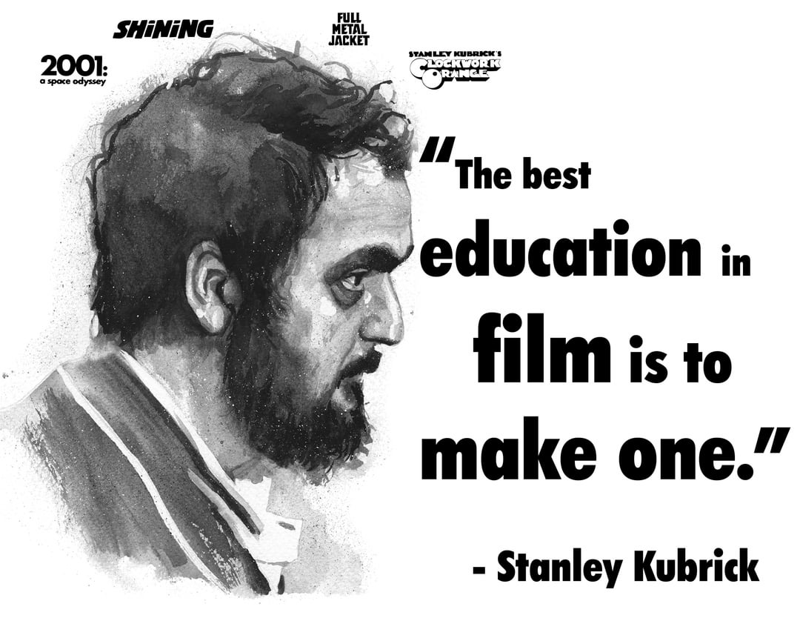
Unmatched Ambition

Slide 5
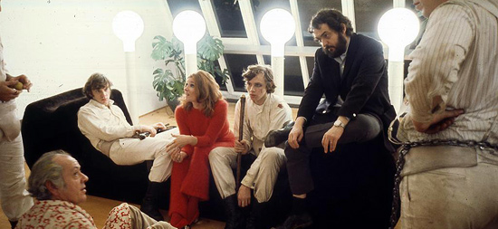
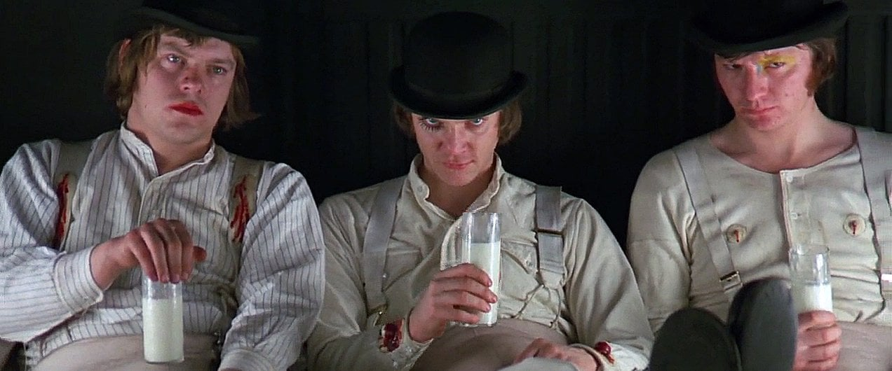
A Clockwork Orange (1971)
Based on Anthony Burgess' novel
Dystopian society
Incredible worldbuilding
Nadsat language (droog, moloko, krovvy)
Kubrick withdrew the film from the UK

Slide 6
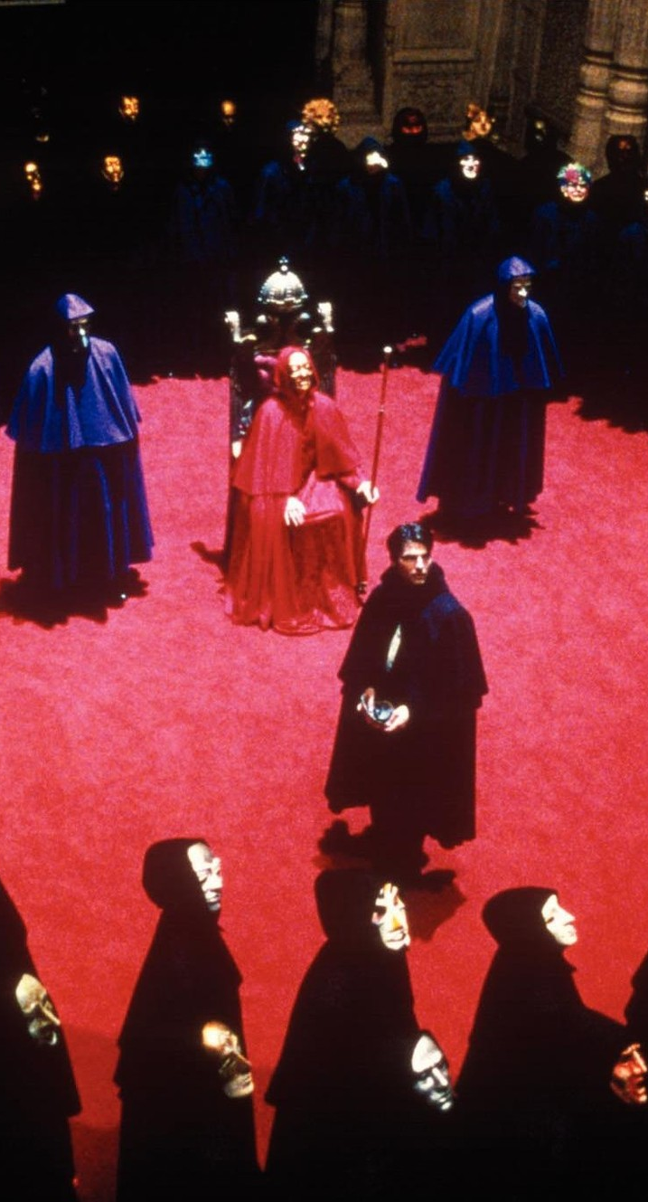
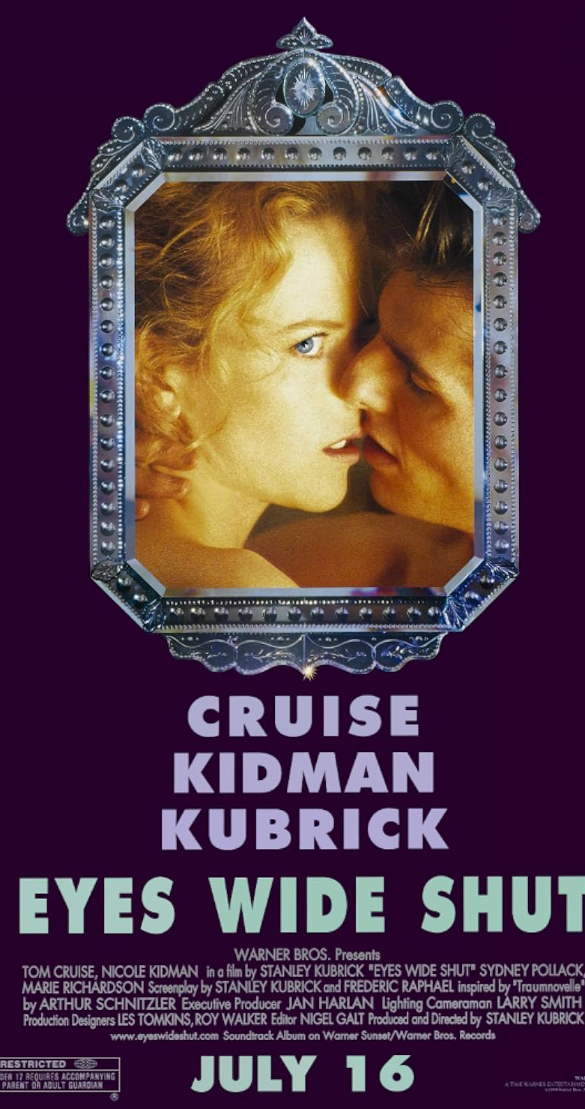
Eyes Wide Shut (1999)
Tom Cruise's character stumbles upon a cult
Hollywood's corruption and secrecy
Kubrick died 6 days after showing the film to Warner Bros.

Slide 7
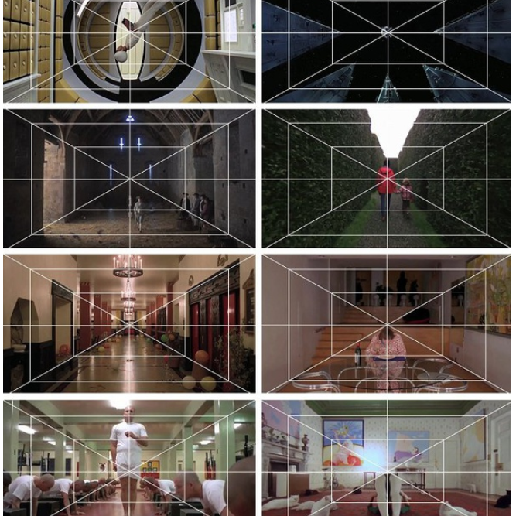
Perfectionism
Got the most out of actors: Sellers, Duvall, Ermey
The Shining (1980): 148 takes
One-point perspective

Slide 8
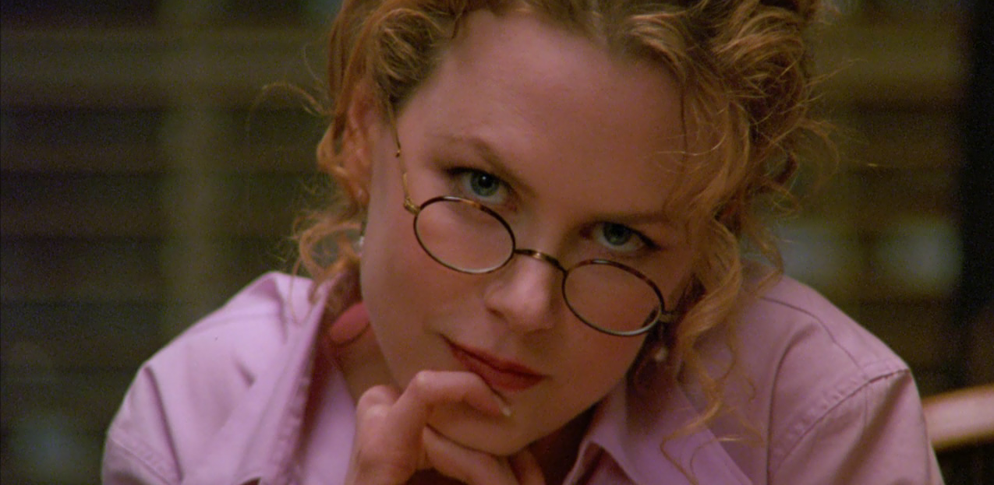
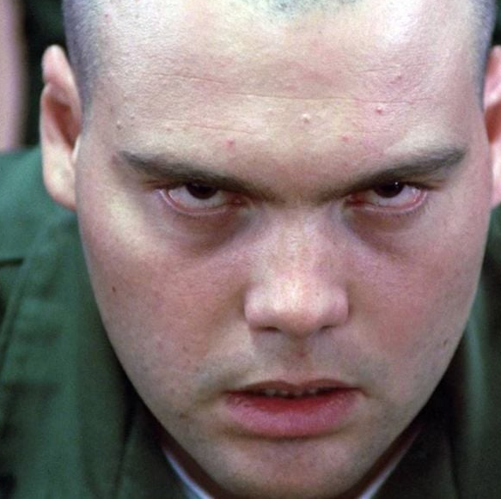
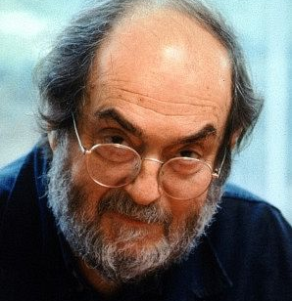
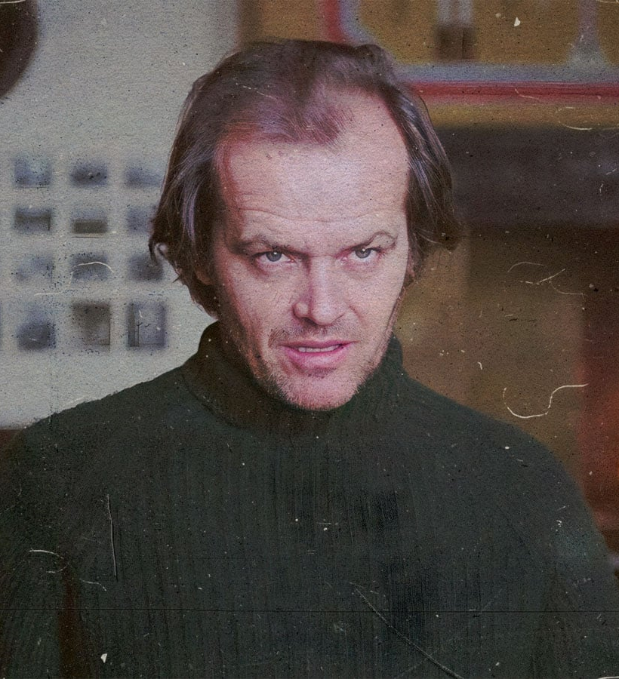
"Kubrick Stare"

Slide 9
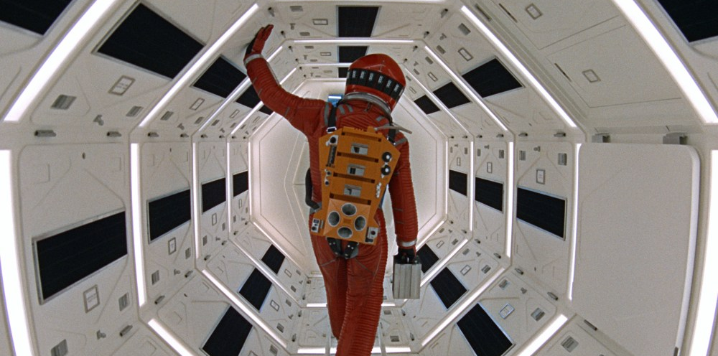
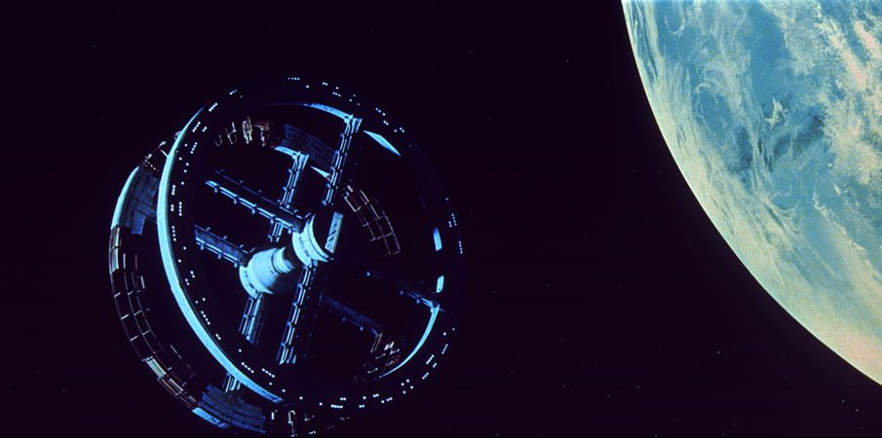
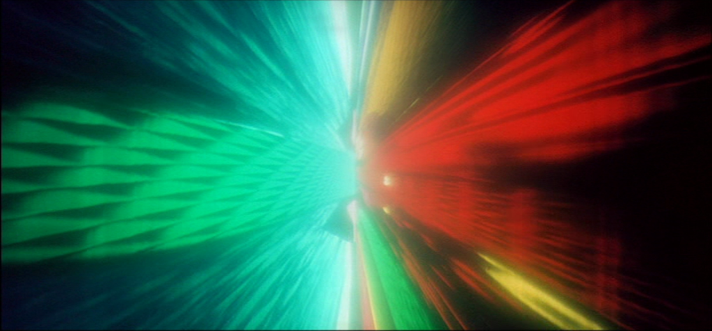
2001: A Space Odyssey (1968)
Influence
Still relevant
Themes of sentient AI
Not just a movie, but an experience

Slide 10
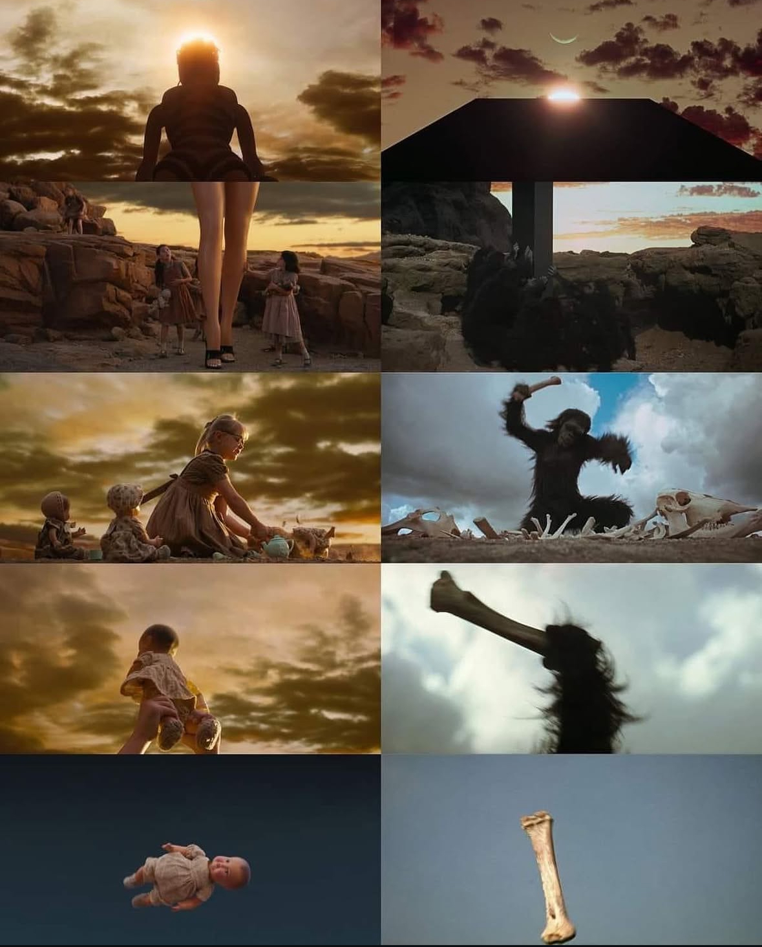

Slide 11
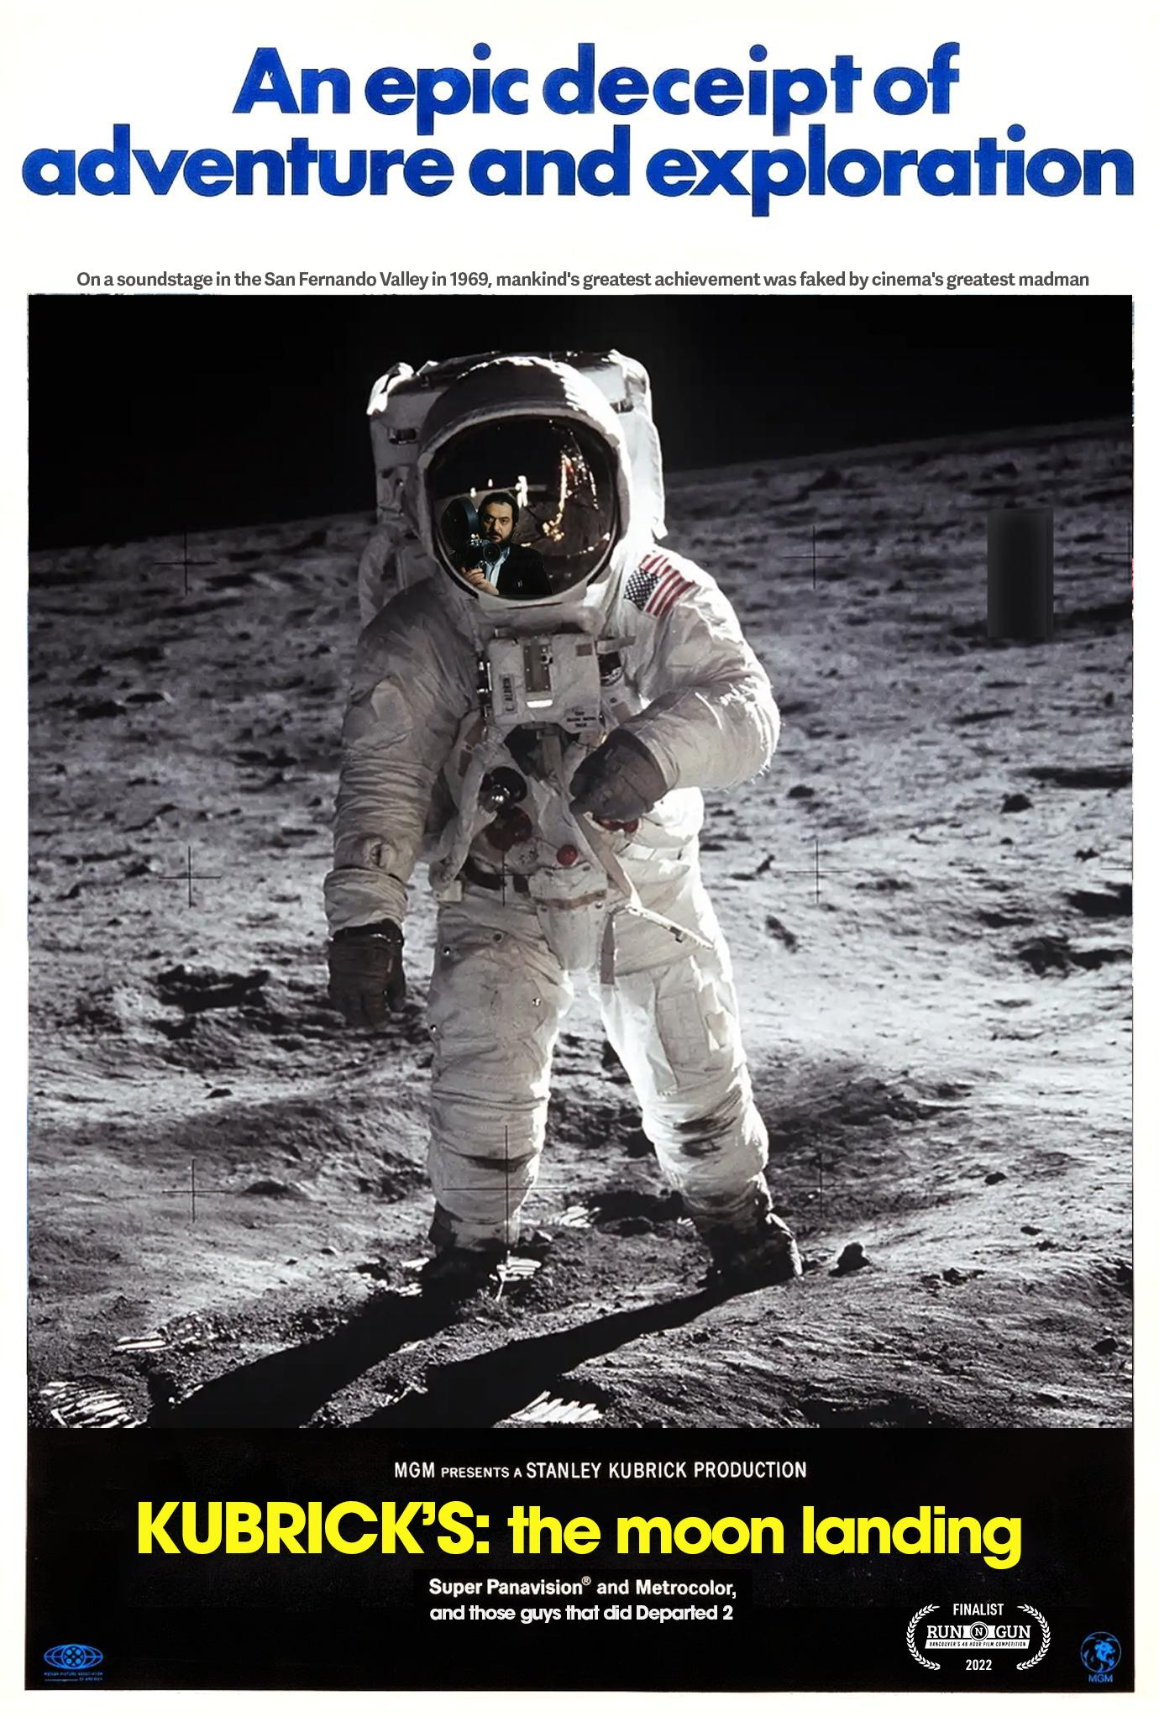
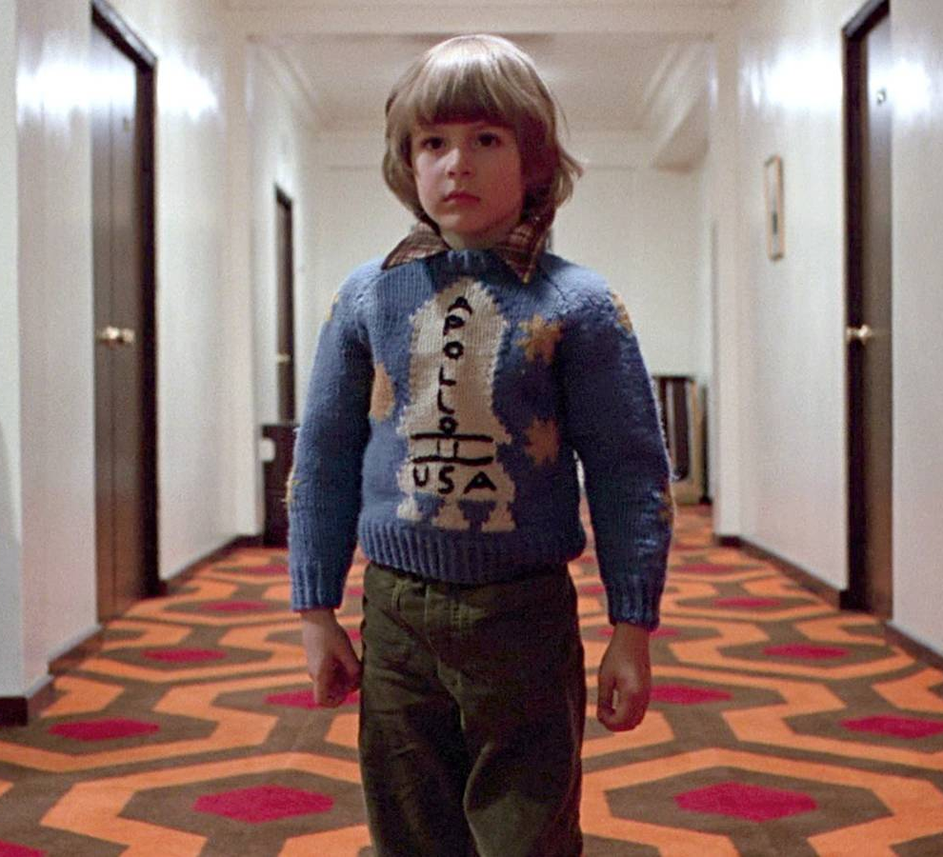

Slide 12
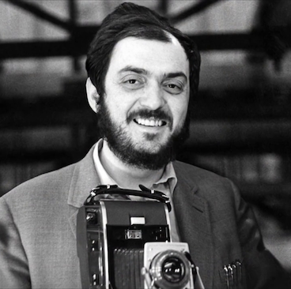
Kubrick's Greatness
Lasting mark on cinema
My top Kubrick films
Directed 13 feature length films

