Slide 1
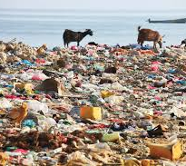

Why We Must Ban Plastic

Slide 2
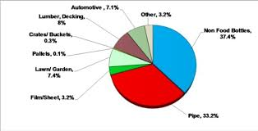
The Statistics
Over 380 million tons of plastic are produced each year — half of it designed for single use.
Only 9% of plastic waste is ever recycled
Most ends up in landfills, rivers, and oceans, where it can take up to 500 years to decompose.

Slide 3
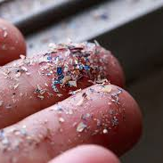
The Impacts on Environment
Plastic pollution affects over 700 marine species, including sea turtles and seabirds.
Microplastics have been found in fish, soil, rainwater, and even human blood.
Plastics release toxic chemicals when exposed to heat and sunlight, contributing to both pollution and climate change.

Slide 4
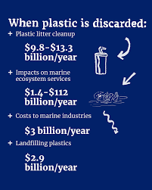
Financial Costs
The UN estimates $13 billion annually in damage to marine ecosystems from plastic pollution.
Cleanup costs are enormous and often fall on taxpayers, not corporations.
Microplastics can carry harmful chemicals linked to cancer, infertility, and immune disorders.

Slide 5
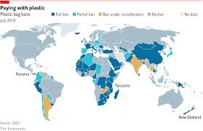
Proof the Plastic Action is Successful
Over 180 countries have taken steps to reduce plastic waste; the EU banned many single-use plastics in 2021.
Kenya’s 2017 plastic bag ban cut plastic bag pollution by 80%.
When governments take bold action, results follow — and economies adapt quickly with reusable alternatives.

Slide 6
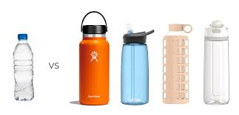
How We Must Expand the Global Action
Governments must phase out production and sale of single-use plastics.
Companies should shift toward biodegradable or reusable materials.
Individuals can help by refusing plastic, using reusables, and supporting policy change.

Slide 7
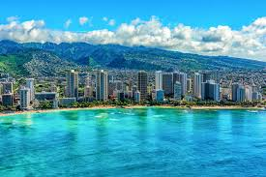
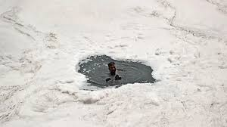
A Future Without Plastic
Oceans free of floating waste
Wildlife thriving without pollution
Cities powered by reusable and biodegradable materials
A culture of responsibility and innovation

