Slide 1

Advancing Checks and Balances
Rule of Law

Slide 2

Historical Origins on philosophical terms
Aristotle believed that we should have a mix of different governmental forms of government with balanced powers. Believed in both aristocracy and democracy.
Montesquieu believed that government powers should be divided and able to limit each other. Optimized the idea of three different branches

Slide 3
Origin of American checks and Balances
Founding fathers wanted to prevent concentration of power after living under British tyranny
Typically colonial governments had governors, assemblymembers and courts that would clash with each other
Many state constitutions had separation of powers but this wasn’t always put into practice
Articles of confederation left legislative branch too powerful
Constitution never explicitly mentioned "checks and balances" however the legal framework is set up through constitution with the separation of powers between the legislative, executive, and judicial branches

Slide 4
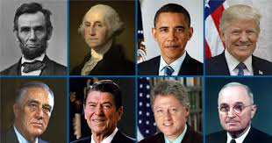
Executive Branch
Include presidents, governors, vice presidents, cabinet members, department and agency heads
Jobs Include
Enforcing laws created by congress or executive order
In charge of foreign policy
Appoints cabinet members, judges, and foreign policy officials
Can sign or veto laws passed by congress

Slide 5
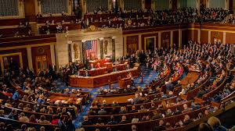
Legislative branch
Includes the House and Senate on both federal and state levels, as well as supporting agencies such as congressional budget office and government publishing office
Jobs Include
Writing and voting on laws
Approval the federal budget aka power of the purse
Votes on presidential nominees
Can declare war

Slide 6
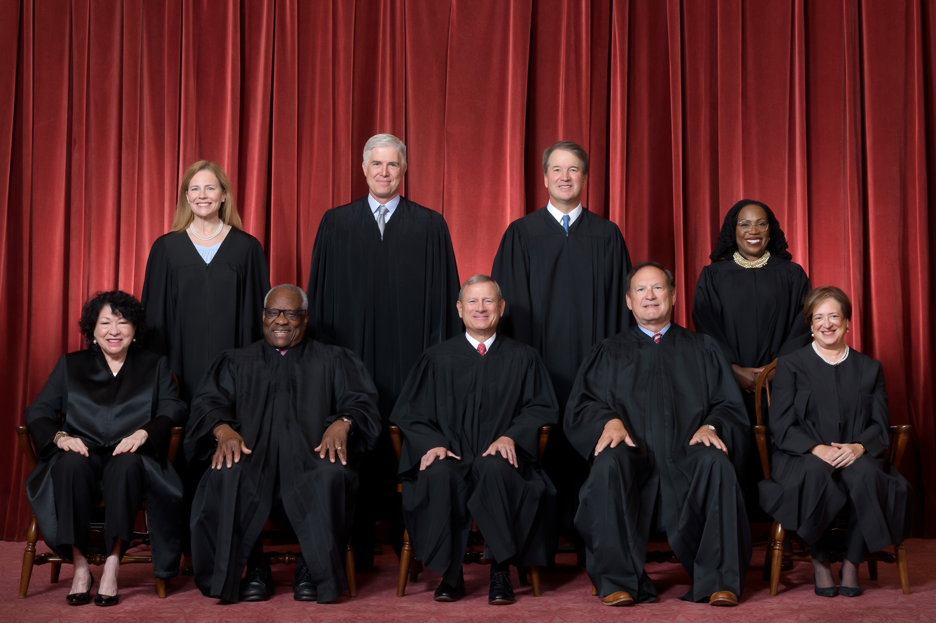
Judicial Branch
Includes the 9 supreme court justices as the highest ranking court above appeals courts and district courts. Also includes courts at the state levels.
Jobs Include
Interpreting laws by congress to see if they are constitutional
Interpreting executive orders to see if they are constitutional
Mediates disputes between different states or branches of government

Slide 7
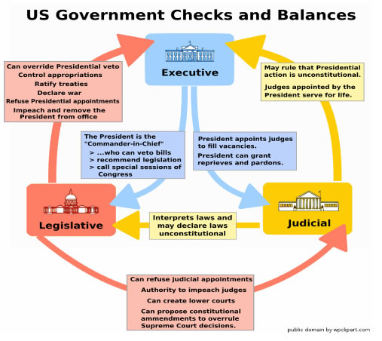
How each branch checks each

Slide 8
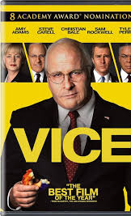
The problem with checks and balances?
- It doesn’t really exist
While checks and balances is written into law, a lot of it is based on a trust system with no way to enforce and counter violations of checks and balances

Slide 9
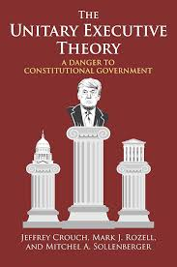
Unitary executive theory
Stems from article 2 of the constitution- gives all executive power in a president
Idea that president has the sole authority over the executive branch and can fire any department heads such as federal reserve.
More extreme versions of this idea state that the president has the right to defy court orders and has more power with executive orders
Since Reagan era, many court ruling have favored a unitary executive ideology

Slide 10
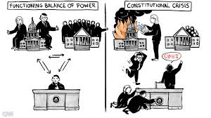
Constitution crisis
One key element of checks and balances is that the judiciary can overrule actions done by the president, but there is a twist
There is no "police force" to enforce judiciary power, meaning that this distribution of powers is all based on a trust system
No way to enforce checks and balances

Slide 11
So how can we restore checks and balances
There are many options for revitalizing Checks and Balances now, based on Constitutional and Congressional Authority!
Congress can tighten restriction on the power of the purse and do more to control impoundment
Increase oversight on departments and agencies
Empower state governments by giving them more independence from federal government
Require more transparency on reporting on government actions, budgets, and emergency powers
Creating a way to enforced judicial rulings such as creating an independent force or freezing assets forviolating court orders
Protect whistleblowers
Give powers such as emergency declarations, tariffs, and wartime powers back to the legislative branch

