Slide 1
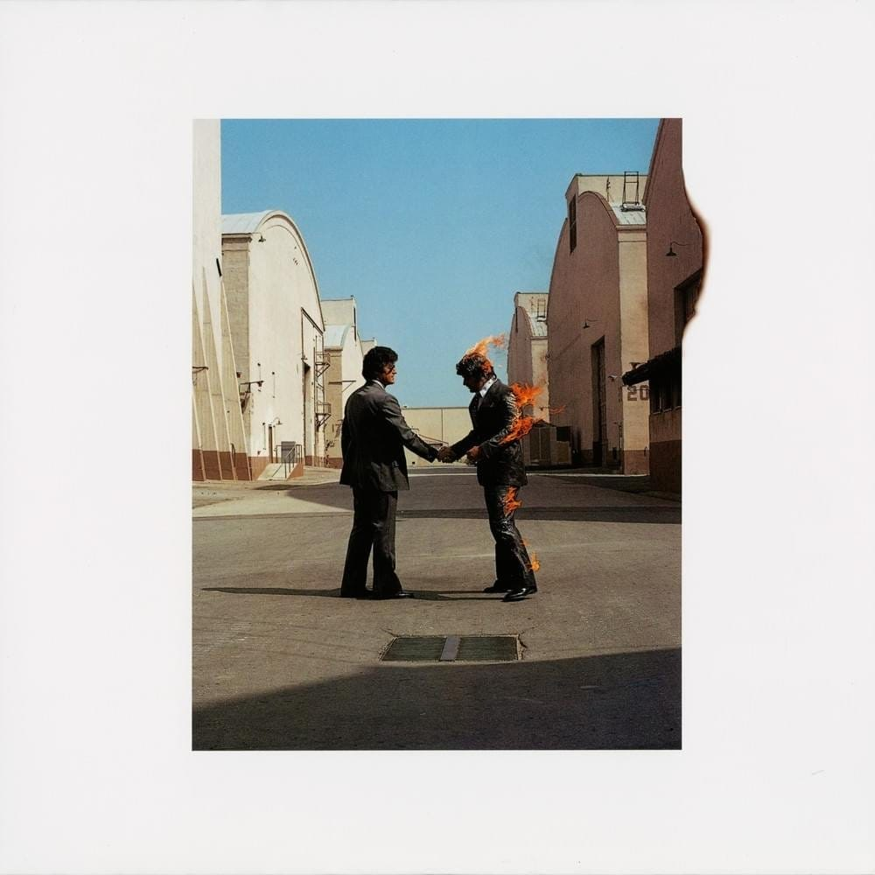
Pink Floyd's Wish You Were Here turns 50
The band's 9th studio album
Released in 1975
Progressive rock

Slide 2
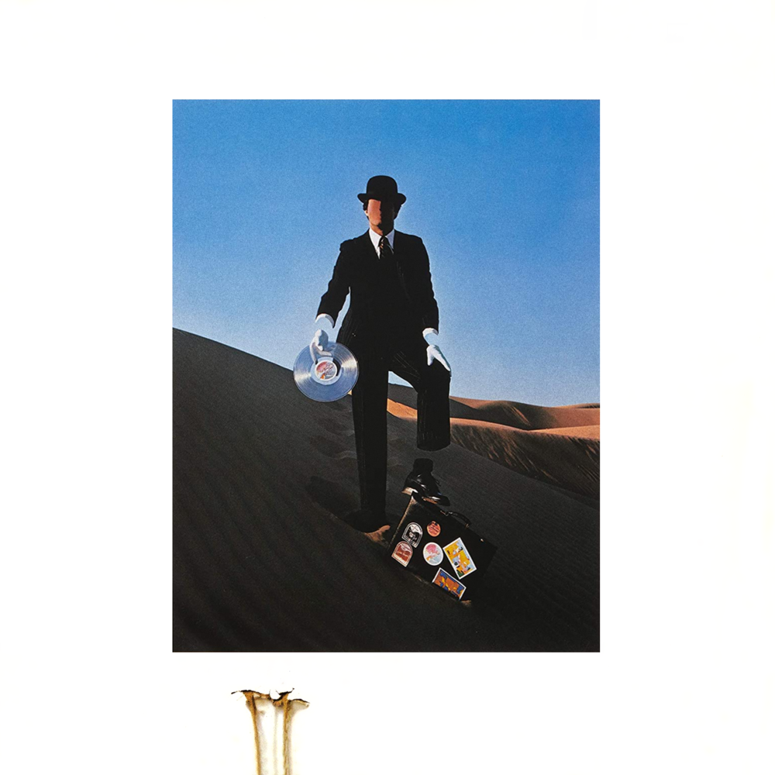
Track Listing:
Shine On You Crazy Diamond, Pts. 1-5
Welcome to the Machine
Have a Cigar
Wish You Were Here
Shine On You Crazy Diamond, Pts. 6-9

Slide 3
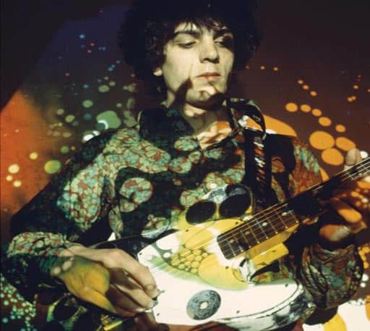
Tribute to Syd Barrett
"Shine On You Crazy Diamond" and "Wish You Were Here" are tributes to the band's original vocalist
Contributed to first two albums
Left in 1968
LSD abuse

Slide 4
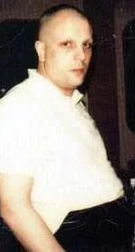
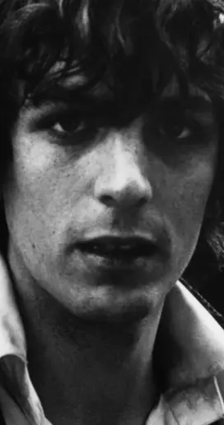
Barrett's Visit
Syd Barrett unexpectedly visited the studio
Visibly larger with shaved head and eyebrows
Unrecognizable
Roger Waters brought to tears

Slide 5
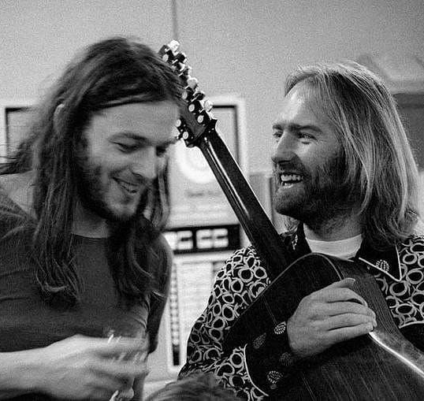
Critique of the Music Industry
"Welcome to the Machine" and "Have a Cigar"
Greed and corruption of the industry
Folk musician Roy Harper sings "Have a Cigar"

Slide 6

Album Artwork
Iconic cover shot in Warner Bros. lot
Burbank, California
Metro Boomin's HEROES & VILLAINS

Slide 7
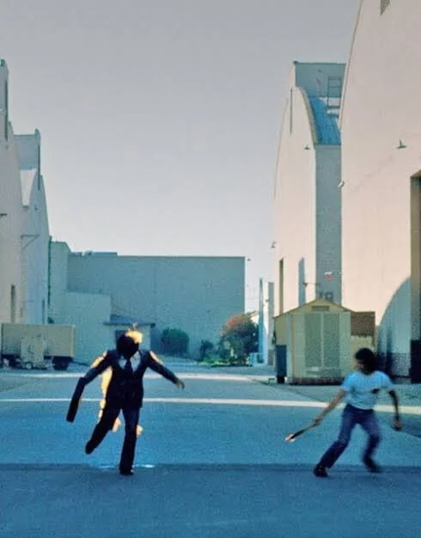
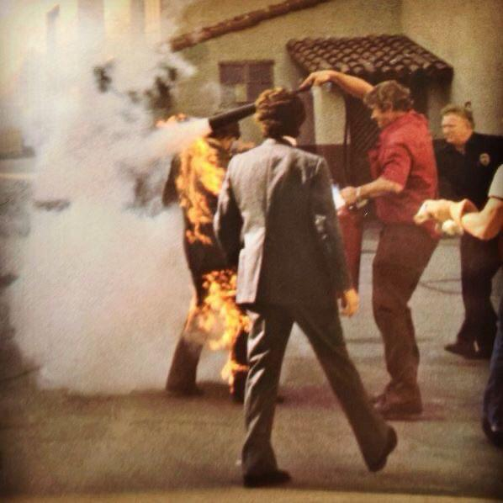

Slide 8
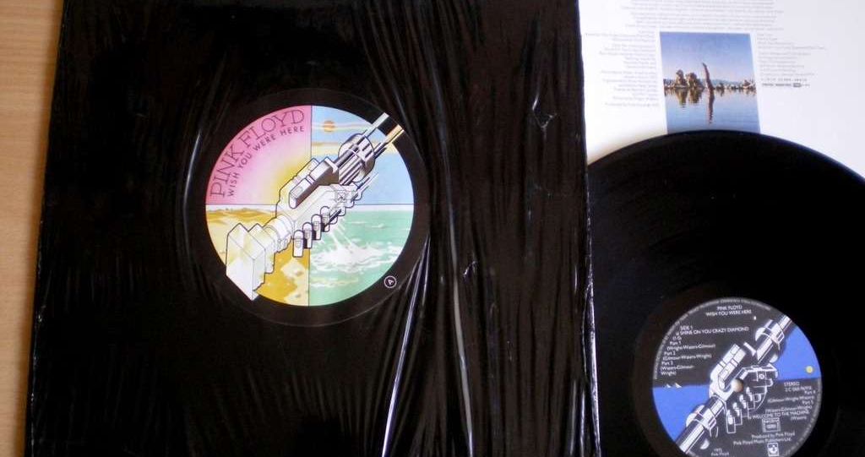
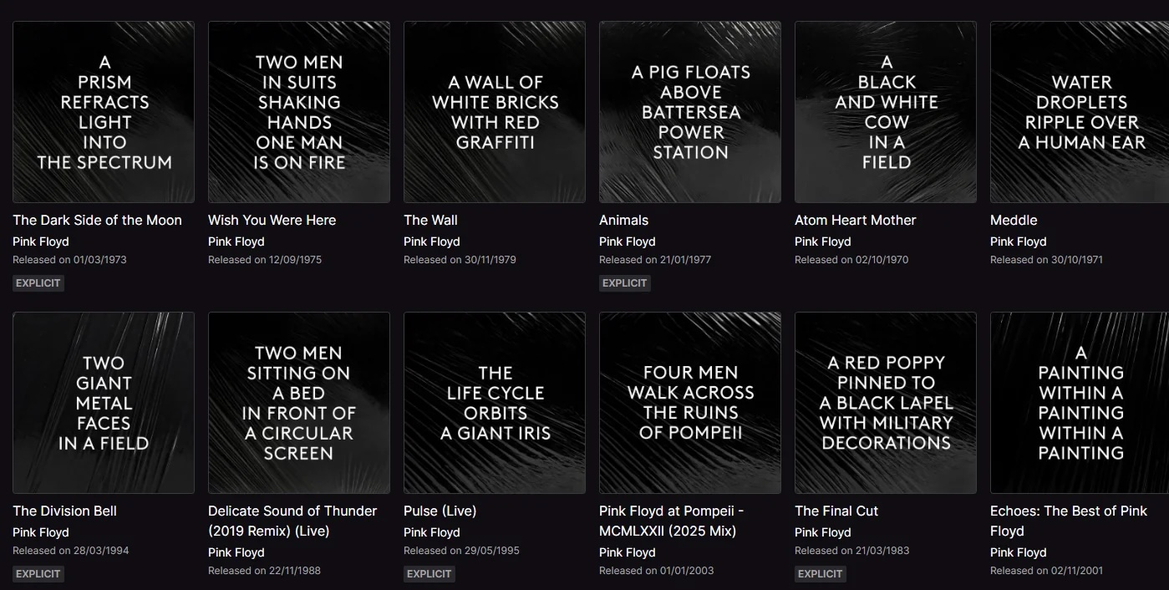
50th Anniversary
Vinyl's black plastic wrap
Text-only descriptions for album artwork
Anniversary edition: demos, alternate takes, live tracks

