Slide 1
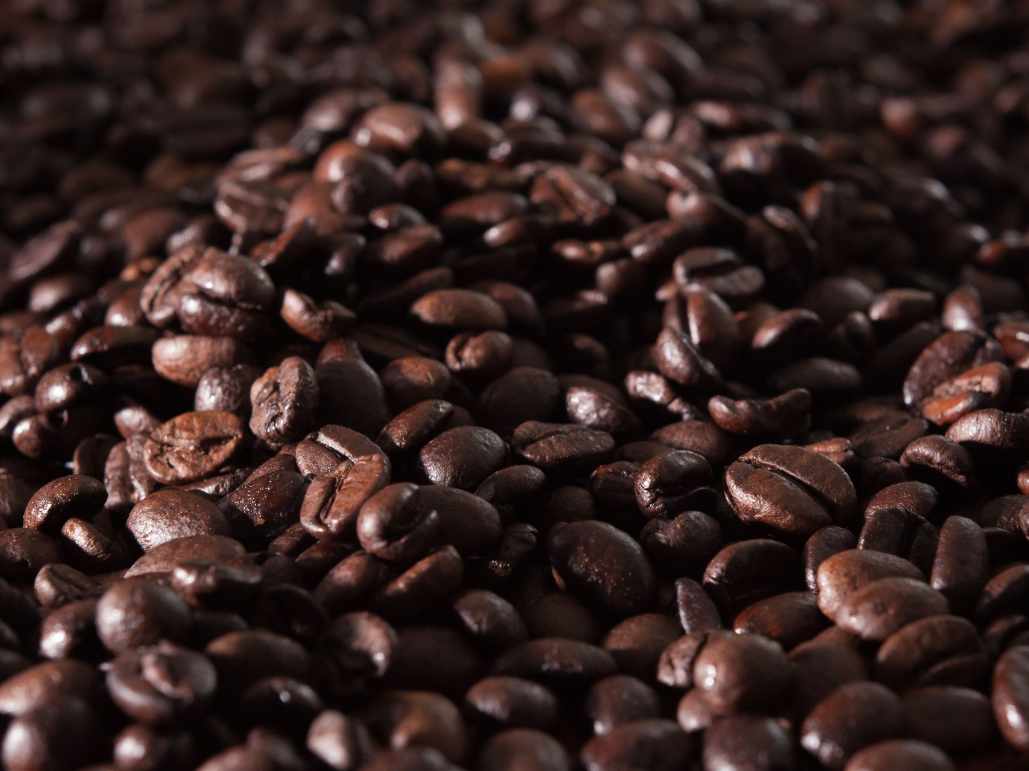
The Journey of a Coffee Bean

Slide 2
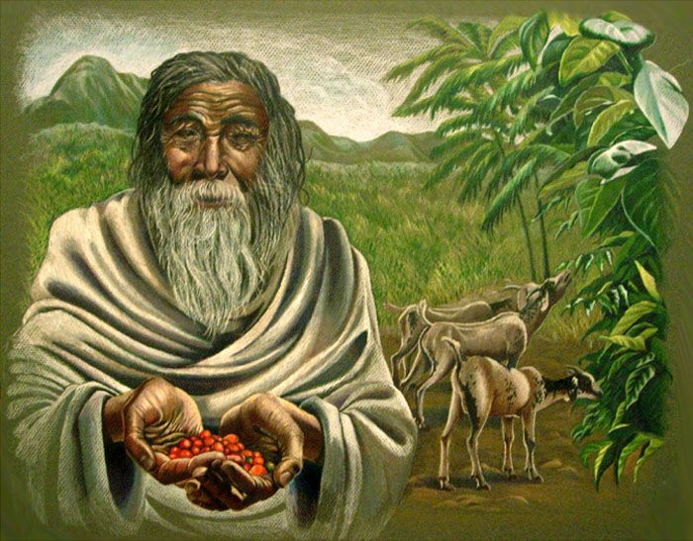
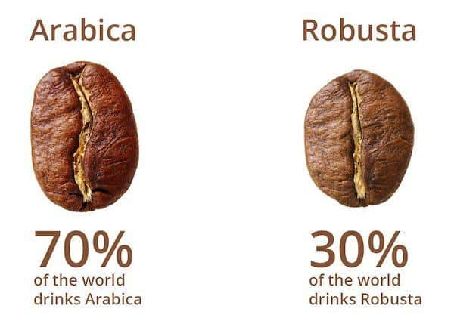
Coffee Origin
Coffee Kaldi, an Ethiopian goat herder
Coffee comes from the seeds of the coffee cherry.
The two main species are Arabica and Robusta.

Slide 3
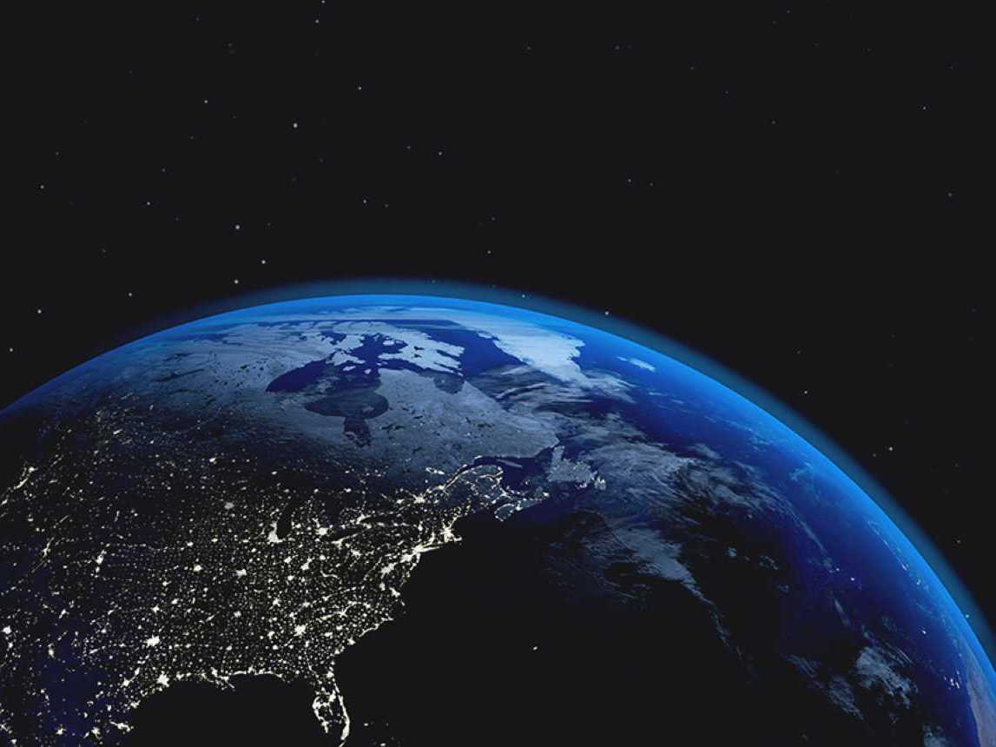
Where It’s Grown
Grown in over 70 countries within the 'Coffee Belt.'
Top producers: Brazil, Vietnam, Colombia, Indonesia, Ethiopia.

Slide 4
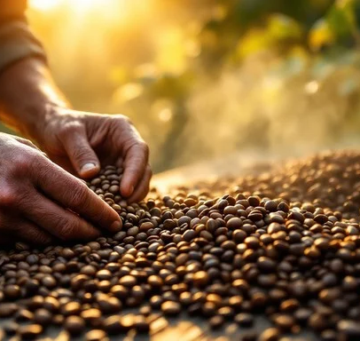
Harvesting & Processing
Handpicked for quality.
Two processing methods:
Wet: Fruit removed before drying.
Dry: Whole cherry dried first.

Slide 5
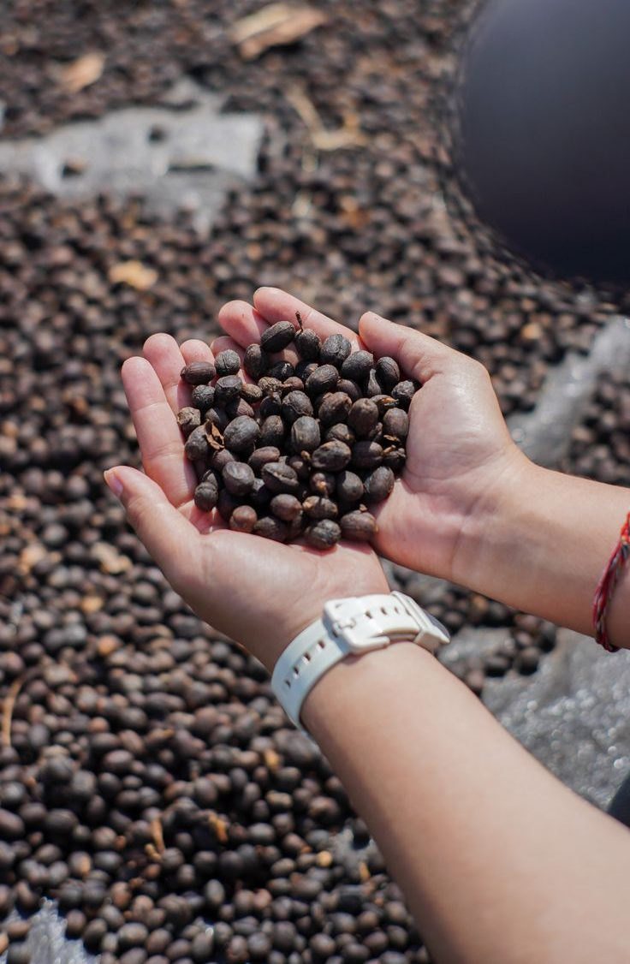
Drying, Milling, and Exporting
Dried to 10-12% moisture.
Hulled, sorted, and exported as green coffee beans.

Slide 6
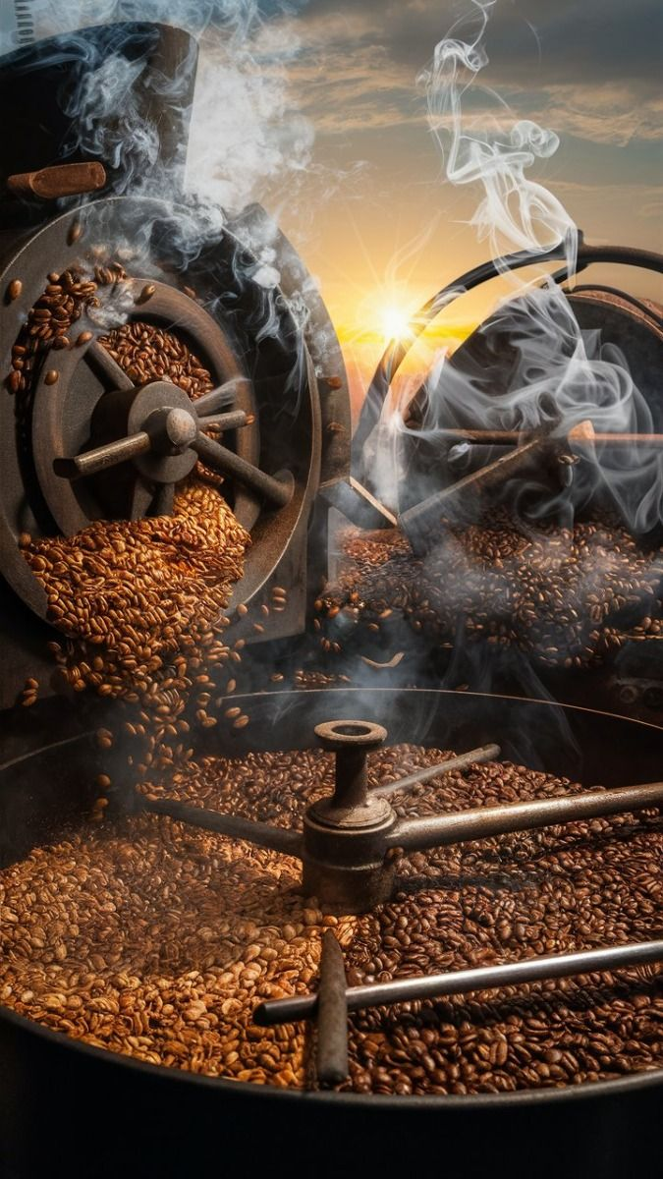
Roasting, Grinding, and Brewing
Roasting: 180°C to 240°C.
Grinding: Fine for espresso, Medium for drip, Coarse for French press.
Brewing: Drip, Espresso, French press, Pour-over.

Slide 7
Global Coffee Consumption
Over 2.25 billion cups consumed daily worldwide.

Slide 8
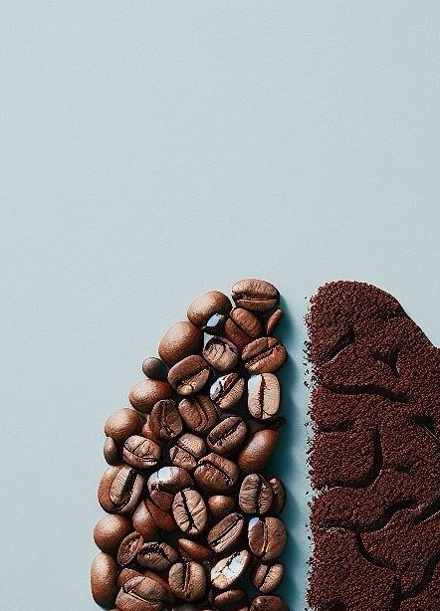
How Coffee Is Useful for Us
Improves alertness and focus.
Boosts physical performance.
Rich in antioxidants.
Supports mental health.
Has social and cultural significance.

Slide 9
Conclusion
Coffee goes through farming, processing, roasting, and brewing.
It boosts alertness, contains antioxidants, and supports mental health.
Coffee is a major global commodity with cultural and social significance.

