Slide 1
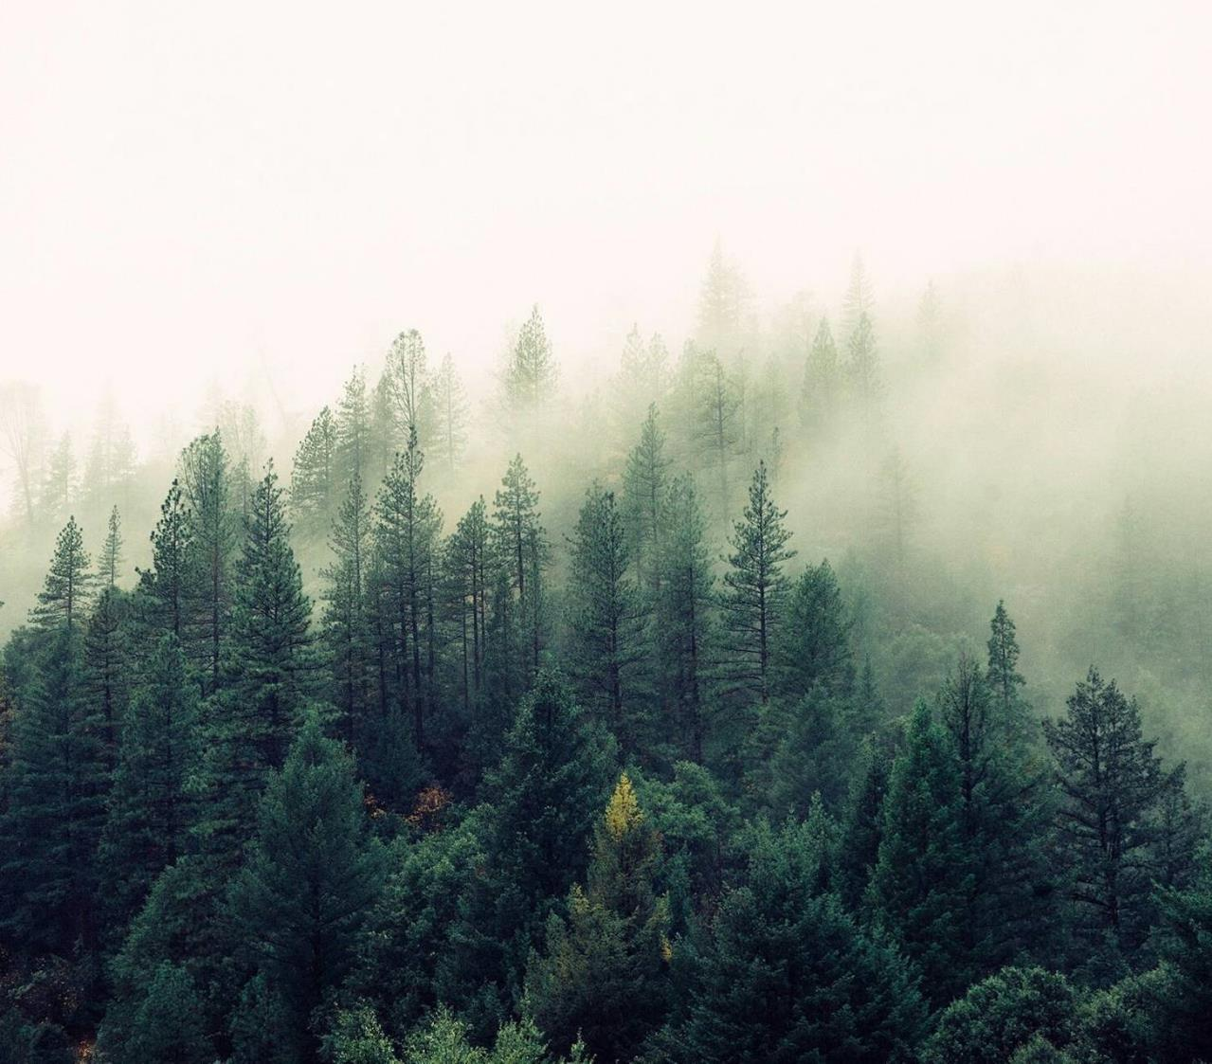
Ethical Moment: Harvesting Old-growth Forests
Alex Stahl

Slide 2
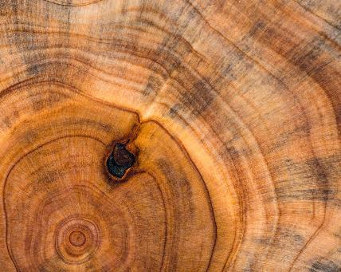
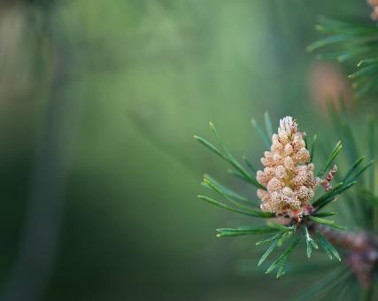
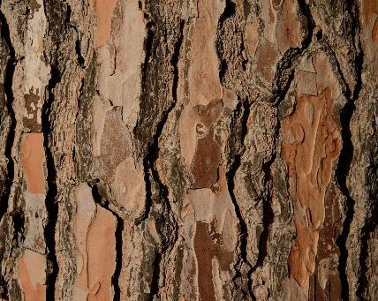
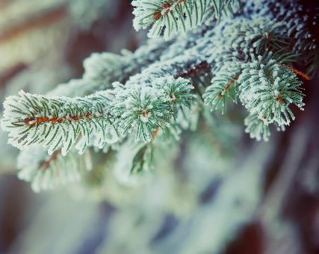
What are old-growth forests?
Old, large trees: ages from 100’s to 1000’s of years
Complex Structure: varying sizes, canopy layers
Dead wood: has decaying wood, vital for habitat
Rich biodiversity: high variety of species
Untouched: no logging or any human disturbance

Slide 3
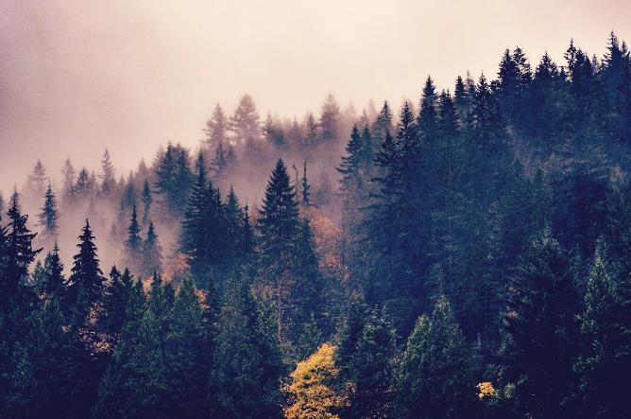

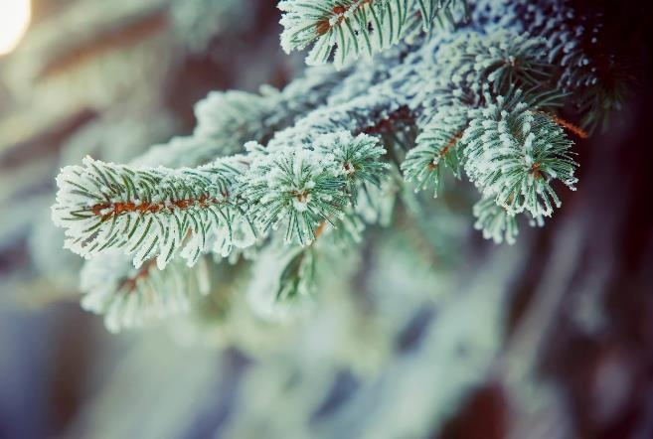
Pros of Harvest
Economic Benefit – creates jobs for timber/paper
Durable Resources – high quality, strong wood for the market
Forest Management?? – potentially improves forest health/lowers forest fires (very debatable for old-growth)

Slide 4
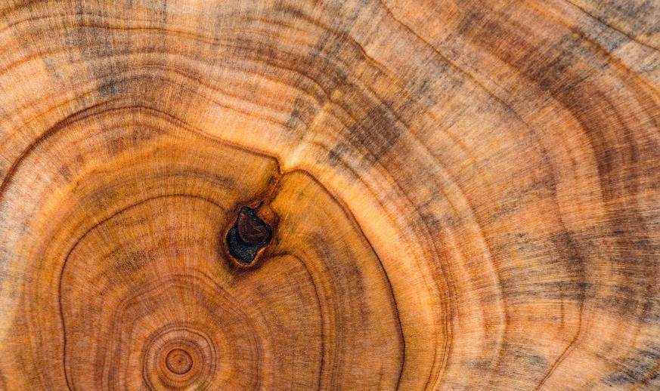
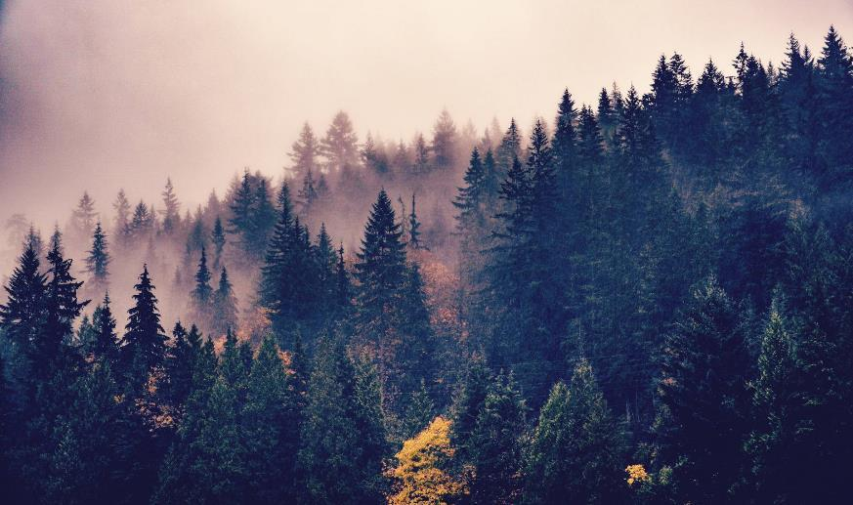
Cons of Harvest
Ecological Damage – irreversible loss of habitats and species
Impacts Climate –releases stored carbon and methane
Cultural/Environmental Significance – important to communities

Slide 5
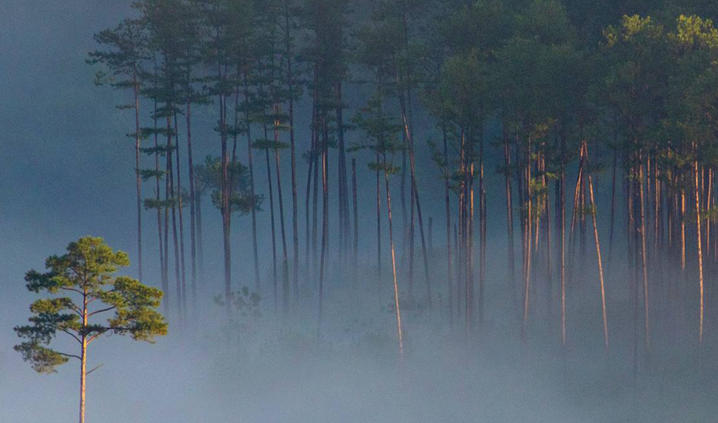
Thoughts? What would you decide?

