Slide 1
Enhancing Community Engagement for Meals on Wheels
By: Maggie Lavoie, Devin Grant, Colin Deitz

Slide 2
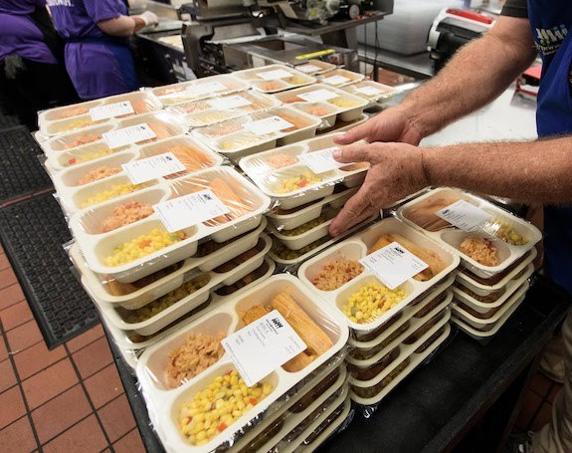
All about Meals on Wheels
Meals on Wheels is a National Non-Proft
It was brought to Syracuse in 1959
Meals video

Slide 3
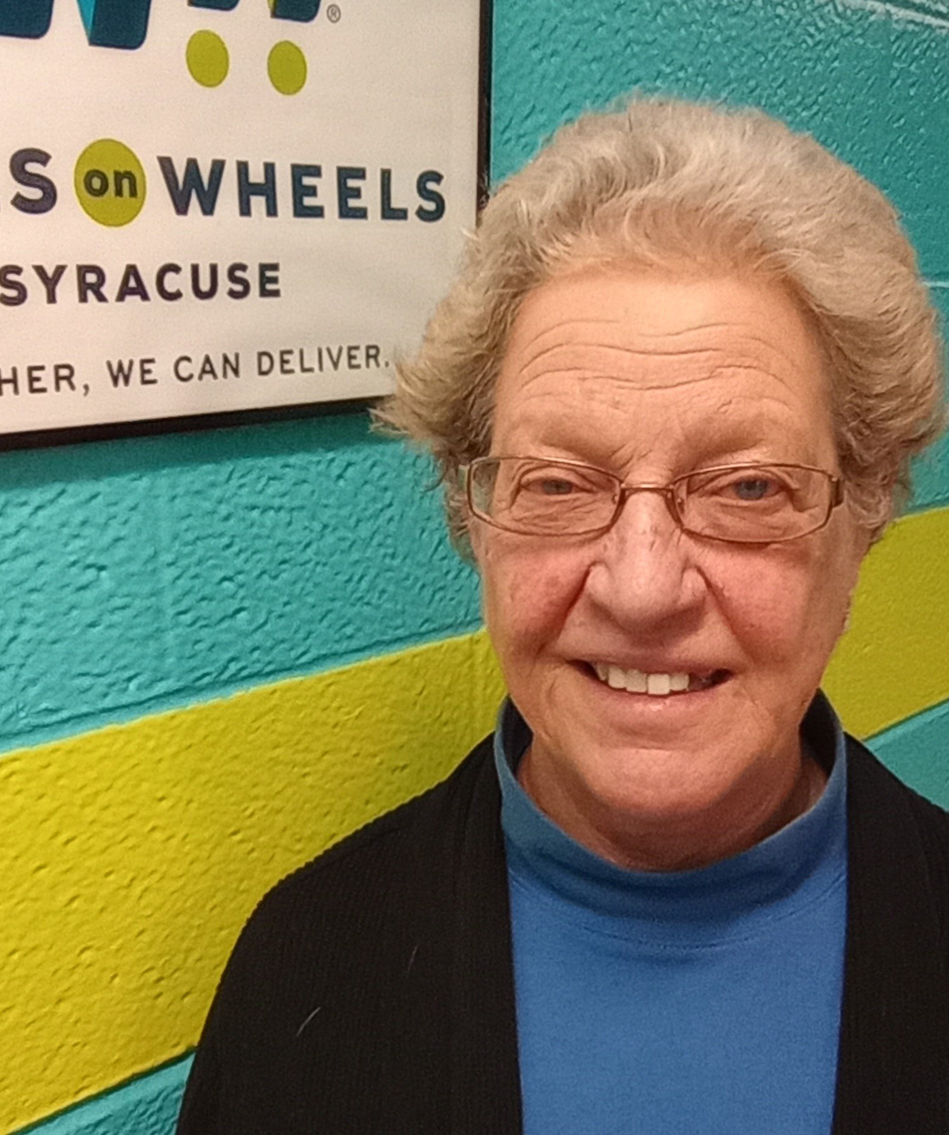
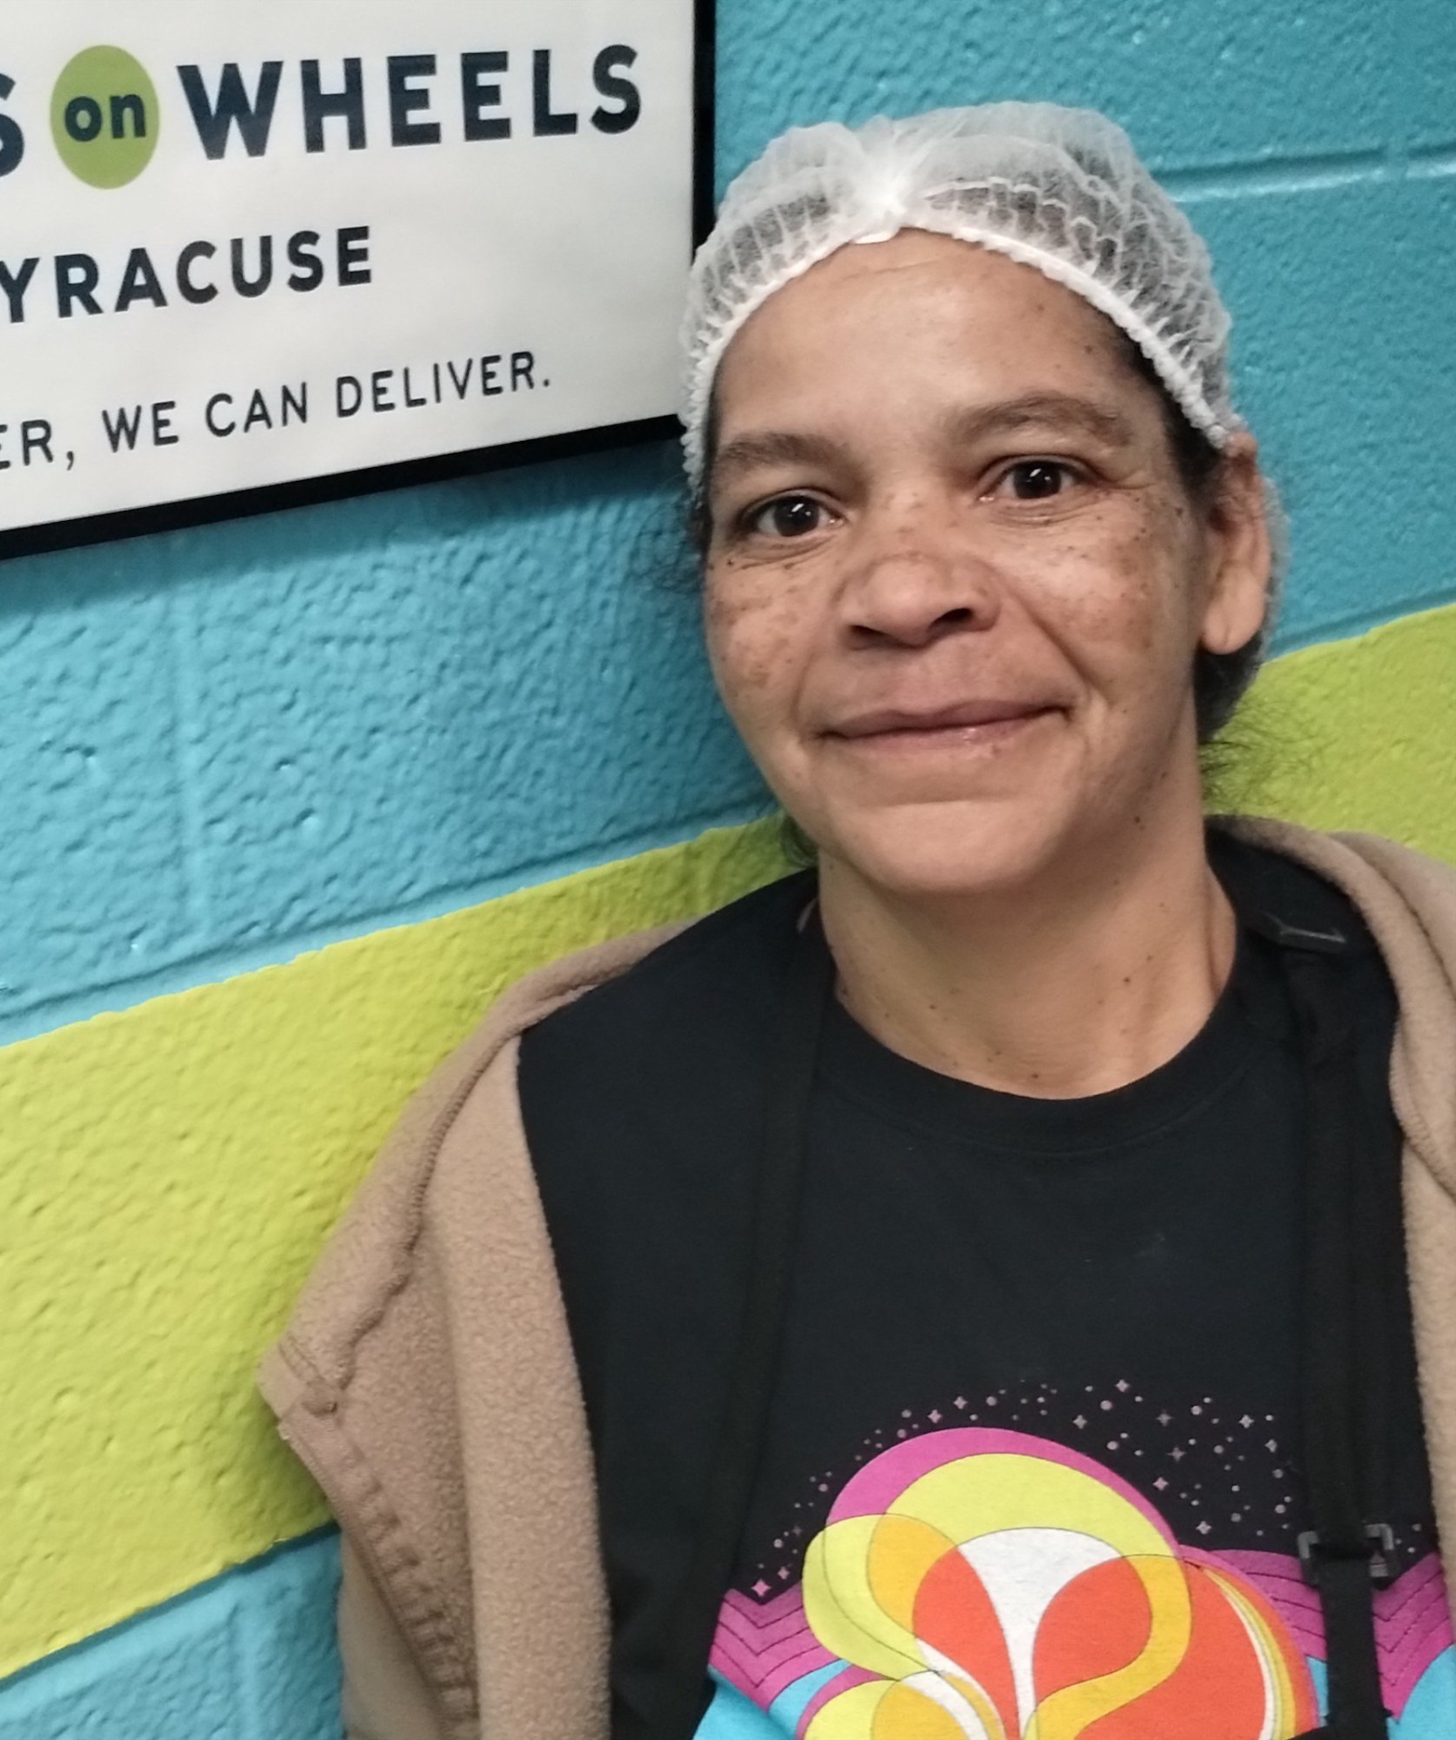
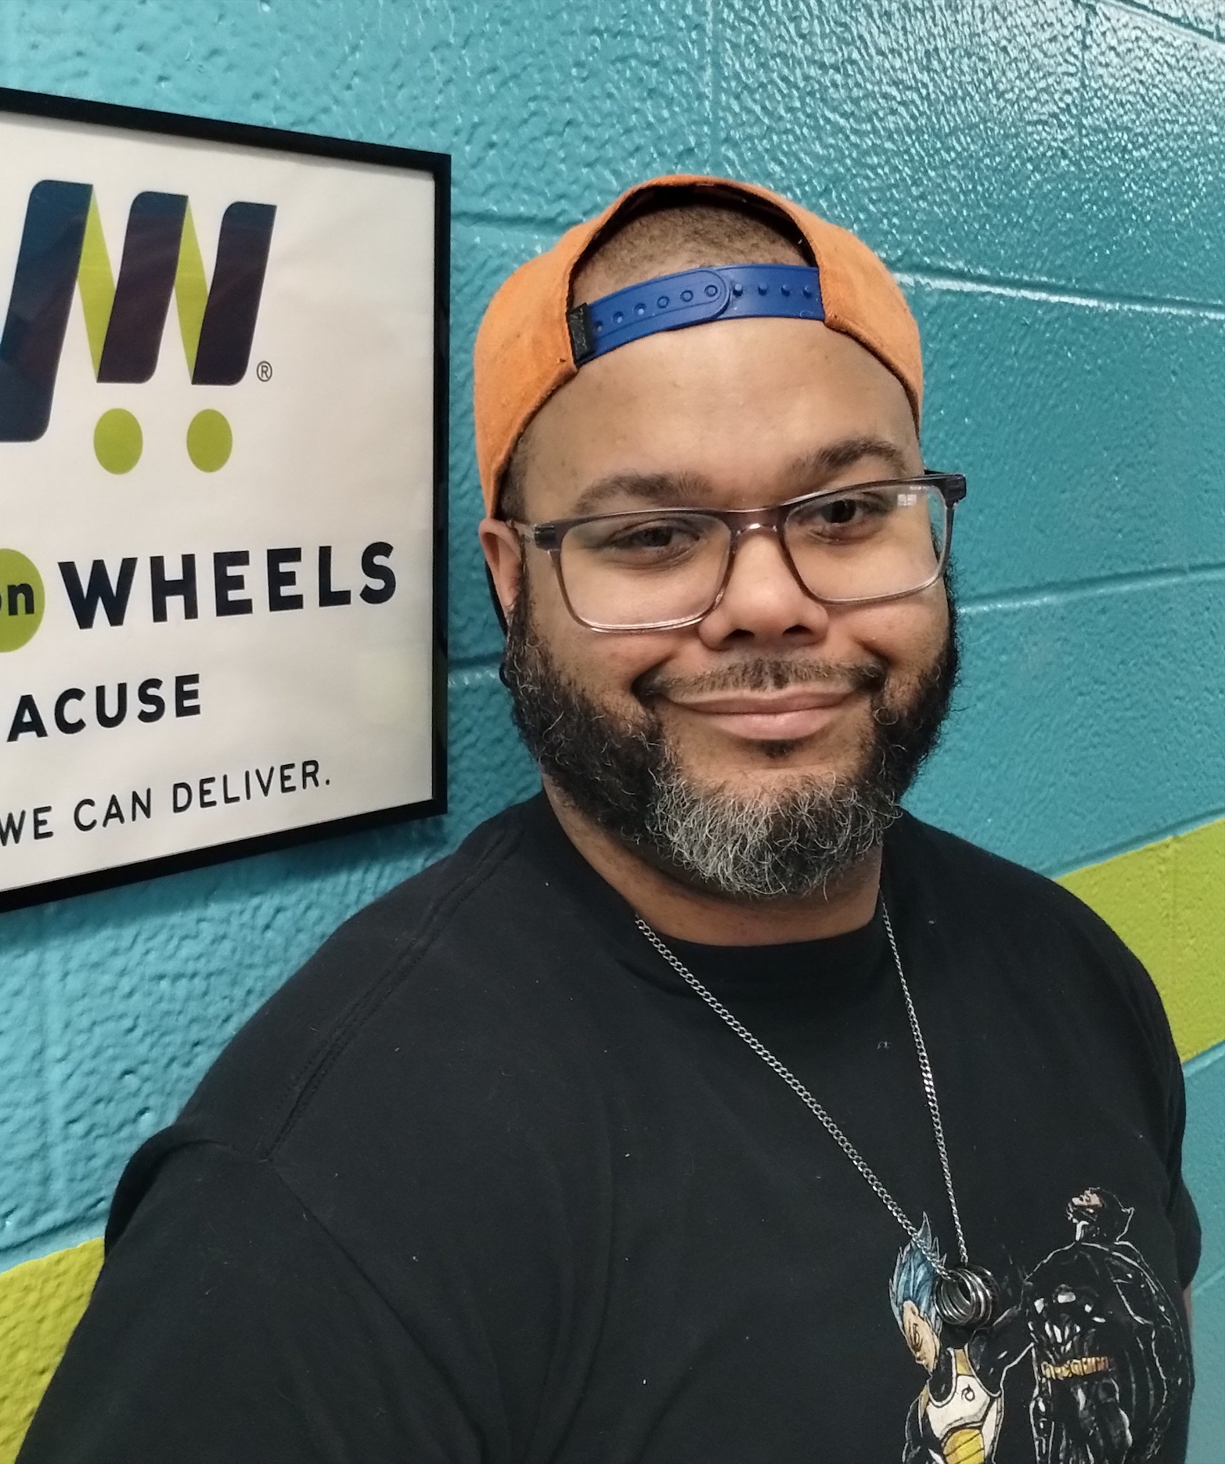
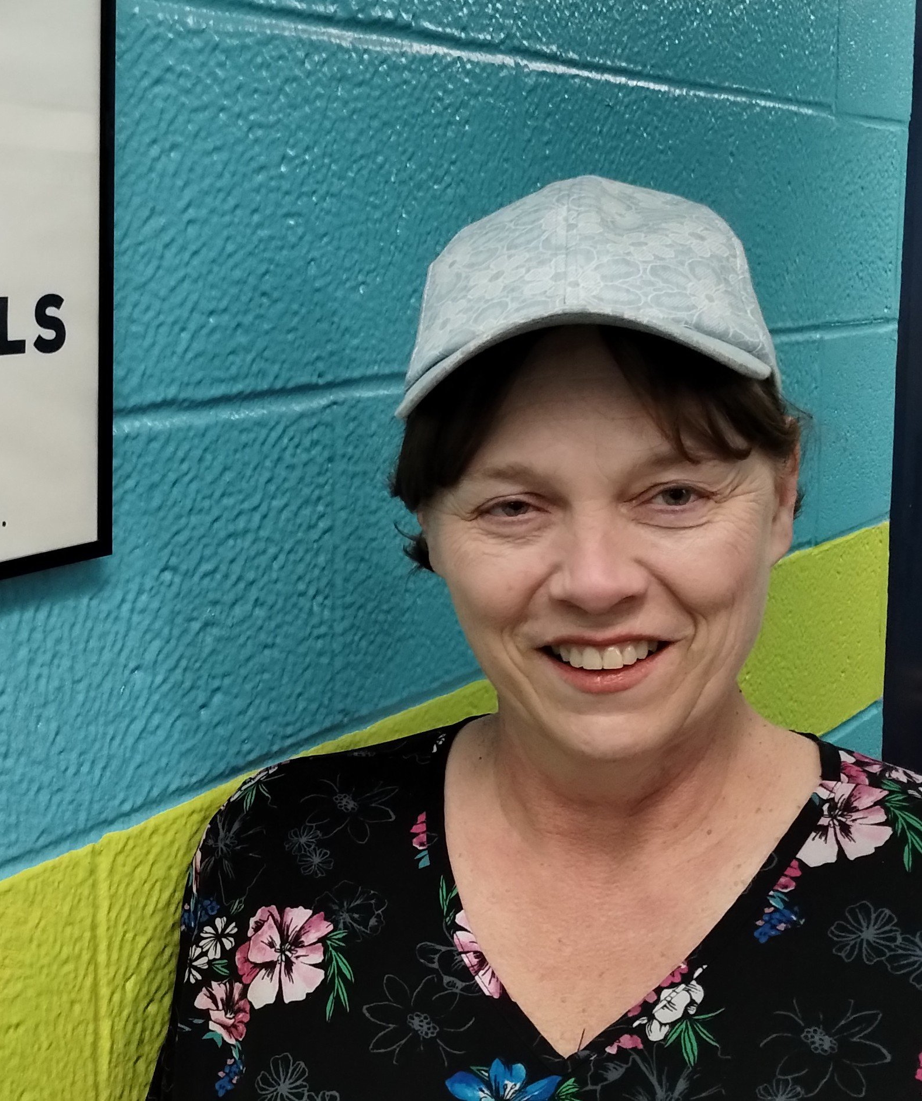
About the Meals staff
Tina
Linda
Rueben
Jennifer
Meals on Wheels has many hands-on deck to continue to provide for our community!

Slide 4
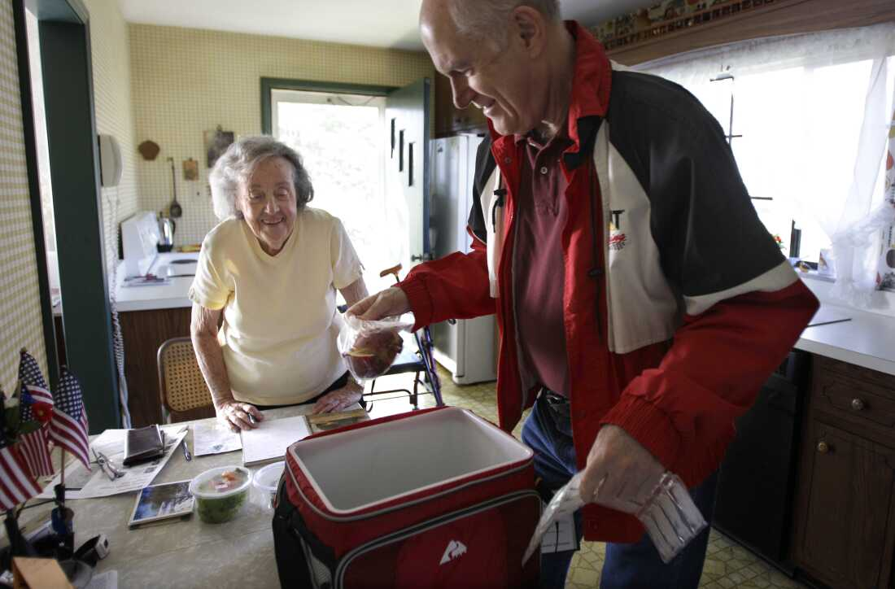
Why we want to help
What Meals on Wheels means to us and the Syracuse community and why this was the organization we wanted to help.

Slide 5
About our meals experience
Some of the members of our group have been involved in volunteering with the organization and we will share how that experience went.

Slide 6
What we're going to do
We will act for this wonderful organization

Slide 7
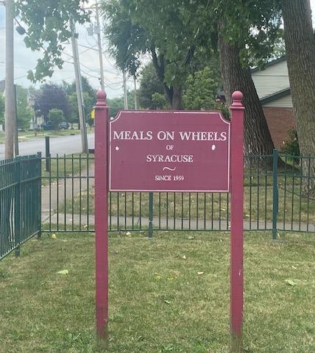
Step one/Reaching out
Reach out to Meals on Wheels, Syracuse!
We will talk to the people we are advocating in preparation to be the best help we can be

Slide 8
Step Two/ Secure the perfect time and place!
After talking to the staff at Meals on Wheels, we must then get permission with the university.
This will be scheduled ahead of time so we can ensure the best quality time and place.

Slide 9
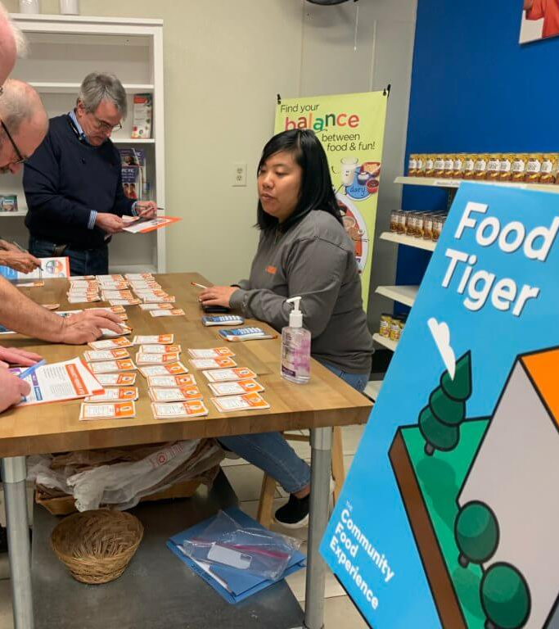
Step Three/ Design and creating!
This will be the preparation of all things needed for our tabling.
We will use the help of people at Syracuse and Meals on Wheels to obtain our material

Slide 10
Step Four/ Advertising!
To get students to come to our table, we will promote around campus to tell people when we are tabling!
This will include signs and QR codes that go straight to the Meals on Wheels website.

Slide 11
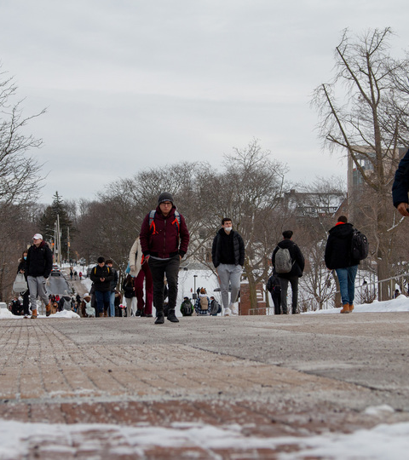
Step Five/ Engaging with Campus
This is where our action is taking place!
Getting people to hear us talking about Meals on Wheels is the most important part!
Any donation and volunteer is a wonderful bonus on top of getting to advocate for Meals!

Slide 12
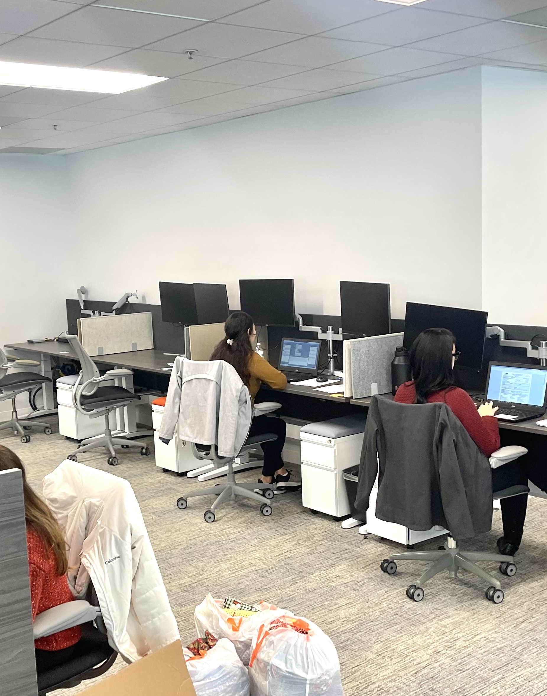
Step Six/ Collecting feedback and going through new information
After our tabling is over, we will hopefully have many new volunteers and maybe some cash donations!
This is information and numbers that must be sorted through, and we will offer our help in doing so.

Slide 13
Why this will work
An explanation of what we want to accomplish and why we think we can accomplish our goal.

Slide 14
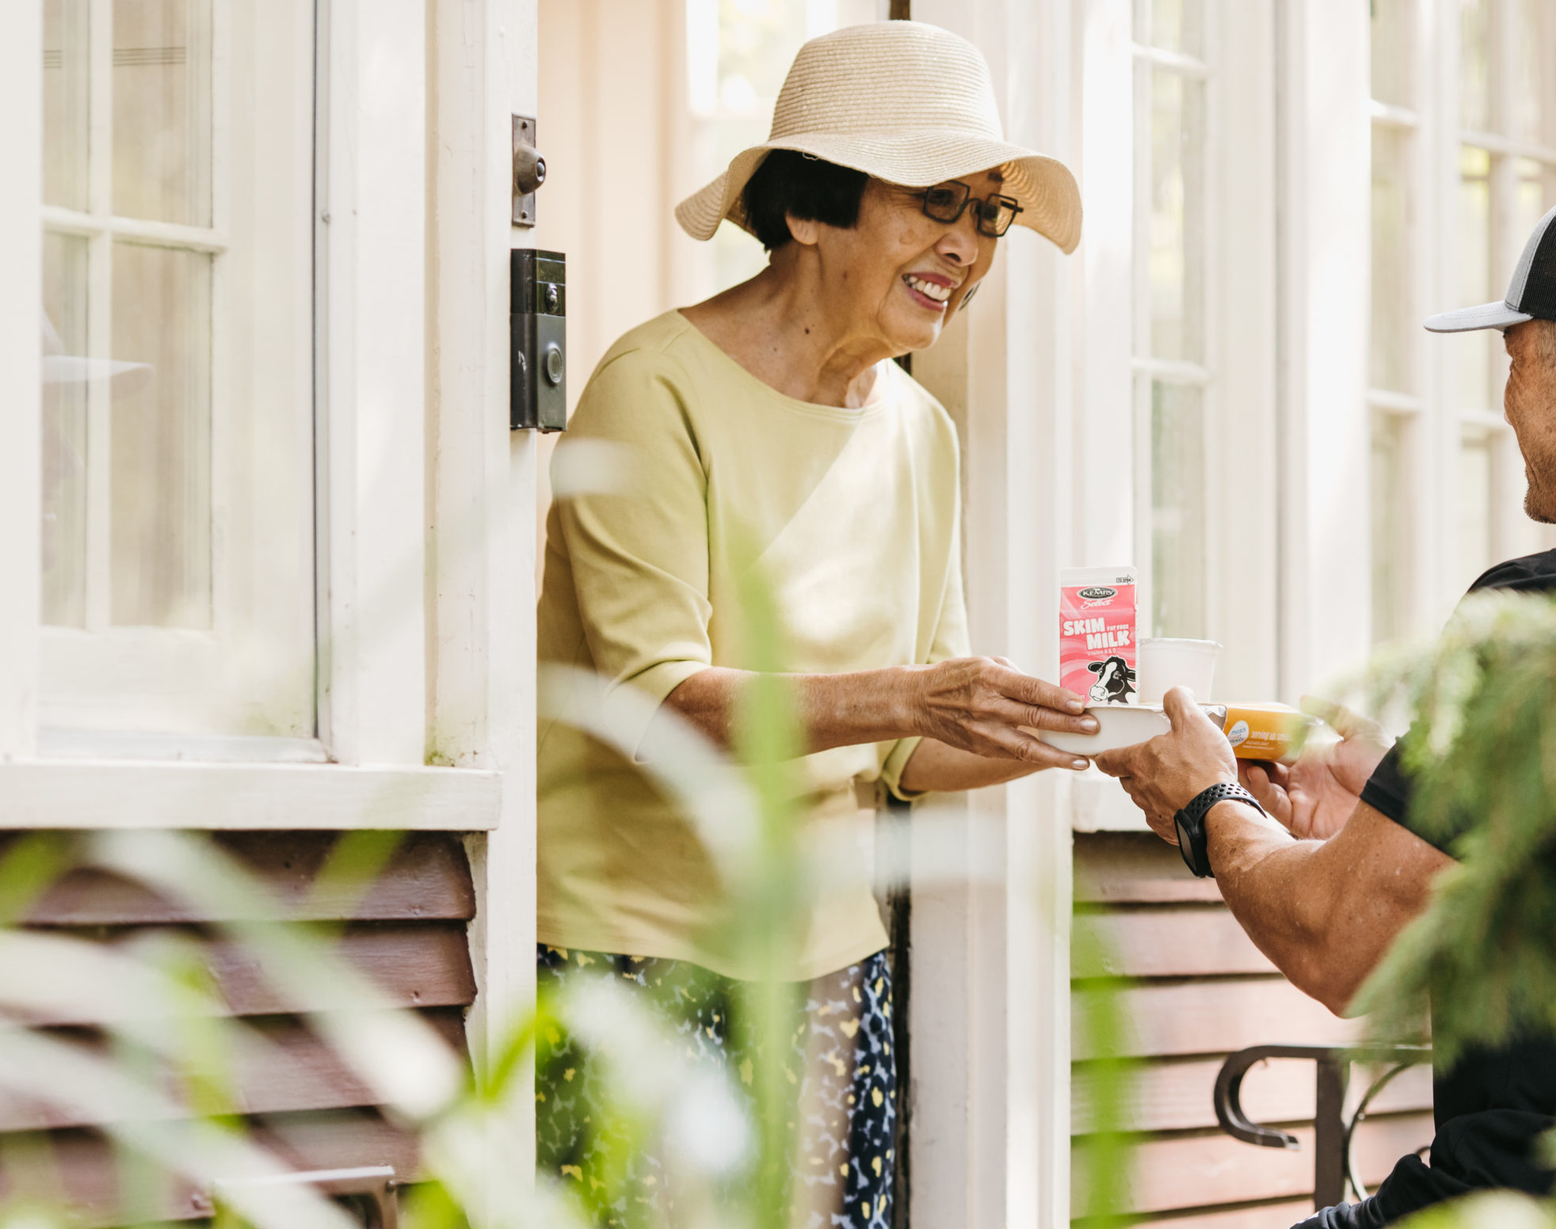
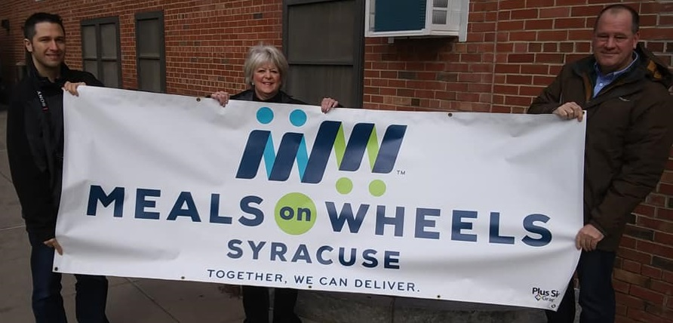
Here is what YOU can do!
Impact video

