Slide 1
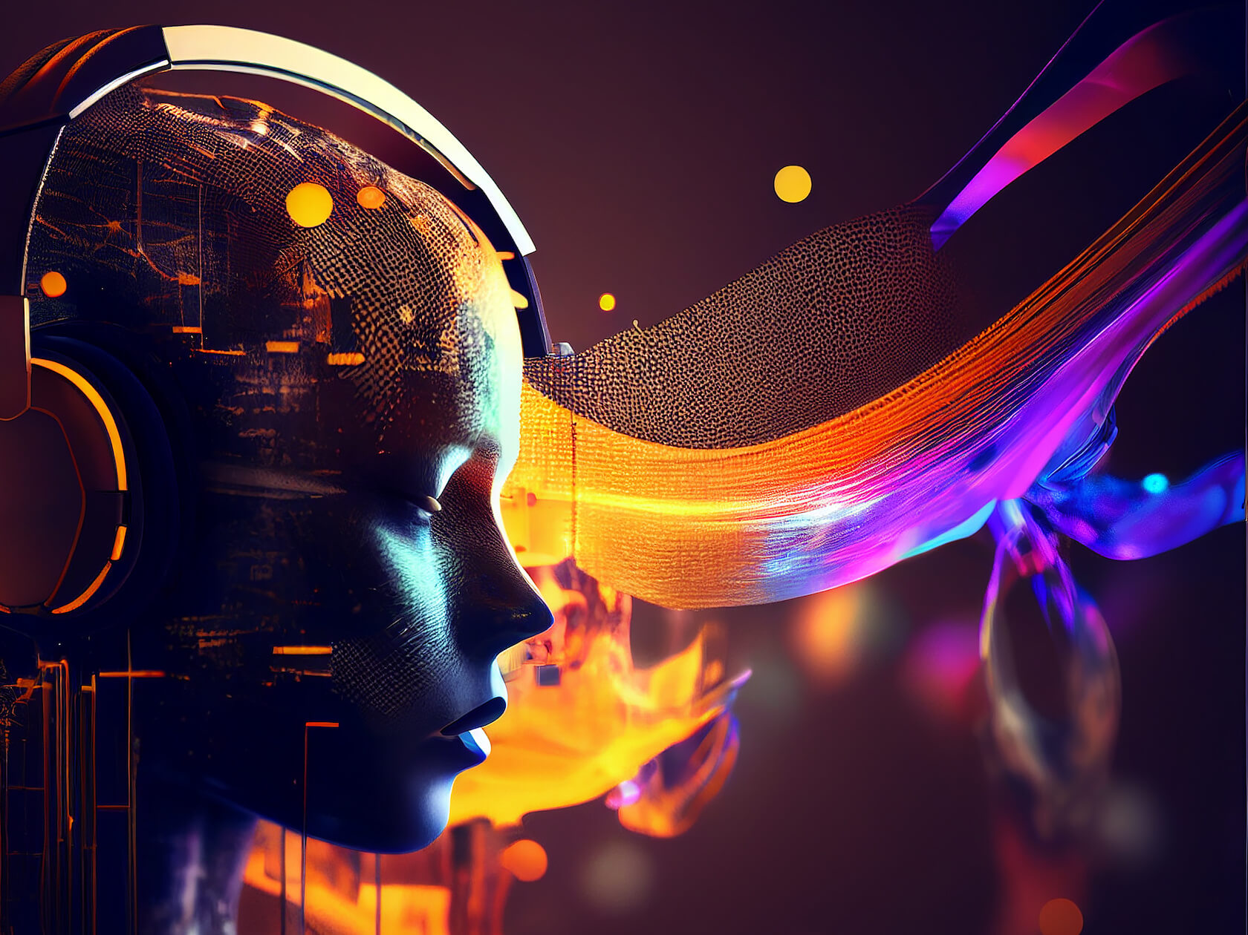
The Ethics of Artificial Intelligence in Art and Music Creation

Slide 2
Introduction
AI is increasingly used to generate art and music.
Examples: DALL·E (AI art), AIVA (AI music composer).
Ethical issues: authorship, originality, and human artistic value.

Slide 3
Authorship & Ownership Concerns
Who owns AI-generated art? The programmer, the AI user, or the AI itself?
Example: AI-generated painting sold for $432,500 at Christie’s.
Legal challenges: AI-generated works not protected under traditional copyright laws.
Should AI-created art receive the same recognition as human-created works?
Notes:
As technology advances, we must decide: is AI a creative tool or a replacement

Slide 4
AI’s Impact on Human Artists & Jobs
AI as a tool vs. a competitor.
AI-generated music replaces background music composers.
Automated design tools reduce demand for graphic designers.
Laws Protect Human Artists from AI Competition

Slide 5
Ethical & Philosophical Debates on AI Creativity
Can AI be truly creative, or does it just mimic patterns?
AI lacks human emotion and intent.
Should AI artworks and music be labeled differently?

Slide 6
Conclusion
AI in art and music presents both challenges and opportunities.
Ethical concerns must be addressed for fair recognition.
The future of AI in creativity should focus on collaboration.
Should AI-generated art and music be treated the same as human-created works?

