Slide 1
The Ethics of Genetic Editing CRISPR

Slide 2
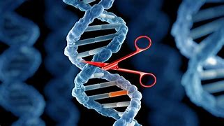
Understanding what Genetic Editing is
Genetic editing is the alteration of DNA sequences in an organism, allowing scientists to add, remove, or modify genes.
CRISPR-Cas9 – A revolutionary gene-editing tool that can precisely modify DNA.
Potential Uses
Treating genetic disorders (cystic fibrosis, sickle cell anemia).
Enhancing human traits (intelligence, athletic ability).
Preventing inherited diseases.

Slide 3
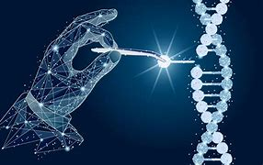
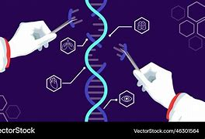
Ethical Arguments For Genetic Editing
Eliminating Genetic Diseases: Could cure inherited disorders like Huntington’s, cystic fibrosis, and muscular dystrophy.
Enhancing Quality of Life: If we can prevent disabilities and diseases, shouldn’t we?
Fighting Pandemics: CRISPR can help modify immune responses to diseases like HIV and COVID-19.
Reproductive Freedom: Parents should have the right to give their children the best genetic advantages.

Slide 4
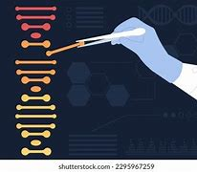
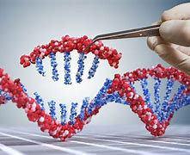
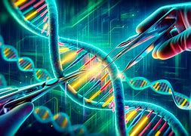
Ethical Arguments Against Genetic Editing
Unintended Consequences: Editing one gene may have unknown side effects on future generations.
Playing God: Is it ethical to alter nature and human evolution?
Widening Social Inequality: Only the rich may afford genetic enhancements, increasing the gap between classes.
Designer Babies: What if people start modifying genes for intelligence, height, or beauty?

