Slide 1
APA citations & Locating Sources
Bella Crum, Information Literacy Scholar
Patrick Williams, Humanities Librarian

Slide 2
Overview
Thinking about why and how we cite sources
Learn about the APA Citation style & how we all benefit from good citations
Strategies for using the Libraries’ search tools to locate sources for your research with citations in mind
Questions & where to get help

Slide 3
What’s a reason you’ve cited sources before?

Slide 4
Our citation methods are supportive of and informed by the conversations in which we participate.

Slide 5
The APA Style
“Write With Clarity, Precision, and Inclusion”
“APA Style is used by writers in many disciplines around the world for concise, powerful, and persuasive scholarly communication.”
Designed for social sciences scholarship, but embraced widely because it is flexible, clear, and accommodating

Slide 6
The APA Style
“Write With Clarity, Precision, and Inclusion”
“APA Style is used by writers in many disciplines around the world for concise, powerful, and persuasive scholarly communication.”
Designed for social sciences scholarship, but embraced widely because it is flexible, clear, and accommodating
Essentially, to make reading and writing easier!

Slide 7
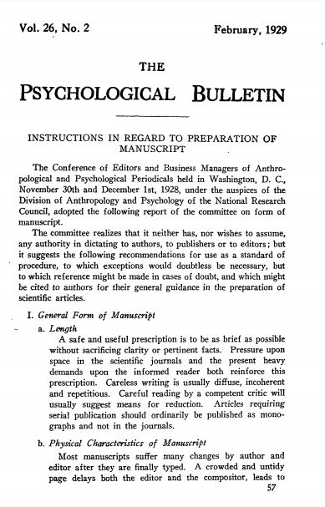
The APA Style
Bentley, M., Peerenboom, C. A., Hodge, F. W., Passano, E. B., Warren, H. C., & Washburn, M. F. (1929). Instructions in regard to preparation of manuscript. Psychological Bulletin, 26(2), 57–63. https://doi.org/10.1037/h0071487
Began nearly 100 years ago
Regularly adapts to new developments
Connects today’s research with its generations of history (& aids in contemporary searching)

Slide 8
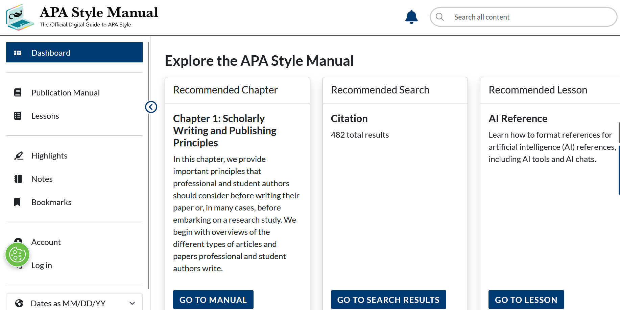

Slide 9
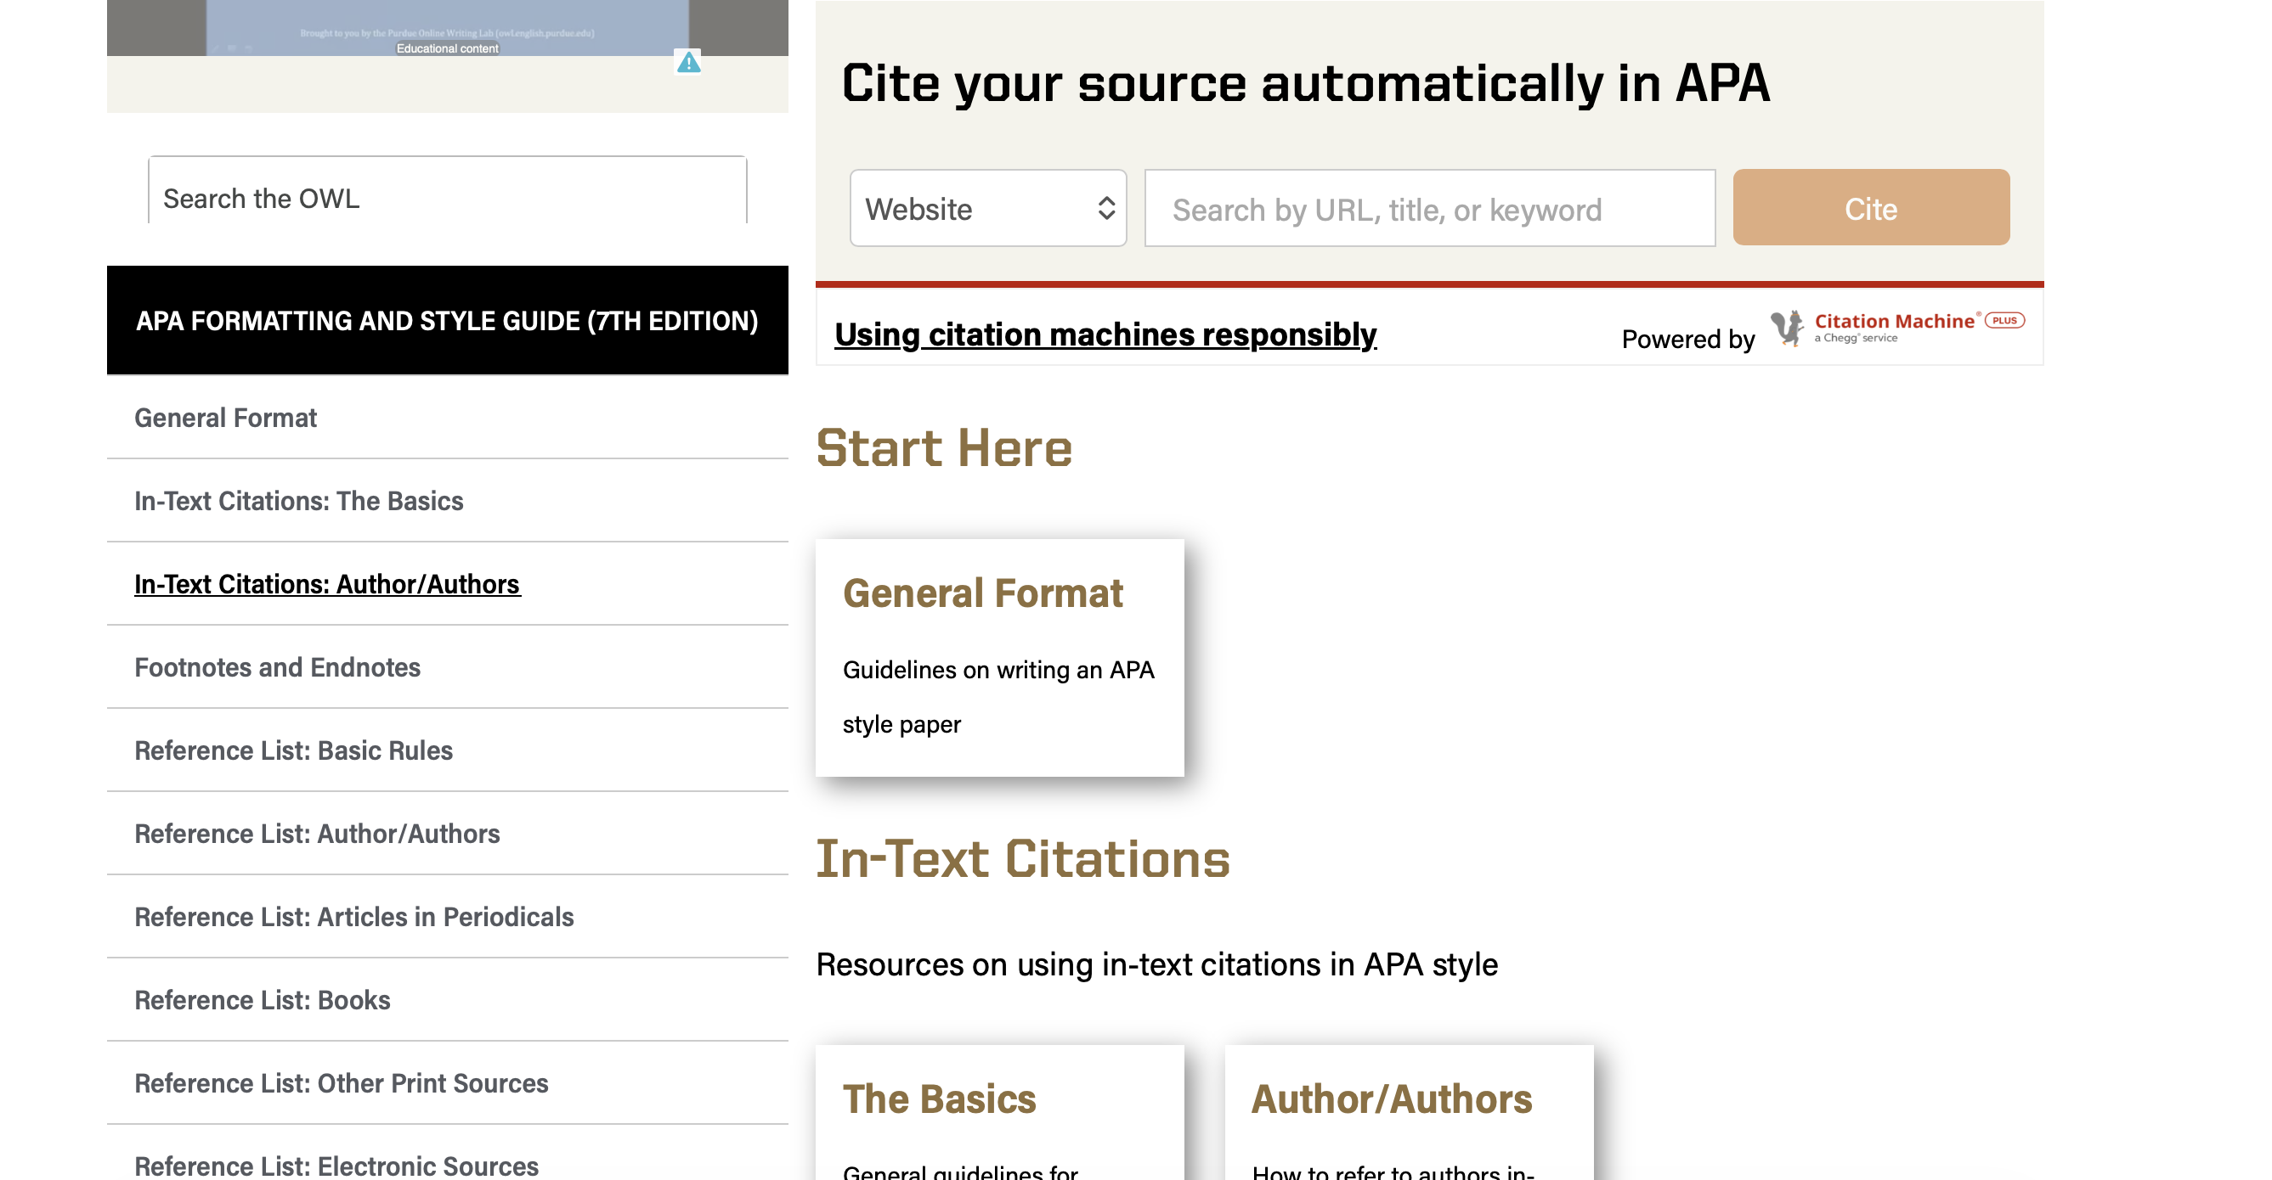

Slide 10
APA citations (in your own work)
Ensure that you credit others for their ideas
Connect your work to the sources it’s built on
Allow readers to locate and engage with those sources
Protect you from claims of plagiarism
Inform your readers that you are a knowledgeable participant in a conversation

Slide 11
APA citations
Are comprised of two parts:
  The in-text citation, which you employ in the body of your writing
  The complete citation on the reference list
The in-text citation connects the portion of your writing, your quotes, etc. to the full information about that source in your reference list.
Example of in-text citation:
Williams (2022) revealed that citations are “essential tools for researchers” (p. 171). Other authors have debated the usefulness of citations (Smith, 1989; Anderson & Brown, 2005).

Slide 12
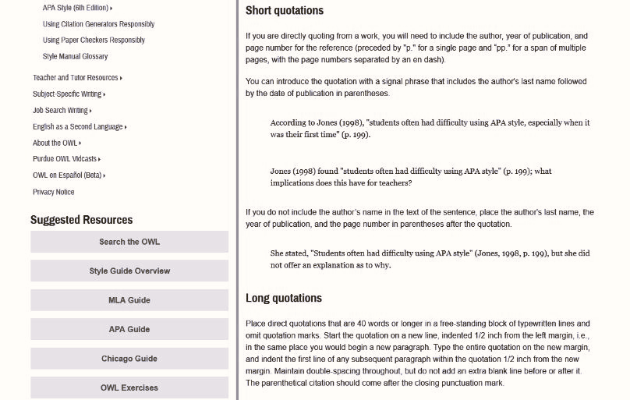
https://owl.purdue.edu/owl/research_and_citation/apa_style/apa_formatting_and_style_guide/in_text_citations_the_basics.html

Slide 13
APA citations
Important parts of a citation:
  Author(s): to give credit & connect to in-text citation
  Date: to show currency & to help readers locate which item in list
  Title of source: might be an article, a chapter, or other part of a source
  Title of publication: might be a book, a journal, a magazine.
  Additional information: publisher (for books), page numbers (for articles), links or DOIs for electronic documents
Each of these items helps identify and locate the specific sources you used
They are also useful for searching / locating related articles
Take care to notice this kind of information; library tools will assist you in doing so

Slide 14
APA citations – Reference List
Williams, P. (2022). APA citation is very important. Journal of Important Stuff ,1(2), 100-200.
Author, A. A., Author, B. B., & Author, C. C. (Year). Title of article. Title of Periodical, volume #(issue #), pages. https://doi.org/xx.xxx/yyyy (if available)
Different styles for each type of publication (book, newspaper, etc.)
  See a full list of citation types at the OWL APA Citation guide

Slide 15
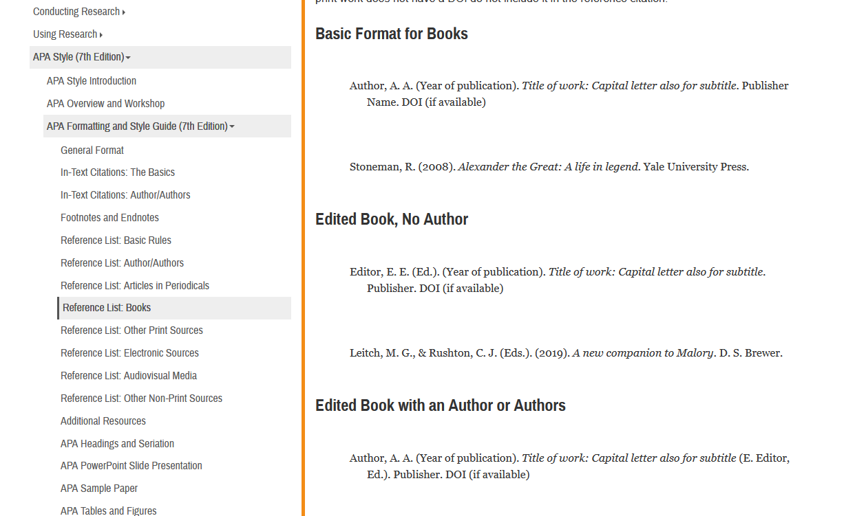
Author, A. A., Author, B. B., & Author, C. C. (Year). Title of article: Capital letter also
for subtitle. Publisher Name. DOI (if available)

Slide 16
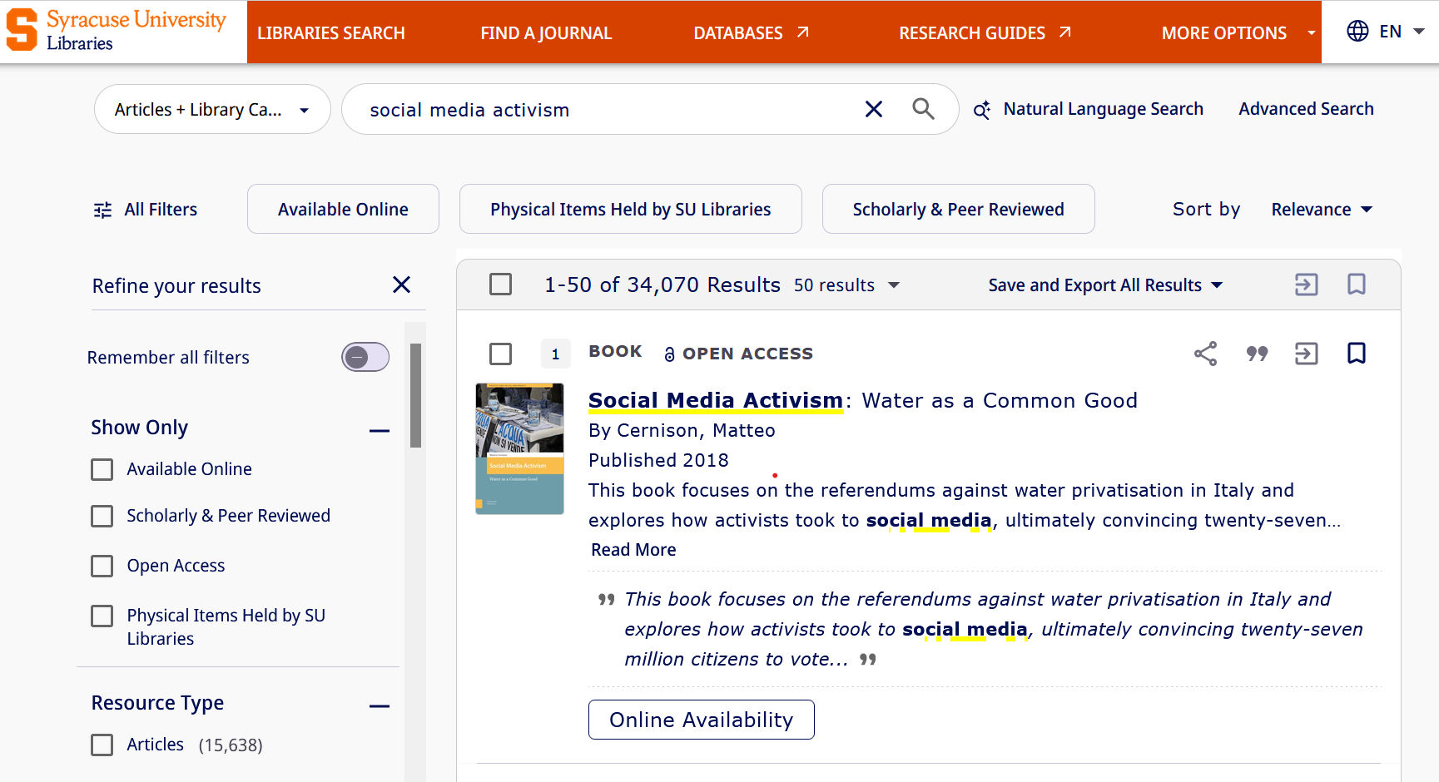

Slide 18
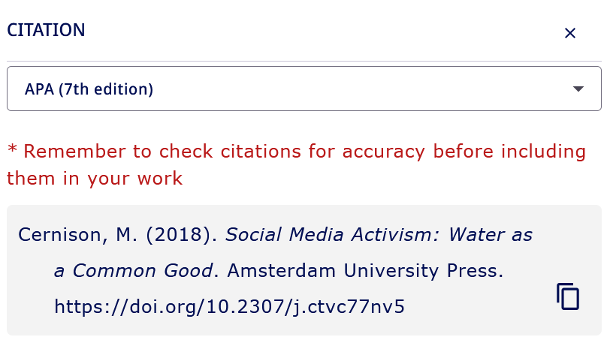

Slide 19
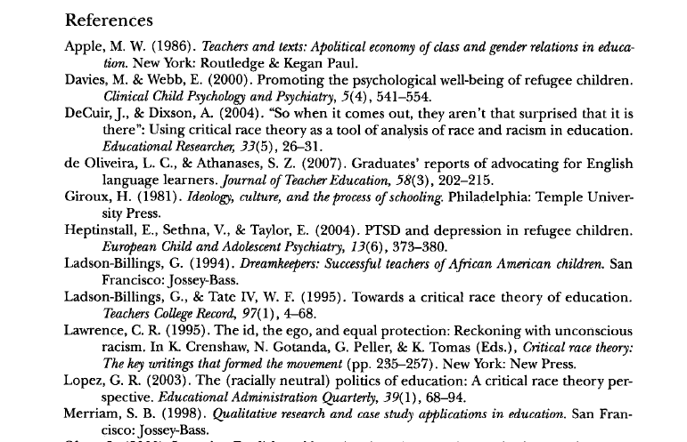
APA Reference List
Organized alphabetically by author, and then by date within authors
Corresponds directly to the sources you use in your writing
In-text citations should clearly point readers to which item on the reference list you are writing about

Slide 20
We all benefit from good citations!
Scholars point to important work on their references page—those make great places to locate sources
We get to quickly see when and how a conversation has grown and shifted; citations + literature reviews give us a lay of the land
Well-formed citations allow us to locate similar and related articles as we search
Titles, keywords, and authors from citations can strengthen our queries

Slide 21
Pop Quiz!
(by show of hands)

Slide 22
Why was the APA citation style created?
So people would stop plagiarizing each other
Because teachers are mean
For uniformity and consistency in academic writing
To make papers easier to read and understand

Slide 23
Why was the APA citation style created?
So people would stop plagiarizing each other
Because teachers are mean
For uniformity and consistency in academic writing
To make papers easier to read and understand

Slide 24
Important parts of a full APA citation on your References list include…
Date you viewed the source
Author
Date
Source/Article/Chapter title
Publisher
Publication/Journal title
Page range

Slide 25
Important parts of a full APA citation on your References list include…
Date you viewed the source – older versions of APA
Author – specific style rules for # of authors
Date – year for most sources, month/day for newspapers
Source/Article/Chapter title – for chapters in multiauthor volumes
Publisher – for books only!
Publication/Journal title – this is the italic part!
Page range – only articles and chapters, no need with books

Slide 26
What is the publication title?
Cronin, J., Mao, Y., & Menchen-Trevino, E. (2022). Connecting during a government shutdown: Networked care and the temporal aspects of social media activism. Social Media + Society, 8(1) 1 – 16. https://doi.org/10.1177/20563051211069054
Connecting during a government shutdown
Networked care and the temporal aspects of social media activism
Social Media + Society
Social Media + Society, 8

Slide 27
What is the publication title?
Cronin, J., Mao, Y., & Menchen-Trevino, E. (2022). Connecting during a government shutdown: Networked care and the temporal aspects of social media activism. Social Media + Society, 8(1) 1 – 16. https://doi.org/10.1177/20563051211069054
Connecting during a government shutdown
Networked care and the temporal aspects of social media activism
Social Media + Society – title is always italicized
Social Media + Society, 8 – APA italicized volume # too

Slide 28
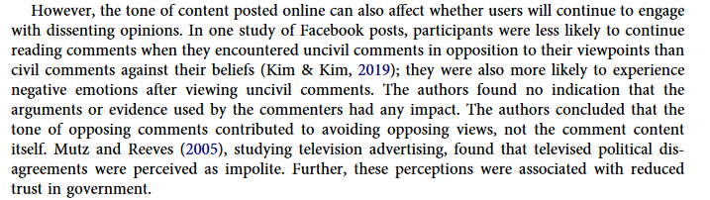
Which in-text citation is formatted correctly?
(Kim & Kim, 2019) C. Both
Mutz and Reeves (2005) D. Neither

Slide 29
Which in-text citation is formatted correctly?
(Kim & Kim, 2019) C. Both
Mutz and Reeves (2005) D. Neither

Slide 30
Which in-text citation is formatted correctly?
APA in-text citation rules offer flexibility for clear & concise writing
(Kim & Kim, 2019) C. Both
Mutz and Reeves (2005) D. Neither

Slide 31
Who benefits from APA citations?
Teachers
Students
Readers
Writers
Plagiarists

Slide 32
Who benefits from APA citations?
Teachers
Students
Readers
Writers
Plagiarists (maybe they do, but APA won't help them plagiarize)

Slide 33
Why use the APA citation style?
It makes writing easier
It makes reading easier
To direct readers to additional sources
To give acknowledge the work of others
To demonstrate your own knowledge
To connect your work to the work of others

Slide 34
Why use the APA citation style?
It makes writing easier
It makes reading easier
To direct readers to additional sources
To give acknowledge the work of others
To demonstrate your own knowledge
To connect your work to the work of others
Can you think of any other benefits?

Slide 35
Database & Citation Demonstration

Slide 36
Google & other web search engines do not have access to this material.

Slide 37
How do I find an article that I know I’m looking for?

Slide 38
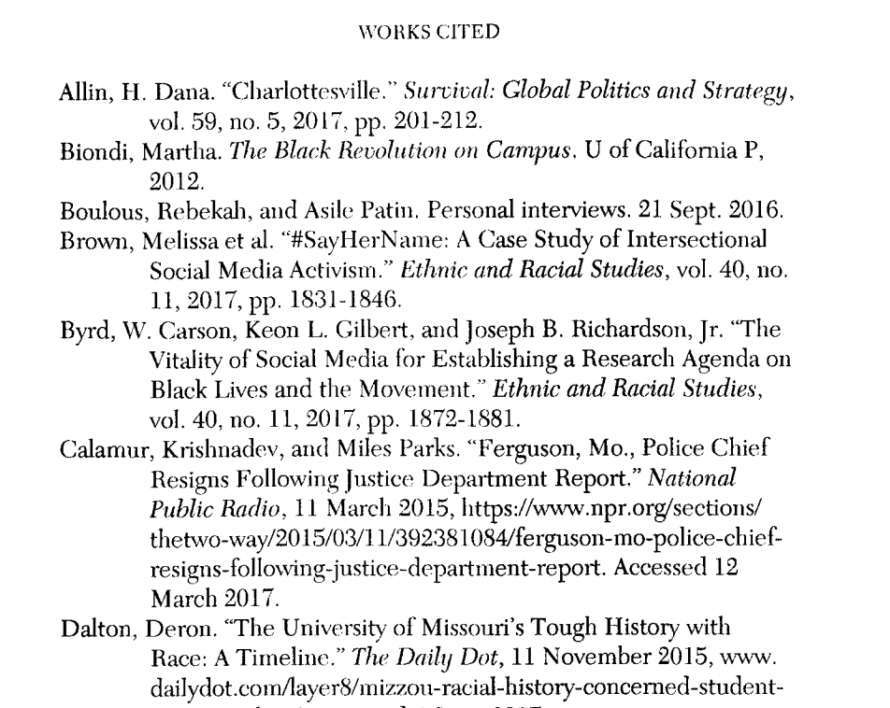

Slide 39
Resources and how to get help!

Slide 40
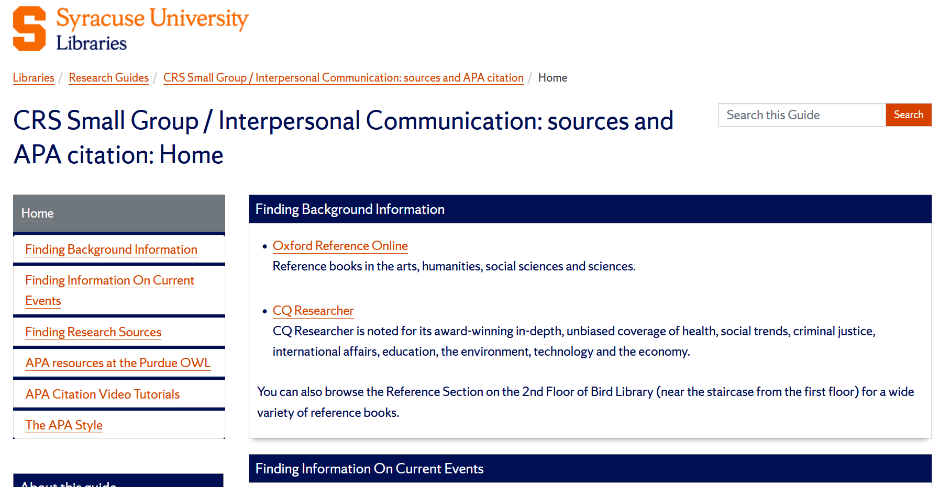

Slide 41
researchguides.library.syr.edu/crsapa

Slide 42
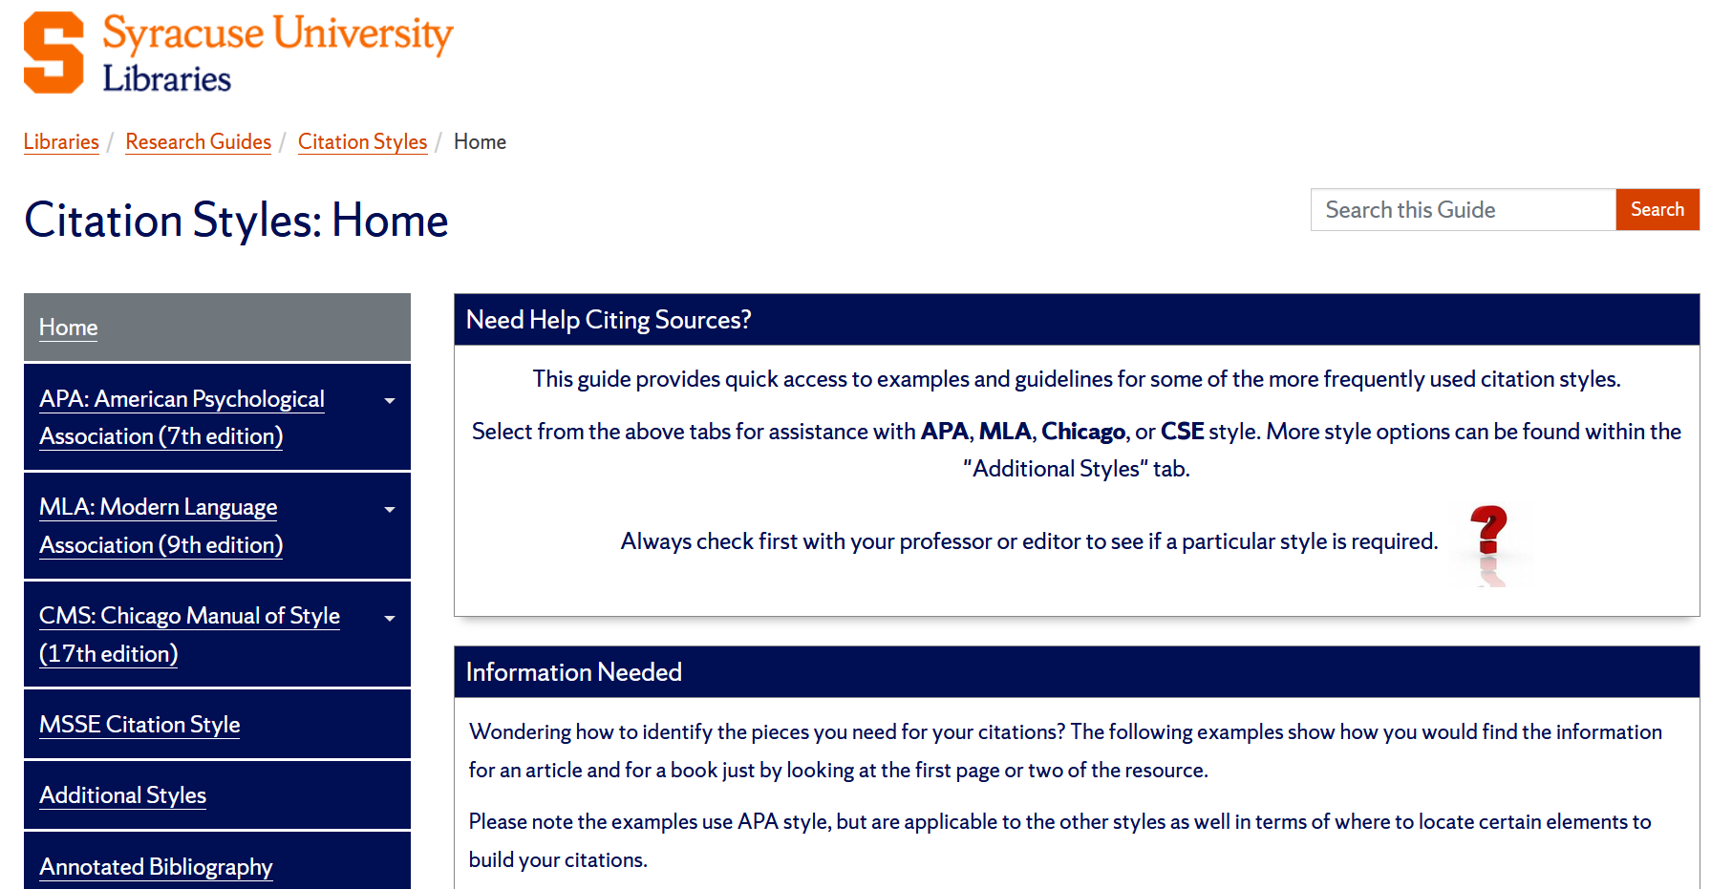
Citation Styles & Managers

Slide 43
Citation Styles & Managers
researchguides.library.syr.edu/citation

Slide 44
Getting Library Help
Many ways to reach us
Text, phone, email, and 24-hour chat service
https://library.syracuse.edu/help/askus.php
Subject librarians
Experts in subject-specific library resources
https://library.syracuse.edu/staff/subjects.php
Library tutorials & videos
https://researchguides.library.syr.edu/tutorials
Research guides
Research guides for academic programs, topics, and specific courses: researchguides.library.syr.edu
APA: https://researchguides.library.syr.edu/citationstyles/apa
Public libraries: https://researchguides.library.syr.edu/publiclibraries

Slide 45

Citation Detective Activity!
A 2021 peer-reviewed study on how lack of sleep affects memory
A newspaper article from today on the best tv shows
An article from the Journal of Bioethical Inquiry on human vs ai doctors
A 1992 best seller by Donna T.
https://tinyurl.com/379jfmx5
Notes:
https://sumailsyr-my.sharepoint.com/:x:/g/personal/iscrum_syr_edu/IQDxhkjhhnJRRLXocjK39F_cAf-ssaLDiTFMGGX4oS-M6oU
Newbury, C. R., Crowley, R., Rastle, K., & Tamminen, J. (2021). Sleep Deprivation and Memory: Meta-Analytic Reviews of Studies on Sleep Deprivation Before and After Learning. Psychological Bulletin, 147(11), 1215–1240. https://doi.org/10.1037/bul0000348
Appel, J. M. (2026). The Replicant Will See You Now: Artificial Intelligence and the Right to a Human Physician. Journal of Bioethical Inquiry. https://doi.org/10.1007/s11673-025-10547-z

